Slide 1
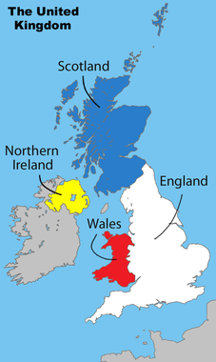
Part 3: Citizens, Society & the State
FALL 2015

Slide 2
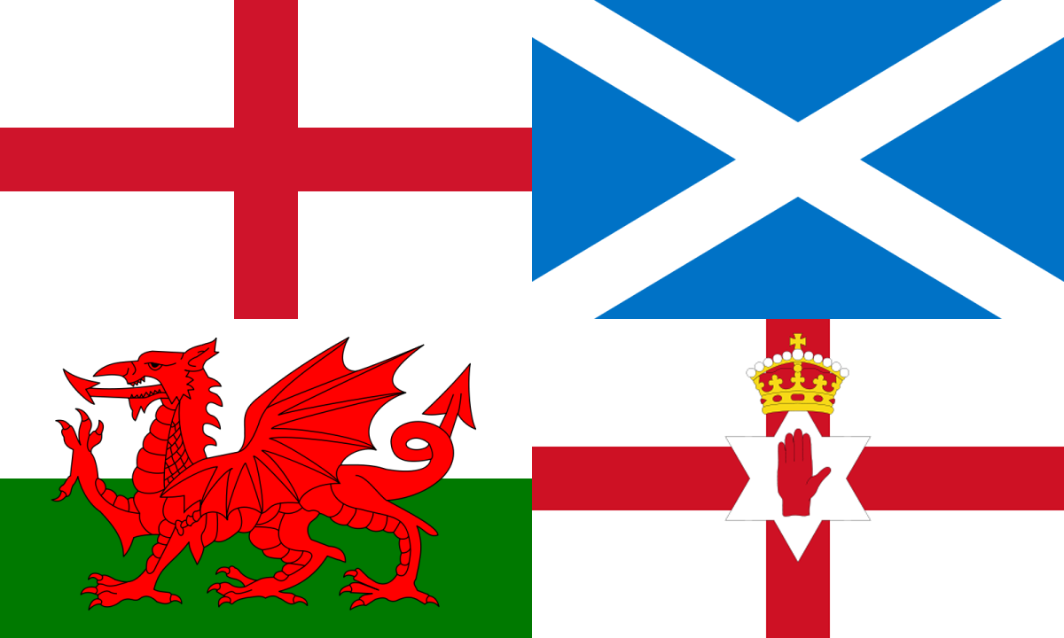
Social Cleavages
For much of British history based on:
Multi-National Identities
English (77%)
Welsh (4.5%)
Scottish (7.9%)
Northern Irish (2.7%)
Religion
Catholics (mostly Irish) vs. Protestants (mostly Scottish & English) – primarily before 1998
Notes:
Wales
Flag, Welsh Language
Scotland
Strong nat’l identity
National flag, currency, Parliament
Northern Ireland
1949 most of Ireland became a totally independent country and N. Ireland remained under British rule
Protestants/Catholics
Good Friday Agreement: April 1998, Britain agreed to give N. Ireland a regional govt in which all parties would be represented on Proportional Basis

Slide 3
Social Cleavages
Discussion Question: How has devolution impacted social cleavages: Weakened or strengthened them? How?

Slide 4
Social Cleavages
Discussion Question: How has devolution impacted social cleavages: Weakened or strengthened them? How?
UK devolution created:
national Parliament in Scotland (national flag, currency, referendum!)
national Assembly in Wales (Welsh language, flag)
national Assembly in Northern Ireland (Good Friday Agreement in 1998)
Have much more control over regional issues; less likely to separate?

Slide 5
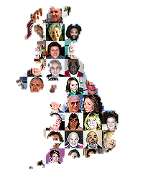
Social Cleavages
More Recently Ethnic Minorities
Only about 7.1% of British pop is of non-European origins:
23% Indian (1.8% of total population)
16% Pakistani (1.3% of total population)
12.2% Afro-Caribbean
10.5% Black
BUT minority ethnic population grew by 53% between 1991 – 2001
Also, immigrants from Eastern European countries (EU) has increased
2nd most spoken language in UK – Polish!
Notes:
Immigrants from Eastern Europe:
About 1 million immigrants from 8 central eastern Eur countries that joined the EU in 2004
Poles, who have made up abt 2/3 of the newcomers, are now the largest group of foreign nationals in Britain
Main draw has been better job opportunities

Slide 6
Social Cleavages – Treatment of Minorities
Minorities have experienced some discrimination:
Ethnic minorities disproportionately suffer diminished opportunities
Unequal treatment by police (esp young men)
Physical harassment by citizens
Marginalization in education, job training, housing & labor
But some have also been very successful
Among men of African, Asian, Chinese & Indian descent, the proportional representation in managerial/professional ranks is actually higher than that for white men
British South Asians (esp Indians) have high rate of entrepreneurship
Notes:
Discrimination
More than 1/3 of ethnic minority population is younger than 16, nearly ½ is under 25, 4/5 is under 45

Slide 7
Social Cleavages
Discussion Question: Based on what you know so far, why do you think Pakistani Muslims have faced more discrimination than other ethnic minorities?

Slide 8
Social Cleavages
Discussion Question: Based on what you know so far, why do you think Pakistani Muslims have faced more discrimination than other ethnic minorities?
Attacks on 9/11 & 7/7
Largest group of British Muslims come from Pakistan
Muslims have an identity of being a minority distinct form a well-established majority
Many British Muslims are disaffected and unemployed
Lack of integration into British culture
Cleavage is coinciding! Ethnicity, Religion, Social Class
Notes:
Pakistani Muslims
Since Osama bin Laden & his companions were found in Pakistan, some scholars think that links of British Muslims to al-Qaeda are stronger
Social Class differences
U.S. many Muslims tend to be well-off, while many British Muslims are disaffected and unemployed
Many Muslims are the children of illiterate workers who slipped in as cheap industrial labor
Lack of Integration
Polls suggest that alienation of minorities, esp Muslims, may be higher in Britain b/c national culture has not absorbed groups into mainstream culture
Muslims may attend classes in full hijab, but many feel treated as 2nd class citizens

Slide 9
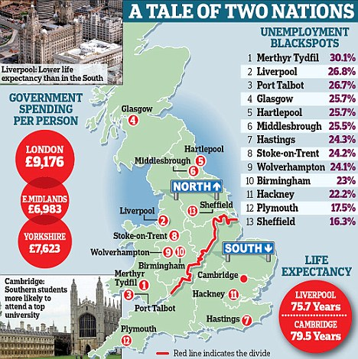
Social Cleavages
Social Class Distinctions
Historically working class vs middle-class
Education (most important portal to elite classes is through Oxford & Cambridge)
Geographic-Economic
South of England vs north of England, Scotland, and Wales
Wealth and high tech industry centered in South England
Notes:
Education
Compulsory until age 17 (just raised from 16, will be 18 by 2015), national curriculum
Most important portal to elite classes is through Oxford and Cambridge
Nearly ½ of all Conservative MPs went to Oxbridge, ¼ of Labour MPs
% higher for cabinet positions/PM
More scholarships available for working class BUT Parliament raised min level of tuition to Eng universities from $5,400 to $14, 500 making higher education less accessible to many students

Slide 10
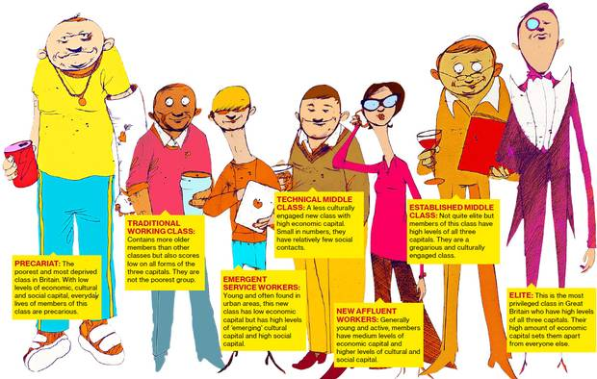
New British Social Classes?
Notes:
Education
Compulsory until age 17 (just raised from 16, will be 18 by 2015), national curriculum
Most important portal to elite classes is through Oxford and Cambridge
Nearly ½ of all Conservative MPs went to Oxbridge, ¼ of Labour MPs
% higher for cabinet positions/PM
More scholarships available for working class BUT Parliament raised min level of tuition to Eng universities from $5,400 to $14, 500 making higher education less accessible to many students

Slide 11
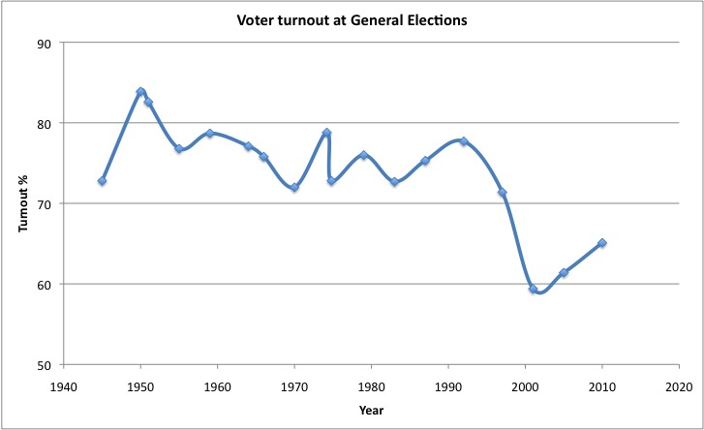
Political Socialization & Participation
Socialization
Family
Schools (civics courses)
Media (BBC)
Participation
Voting – around 70% (down in recent elections)
Voting behavior still tied to social class and region
Social Movements
Not as strong
Centered on issues (Iraq war, environment, etc)
Notes:
Interest in politics is low compared to the U.S., while voting rates are higher (U.S. 2012 58%)
Less than 1/5 of population does anything more than vote
Social Movements:
On local level people are more willing to organize around a specific issues, but participation of the active 20% is sporadic
Historic exceptions – women’s suffrage and nuclear disarmament
More Recent Issues: Women’s mvmt on health and children’s issues; environment; anti-poverty events (Live 8), groups protesting globalization and genetically-modified food products, anti-Iraq war

Slide 12
Linkage Institutions
Political Parties (see student presentations)
Question to consider: To what degree do Political Parties address social cleavages?
Interest Groups
Interest group pluralism
Most influential interest groups are those tied to class and industry
Confederation of British Industry
Trades Union Congress
National Farmers Union
British Medical Association
Neo-corporatism: interest groups (peak associations) take the lead and sometimes dominate the state
Notes:
Interest Groups:
Trade Unions Congress (TUC), Confederation of Business Industries (GSI)
Neo-corporatism: To be able to establish and maintain a neo-corporatist interest group system, a country has to have peak associations that are able to enforce the agreements between business, labour, and the government. Consequently, in Scandinavia, Germany, Austria, and Switzerland, for example, where there are major peak associations that dominate their respective economic sectors, neo-corporatism can best explain major interest group activity.
Neo-corporatist theory also has its critics. Some argue that it is not a distinct interest group system at all but rather just another form of pluralism. This is because it still functions within a pluralist political environment and only major groups are involved in this special relationship with government; all other groups and interests compete in the same way that they would in a pluralist system such as the United States.

Slide 13
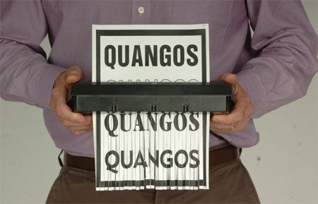
Linkage Institutions
Greatest influence of British interest groups comes through quangos
Quasi-autonomous nongovernmental organizations
Created by Parliament to put govt and private interests together on policymaking board
Recent trend toward eliminating and reforming quangos to save $
Notes:
Quangos:
It is an organization that is funded by taxpayers, but not controlled directly by central government – over 700!
Do things like developing safety regulations for factories, creating proposals to improve race relations, and maintaining railway infrastructure
Civil servants, lobbyists and even members of govt serve on quangos

Slide 14
Political Culture/Values
Discussion Question: Given what you know about Britain from your reading (you are reading, right??), research, discussions and notes, create a list of 5 common values in the UK:

Slide 15
British Values (according to Ken Wedding)
Devotion to justice and fair play
Human and civil rights for all
Acceptance of class distinctions and social mobility
Equal representation
Civilian government
Pragmatism and cooperation
Tolerance
Both community and individual responsibility
Honesty and transparency in govt and business
Acceptance of activist govt

