Slide 1
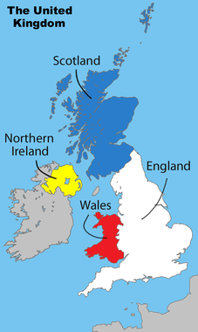
Part 2: Governance & Policy-Making
FALL 2015

Slide 2
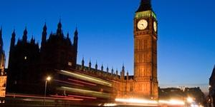
Organization of the State
Parliamentary Democracy
Parliamentary Sovereignty
Parliament can make or overturn any law
Limited now by EU law – overrides British law
Unitary State
With devolved powers to Scotland, Wales & Northern Ireland
Fusion of Powers
Fusion of Executive and Legislative branches
Constitutional Monarchy
Notes:
Unitary: system of government in which no powers are reserved for subnational units of government
Devolution:
1997 Referendums to Scotland and Wales
Northern Ireland and Wales – National Assemblies
Scotland- Scottish Parliaments
Power to decide on matters such as education, health, and social services
West Lothian Question: What right should a Scottish MP have to vote on laws that might relate to England or Wales, while English and Welsh MPs cannot vote on some matters related to Scotland, in areas where policy had been devolved from the Westminster to Scottish Parliament

Slide 3
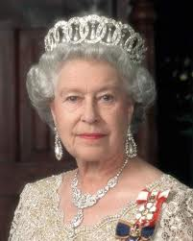
Constitutional Monarchy
Reigns but does not rule
All the power but no power
Head of state (PM = Head of Government)
Gives advice to PM (weekly meeting)
Speech from the Throne: “My government” (speech written by PM)
Gives “Royal Assent” to bills
Black Rod
Apolitical (neutral)
Queen Elizabeth II
(1952 - Present)
Notes:
Black Rod
Black Rod is a senior officer in the House of Lords (Crown appointment). He is responsible for security, controlling access to and maintaining order within the House and its precincts.
Ceremonial duties: State Opening
Black Rod's role at the State Opening of Parliament is one of the most well-known images of Parliament.
Black Rod is sent from the Lords Chamber to the Commons Chamber to summon MPs to hear the Queen's Speech. Traditionally the door of the Commons is slammed in Black Rod's face to symbolize the Commons independence.
He then bangs three times on the door with the rod. The door to the Commons Chamber is then opened and all MPs – talking loudly – follow Black Rod back to the Lords to hear the Queen's Speech.

Slide 4
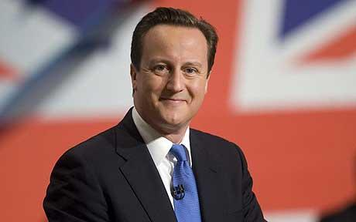
The Executive
Prime Minister (PM)
MP and leader of majority party
“First among equals”
Serves only as long as he/she is leader of majority party
Chooses cabinet and shapes policy for govt
Current PM is David Cameron (2010 - Present)
Conservative Party
Notes:
Following the Fixed-term Parliaments Act 2011 the date of the next general election has been set at the 7 May 2015
Before 2011…
PM has 5 yrs to call next election, can call at anytime
Once there is a new election, clock starts over
PM decides on timing best for him/his party.
Once called 39 days later, election, up and running quickly
Bi-elections held if someone dies/resigns
Since 2011:

Slide 5
How is Prime Minister Chosen?
Leader has a majority (50% + 1) of seats in the House of Comof party that mons
If no party has a majority (Hung Parliament) – 2 options:
Coalition (group) of parties
(Formed by Conservatives and Lib Dems after 2010 election)
or
Minority Government: party most likely to get majority on bills
Notes:
Minority Government: Harold Wilson: 7 months in 1974;collapse of Lib-Lab pact in 1977; Callaghan in 1977; Major in 1997

Slide 6
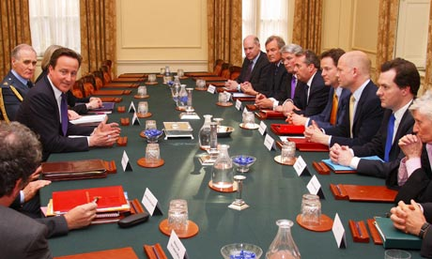
The Executive
Cabinet
Center of policymaking
Members are party leaders from Parliament (both houses) chosen by PM
“Collective Responsibility”
Cabinet members don’t vote
Publicly support PM’s decisions
Cabinet Members are NOT policy experts
Rely on bureaucracy (Whitehall) to provide expertise
Notes:
Approx 2 dozens ministers for the cabinet
Include Foreign Office (like U.S. Sec of State), Home Office (like Attorney Gen), and Chancellor of the Exchequer (Finance Minister)

Slide 7
The Executive
Discussion Question: Why might a PM put his rivals within the party in the cabinet?

Slide 8
The Executive
Discussion Question: Why might a PM put his rivals within the party in the cabinet?
Because of “collective responsibility” – rivals won’t speak out against PM
Silences them!

Slide 9
Comparative Executives
Prime Minister of Britain | President of the U.S.
Serves only as long as he/she remains leader of majority party/coalition
Elected as a member of Parliament
Has an excellent chance of getting his/her programs past Parliament
Cabinet members are always MP’s & leaders of majority party
Cabinet members not experts in policy areas; rely on Whitehall

Slide 10
Comparative Executives
Prime Minister of Britain | President of the U.S.
Serves only as long as he/she remains leader of majority party/coalition
Elected as a member of Parliament
Has an excellent chance of getting his/her programs past Parliament
Cabinet members are always MP’s & leaders of majority party
Cabinet members not experts in policy areas; rely on Whitehall
Elected every 4 years by electoral college based on pop election
Elected directly as President
Has an excellent chance of ending up in gridlock with Congress
Cabinet members usually not from Congress (although they may be)
Expertise in policy area one criteria for appt to cabinet; members head vast bureaucracies

Slide 11
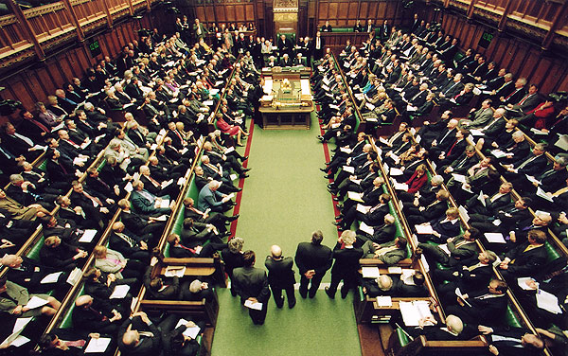
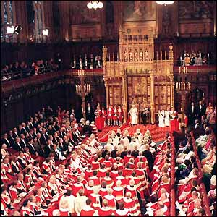
Parliament
Bicameral Legislature: Two Houses
House of Lords (Upper House)
House of Commons (Lower House)
Notes:
Distance between two red lines = two sword lengths – if you step over the line you will be removed
Scepter represents queen/monarchy
Books represent constitution
Front row of gov’t is cabinet members (ministers)

Slide 12
House of Lords (Upper House)
Membership: About 800 members
Life peers: appointed by monarch on advice of PM
Hereditary peers
Lords spiritual: Church of England officials
Role in Legislation
Debate, refine, amend, delay, but not block legislation
Notes:
HOL is the only hereditary parliamentary house in existence today
Although historically it was the original parliament, today it has minimal influence
HOC established supremacy during the 17th cent and Lords gradually declined in authority
May add amendments to bills, but HOC can delete changes with majority vote
Until 2009 included 5 law lords who served as Britain’s highest court of appeals (could never rule acts of Parl. unconstitutional)
Hereditary Peers
Hold seats that have been passed down through family ties over centuries
Until 1999 abt one-half of members
Today only 92
Life Peers
Majority – about 700 members
Any British, Irish or Commonwealth citizen who is a UK resident age 21+ is eligible to be nominated or apply
Appointed on basis of their knowledge and experience
Many are experienced politicians, or may have expertise in business, arts, education, sports
Lords Spiritual:
26 archbishops and bishops from Church of England
Crossbenchers:
Peers that sit on benches between the govt and opposition
Independent members who don’t take a party whip

Slide 13
House of Lords
Discussion Questions:
Should the remaining hereditary peers be removed from the House of Lords?
Should the House of Lords have elected members instead of appointed and hereditary peers?
Or should there be a limit on the number of members a PM can appoint?
Should members have to participate in debate in order to receive compensation?

Slide 14
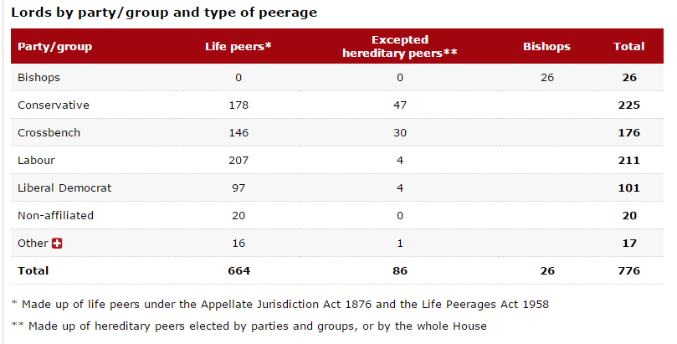
Notes:
Excludes some members (leave of absence, etc)

Slide 15
House of Commons (Lower House)
Government: PM, Cabinet, and Collective Responsibility
Shadow Government referred to as “Loyal Opposition”
Backbenchers: not in government or shadow government
Speaker:
Non-Partisan MP
Decides who speaks during debate and Question Time
Keeps order
Votes only in the case of a tie
Notes:
Based on the assumption that one party will get the majority number of seats and another will serve as the “opposition.”
Whatever party wins a plurality at the polls becomes majority party, 2nd party becomes “loyal opposition.”
Loyal Opposition
Front row – shadow cabinet.
If new party takes office – change in cabinet takes place quickly.
Question Time
one hour weekly
PM and cabinet take questions/defend themselves
very spirited

Slide 16
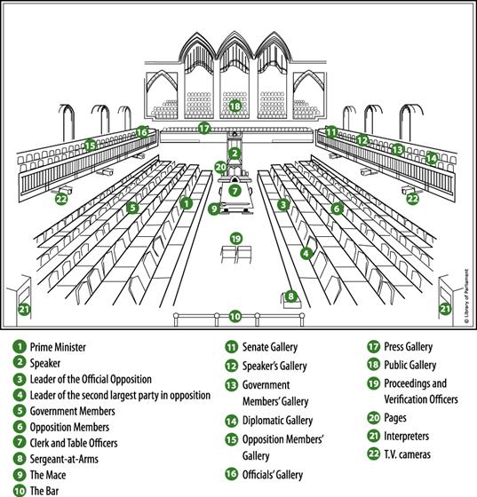

Slide 17
Party Discipline
Since majority party = Govt, party discipline very important
Must vote party line
Majority party wants to avoid losing “vote of no confidence”
If issue is not supported, cabinet must resign immediately and elections for new MP’s must be held as soon as possible
Notes:
Votes – yea door and nea door they walk thru (issue now with “M” part of alphabet because of all the new SNP members – names start with Mc)
3 line whip – vote in parliament – you have to be there – VERY important (changed recently saying only in hospital can not vote)
Can veer from party vote bc of conscience (abortion, etc)
Vote of confidence – PM says if you don’t pass, will dissolve parliament
The government needs to retain the confidence of a majority in the House of Commons. If the House votes to indicate that it has no confidence in the government, either by defeating the government on a confidence motion or by defeating a policy that the government has indicated is a 'matter of confidence', then a General Election would be called if a confidence motion in the new government was not passed within 14 days of the original no confidence motion.
If a government win a confidence motion they are able to remain in office. If a confidence motion is lost then the Government is obliged to resign or seek a dissolution of Parliament (and call a General Election). Although this is a convention, there is no law to say that the Government has to resign but it is very unlikely they wouldn't and it would cause uproar if they didn't. Modern practice shows dissolution rather than resignation to be the result of a defeat. The government is only obliged to resign if it loses a confidence vote although a significant defeat on a major issue may lead to a confidence motion.

Slide 18
How a Bill Becomes an Act
First Reading: The short title of the Bill is read out and then an order for the Bill to be printed.
Second Reading: MPs to debate the main principles of the Bill.
Committee: Line by line examination of bill
Report Stage: Chance for the whole House to discuss and amend the Bill
Third Reading: Opportunity for final debate on the Bill
Bill goes to other house
“Ping Pong”: Each house considers amendments of other house
Royal Assent: Monarch's agreement to make the Bill into an Act
Notes:
Amendments considered; every clause in the Bill is agreed to, changed or removed from the Bill

Slide 19
How to Get Elected to House of Commons
650 members; 650 districts
Single Member District Plurality (First-Past-The-Post)
One MP (member of Parliament) per district
Represent about 70,000 people per MP
Do NOT have to live in district
Party leaders run in “safe” districts
Most votes wins (do not need majority - 50% + 1 more): First-Past-the-Post
Serve fixed 5 – year terms*
Last general election was May 2015
Notes:
When is the next general election?
The Fixed-term Parliaments Act was enacted on the 15 September 2011 and the date of the last general election was Thursday 7 May 2015 with subsequent general elections to held on the first Thursday in May every five years. There are two provisions that trigger an election other than at five year intervals:
A motion of no confidence is passed in Her Majesty's Government by a simple majority and 14 days elapses without the House passing a confidence motion in any new Government formed
A motion for a general election is agreed by two thirds of the total number of seats in the Commons including vacant seats (currently 434 out of 650)
Before this Act, the duration of a Parliament was set at a maximum of five years, although many were dissolved before that. The decision to call a general election was made by the Prime Minister by asking the Queen to dissolve Parliament.

Slide 20
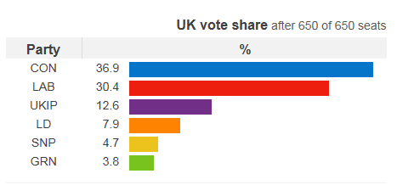
Current House of Commons by Party
Party | 2015 Seats (+/- from 2010)
Conservative | 331 (+24)
Labour | 232 (-26)
Scottish National | 56 (+50)
Liberal Democrat | 8 (-49)
Democratic Unionist | 8 (0)
Sinn Fein | 4 (-1)
Plaid Cymru | 3 (0)
Social Democratic & Labour Party | 3 (0)
Ulster Unionist Party | 2 (+2)
UKIP | 1 (+1)
Green | 1 (0)
Others | 1
Total number of seats | 650
Notes:
Turnout = 66.1% of electorate

Slide 21
U.S. vs British Elections
United States | Britain
Parties are less powerful
Members must live in districts
Party leaders run in their respective districts
Individual votes for four officials on the national level
Between 30 and 60% of eligible voters actually vote (more in recent elections)
Elections are by first-past-the-post single-member districts; almost no minor parties get representation

Slide 22
U.S. vs British Elections
United States | Britain
Parties are less powerful
Members must live in districts
Party leaders run in their respective districts
Individual votes for four officials on the national level
Between 30 and 60% of eligible voters actually vote (more in recent elections)
Elections are by first-past-the-post single-member districts; almost no minor parties get representation
Party determines who runs where
Members usually don’t live in their districts
Party leaders run in “safe districts”
Individual votes for only one official on the national level
About 65% of the eligible voters actually vote
Elections are FPTP, SMD; minor parties get some representation, but less than if they had PR (regional elections in Ireland, Scotland & Wales use PR)
Notes:
Turnout = 66.1% of electorate

Slide 23
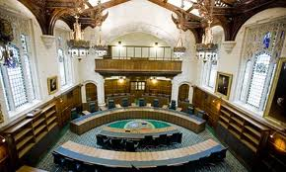
Judiciary - Supreme Court
Established in 2009; 12 justices
Final court of appeal in the UK for civil cases.
Hears appeals in criminal cases from England, Wales and Northern Ireland
Determines devolution issues
have devolved governments acted within their powers?
Ensures laws are consistent with EU laws and the European Convention on Human Rights
cannot overturn any primary legislation made by Parliament (judicial review)
Common law--precedent
Notes:
opened 10/1/09
Original 12 are Law Lords;
twelve justices do not all hear every case; typically a case will be heard by a panel of five justices, but sometimes the panel may consist of three, seven or nine members. All twelve justices are also members of the Judicial Committee of the Privy Council, and spend some of their time in that capacity.
selection commission is to be formed when vacancies arise. This is to be composed of the President and Deputy President of the Supreme Court and a member of the Judicial Appointments Commission of England and Wales, the Judicial Appointments Board for Scotland and the Northern Ireland Judicial Appointments Commission
cannot overturn any primary legislation made by Parliament.^{[3]} However it can overturn secondary legislation if, for example, that legislation is found to be ultra vires of the powers in primary legislation allowing it to be made.

