Slide 1
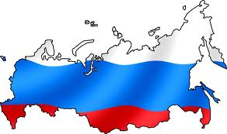
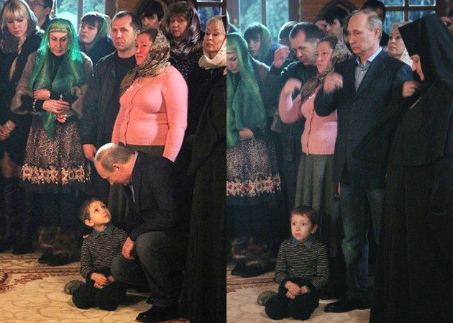
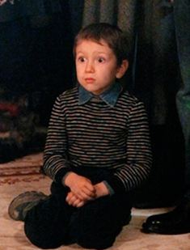
Russia
Part 3: Citizens, Society, and the State

Slide 2
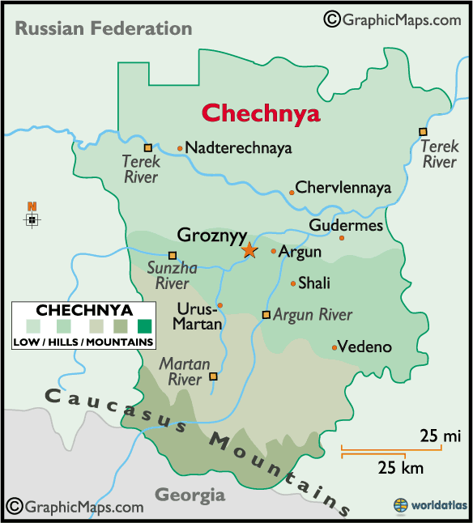
Social Cleavages -Nationality
Biggest Cleavage is Nationality
80% are Russian
Tatar = 3.8% (Muslim)
Ukrainian = 2%
Bashkir = 1.2%
Chuvash = 1.1%
Other = 12.1%
Because of structure of federation, ethnicity tends to be coinciding with region and often religion too
Russkii vs Rossiiskii
Chechnya - primary Muslim region has fought for independence
Notes:
In the USSR, just over 50% of pop was ethnically Russian
Now most of the major ethnic minorities reside in other Soviet successor states
Russkii – Russian word for Russian ethnicity
Rossiiskii – refers to people of various ethnic backgrounds that make up Russian citizenry
Russian nationalists have taken responsibility for kidnappings, beheadings and a 2006 bombing that killed 10 at a Moscow market operated mostly by immigrants
Dec 2010, in wake of a fatal shooting of an ethnic Russian soccer fan by a man from Russia’s North Caucasus region, thousands of young people began an extended riot close to Red Square, chanting “Russia for Russians” and racial slurs
Chechnya
Most ethnic minorities would like to have independence, but most have trade benefits that induce them to stay
Chechnya is a notable exception
Chechens have been involved in terrorist acts (ex: 2004 seizure of school in southern Russia that killed more than 350 ppl, including children)
The govt knows that if Chechnya is successful, other independence movements will break out in the country
In effort to gain legitimacy for Russian govt in Chechnya, a referendum was held to vote on a new constitution for the region
Russian President Vladimir Putin took to the airwaves March 16 in support of the referendum, telling Chechens in a televised address that if they approved the referendum, their war ravaged homeland would have special autonomy and broad control over its affairs.
Was approved by Chechen voters, even though it declared their region was an “inseparable part” of Russia

Slide 3
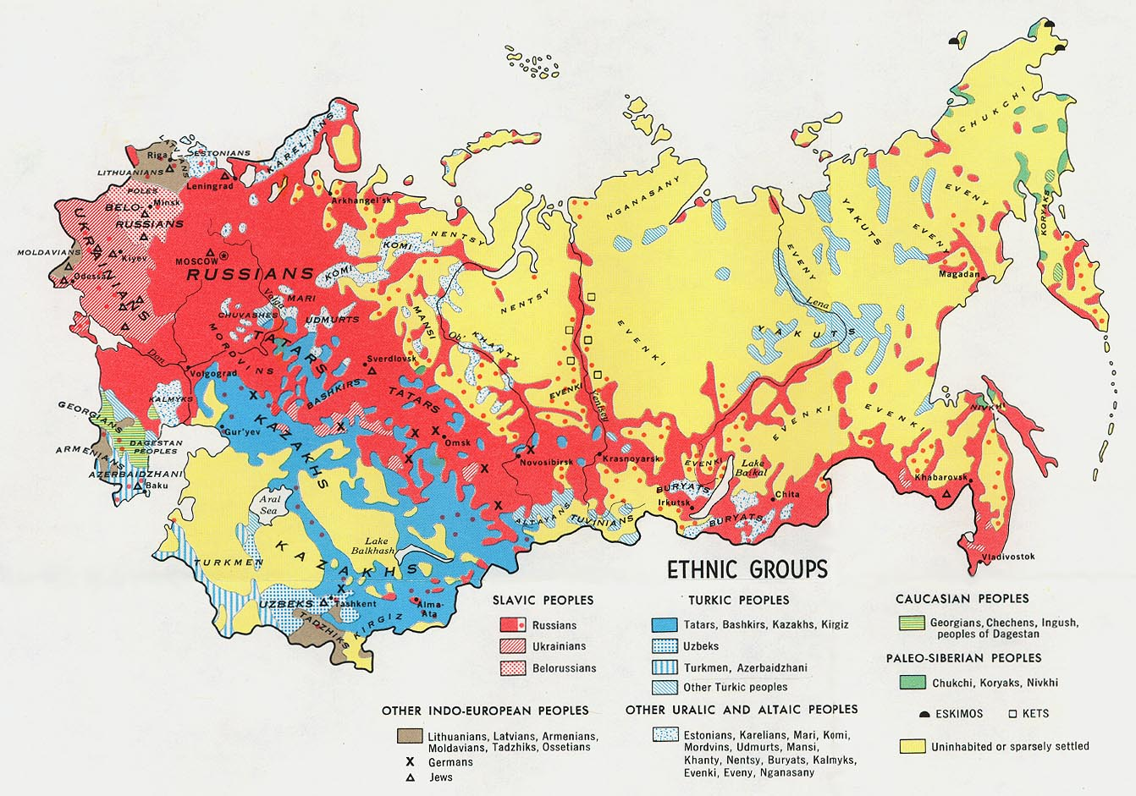
Social Cleavages -Nationality

Slide 4
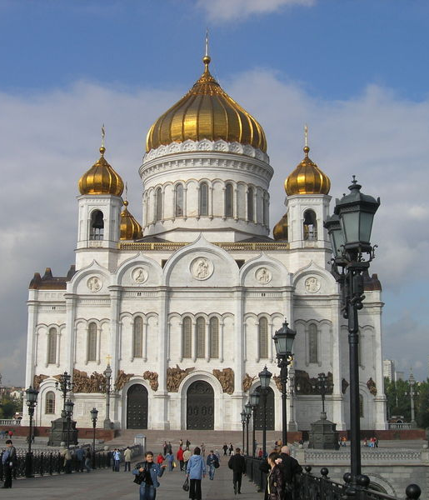
Social Cleavages - Religion
Most ethnic Russians identify themselves as Russian Orthodox, but are largely nonreligious
Other religions are represented in small percentages
Muslims, Roman Catholic, Protestant, Jewish
Recent rapid rise in Muslim share of population
Moscow (laborers)
The Caucasus (area between Black & Caspian Seas)
Includes Chechens
Very unstable region
Bashkortostan and Tatarstan
Notes:
Religion History:
Tsarist Russia was overwhelmingly Russian Orthodox, tsar was spiritual head of church
Soviet Union – prohibited religious practices of all kinds – most people lost religious affiliations during 20th century
2007 – Russian Church Abroad (split after Bolshevik revolution b/c a “godless regime” was in power) reunited with Russian Orthodox Church after Putin met with church officials – reassured them he was a “believing” president
Moscow retained ultimate authority in appointments – critics say church is too much under gov’t control
Growing Muslim Population
Russia has more Muslims than any other European state besides Turkey
The Muslim share of the country’s population is expected to increase from 11.7% in 2010 to 14.4% in 2030
Russia’s non-Muslim population is expected to shrink by an average of 0.6% annually over the same 20-year period
Muslim women generally have more children than other women in Russia (marry more, divorce less, have fewer abortions)
Muslim population has greater percentage in younger ages
Some anti-Semitic and anti-Muslim feelings with rise of an exclusionary form of nationalism
2013 Crackdown on Radical Islamists
In preparation for 2014 Winter Olympics in Sochi, in June 2013, police arrested 300 Muslims in Moscow, 170 were foreigners
The Muslims were found with extremist literature & considered a threat, according to Radio Free Europe

Slide 5
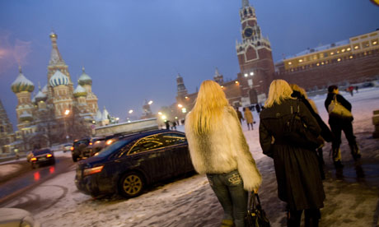
Social Cleavages – Other
Social Class
In USSR – Communist party members (elite) vs. non-members
Modern times – small class of really rich (started with Oligarchs) vs working class (middle class small by Western standards)
Rural/Urban
73% now live in cities, mostly in west
More likely to be well educated and more in touch with western values
Notes:
Social Class History:
Tsarist Russia nobility vs peasantry
Soviet Union abolished social class BUT created new division between communist party members/non-members
Only 7% were party members, but all political leaders were recruited from this group (nomenklatura)
However egalitarian views were promoted and economic/social background not important
Soviet times created large lower class, not much better off than Americans living in poverty
Late Soviet/Early Post-Soviet: severe inflation erased workers’ and pensioners’ life savings
New Russians: new upper class: previously held important state or party positions or ties to organized crime, and a few were entrepreneurs
Late 1990s and early 2000s: small middle class emerged in larger cities; older and rural remained poor, but general prosperity trickled down (partly through government programs)

Slide 6
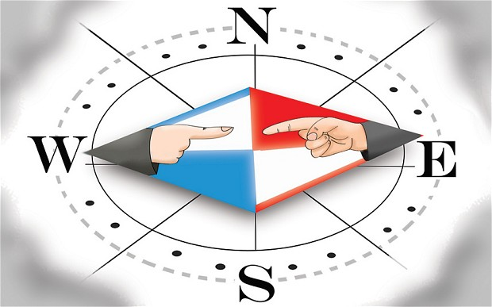
Political Culture
Deference to authority
Tradition of personalistic authority
Highly centralized leadership
Mistrust of Government
Most of population historically alienated from political system
Subjects rather than participants
Statism and Collectivist tendencies
Expect the state to take an active role in their lives
Collectivism/egalitarianism – distrust those who get ahead
Desire for order/stability
Even at expense of personal freedom
Notes:
Collectivist Distrust those who get ahead…Who Wants to Be a Millionaire – audiences give the wrong answer so contestants won’t win

Slide 7
Political Culture
Discussion Question: In Russia, when a contestant on the show “Who Wants to be a Millionaire” asks the audience for help, the audience usually gives the incorrect answer. Based on your understanding of Russian political culture/cultural values, WHY do you think they give the wrong answer?

Slide 8
Political Culture
Discussion Question: In Russia, when a contestant on the show “Who Wants to be a Millionaire” asks the audience for help, the audience usually gives the incorrect answer. Based on your understanding of Russian political culture/cultural values, WHY do you think they give the wrong answer?
Because of Collectivist value, they distrust anyone who gets ahead, especially those who try to “get rich on the backs of the audience members”
Notes:
http://www.go2cio.com/articles/index.php?id=3603
Now in Russia, the oligarchs"-a select group of entrepreneurs who found a way to make quick money after the Soviet collapse-"all achieved their wealth by means which were of dubious regard at best. That's the first thing that Russians resent. And secondly I think they resent the very fact that these people have become so much richer than everyone else."
From this perspective, it is clear that the Who wants to Be a Millionaire audiences in Russia see contestants as trying to get rich on the backs of the audience members-and why should they contribute to such unfair behavior?

Slide 9
Political Culture
Slavophile vs. Westerner
Slavophile:
Nationalism
Defense of Russian interests/Slavic culture
Strong military
Reject western values
Against integration
Westerner:
Reformers
Want integration
Open to western values
Putin’s supporters tend to be ________________.
Notes:
Slavophile vs. Westerner
Slavophile: nationalism, defense of Russian interests/Slavic culture, strong military, reject western values and integration
Westerner: reformers, want integration

Slide 10
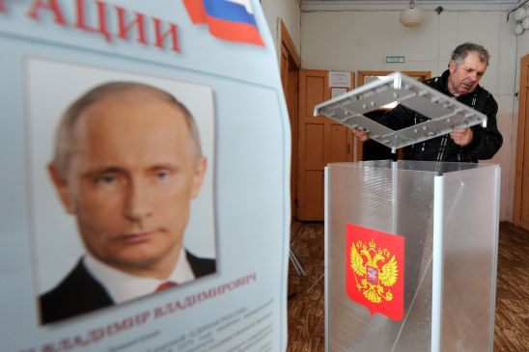
Political Participation
Voting:
Voting 100% under USSR (compulsory)
Presidential Elections: 2008 around 70%, 2012 65%*
Civil Society
Slowly started to emerge since 1991
Under Putin many obstacles:
Registration, reporting requirements, gov’t supervision
Notes:
2012 Presidential Election – plagued by reports of fraud/corruption
Putin won 99.82 percent of the vote in Chechnya
Precinct 451 in the capital Grozny, where Putin got 1,482 votes and (former Communist leader Gennady) Zyuganov got one. Only 1,389 people were registered to vote in the precinct. That means the turnout was 107 percent
Civil Society Obstacles:
The govt has placed severe restrictions on groups activities, esp on groups that are openly critical of gov’t policies
Investigate sources of income, making registration difficult, police harassment
Since Putin’s reelection in 2012, new laws restricting nonprofits: restrict foreign financing, and require them to register as “foreign agents”; definition of “high treason” has been expanded to include assisting foreign organizations

Slide 11
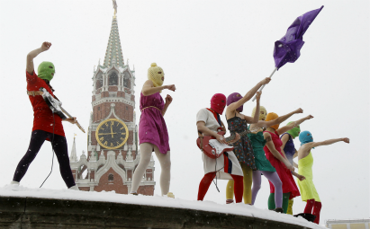
Political Participation - Protests
2007 restricting of use of public demonstrations and protests
2012: arrest of punk rock group (Pussy Riot) members for protesting in front of Russian Orthodox Church
The Other Russia
Opposition Movement
Notes:
New Protest Law:
The law allows individuals to picket, only if there is at least a 50-meter distance between each person picketing. All mass actions are forbidden where they would interfere with residents' access to transport, social infrastructure, everyday goods, pedestrian or motor traffic.
The list of specific places where mass action is forbidden is so exhaustive that it is hard to imagine an area that such a rally could occur. Any action with more than 100 participants has to be authorized, and is not allowed to have more than one person per every two square meters. The law says that any protest planned to take place near a government building would have to abide by separate rules
2012 Pussy Riot Arrest
Feb 21, 2012 punk rock group Pussy Riot arrested for performing a “punk prayer” protesting the Russian Orthodox Church’s support for Putin in upcoming election
Formed in 2011, group describes itself as feminist and in opposition to Putin regime
Arrested 2 members and sentenced them to 2 years for “hooliganism, motivated by religious hatred”
Ruling became a cause celebre and focus of social media attention – served as a symbol for Kremlin’s lack of tolerance of political opposition
Dec 2013, in a well-publicized move, Duma pass amnesty law (supported by Putin) – Pussy Riot members freed
At press conference band members continued criticism of Putin – including now vow to fight for prisoners rights
Move was widely interpreted as effort to bolster tarnished human rights image and head off potential boycotts of Sochi Olympics
The Other Russia
Unites a wide range of opposition figures from both the left and right
July 31, 2009 leaders initiated series of monthly protests, each held on 31st of months with 31 days, to affirm right to free assembly provided for in Article 31 of constitution
Dec 31, 2010, dozens of protesters arrested

Slide 12
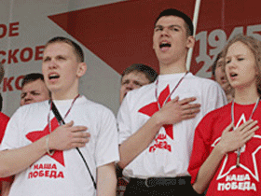
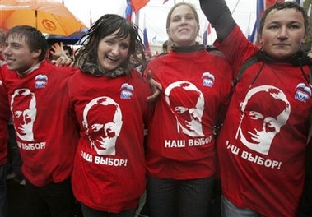
Political Participation
Russian Youth Groups
Created by Putin
Nashi (largest), Youth Guard and Locals
Part of an effort to build a following of loyal, patriotic, young people (diffuse youthful resistance)
Organize mass marches and demonstrations
Notes:
Nashi
Marches/demonstrations (ex: against corruption of gov’t opponents, not gov’t officials)
Critics say Nashi is a modern version of Komsomol, youth wing of the Communist Party of Soviet Union
Nashi receives grants from the gov’t and large state-run businesses, so critics of the group see it as an arm of an increasingly authoritarian state

Slide 13
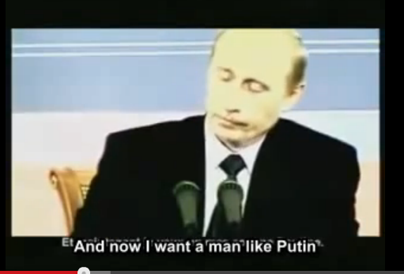
Political Participation
Propaganda

