Slide 1
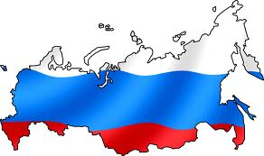
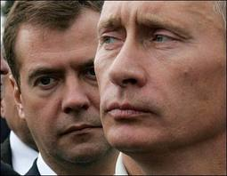
Russia
Part 2: Institutions

Slide 2
Political Structure
1993 Democratic Constitution…but a history of Authoritarianism
Currently considered a hybrid regime:
“Soft authoritarianism”
Semi-authoritarian
Federal system…but Asymmetric Federalism
85 regions (subnational units) (Republic of Crimea & federal city of Sevastopol are disputed)
21 are ethnically non-Russian by majority (republics)
Some subnational units in the federal system have greater or lesser powers than others
Notes:
Soft authoritarianism: A system of political control in which a combination of formal and informal mechanisms ensure the dominance of a ruling group or dominant party, despite the existence of some forms of political competition & expressions of political opposition
Semi-authoritarian: a political system in which elements of democracy are integrated into an otherwise authoritarian system
Federal System:
According to the Constitution, the country comprises eighty-five federal subjects,^{[141]} including the Republic of Crimea and the federal cityof Sevastopol, whose recent establishment is internationally disputed and criticized as illegal annexation.^{[142]} In 1993, when the Constitution was adopted, there were eighty-nine federal subjects listed, but later some of them were merged. These subjects have equal representation—two delegates each—in the Federation Council.^{[143]} However, they differ in the degree of autonomy they enjoy
21 are ethnically non-Russian by majority (republics)
Republics differ from other federal subjects in that they have the right to establish their own official language^{[1]} and have their own constitution. Other federal subjects, such as krais (territories) and oblasts (provinces), aren't explicitly given this right. The chief executives of many republics used to have the title of president, but in 2010 an amendment to the federal law was adopted that reserves such title exclusively for the head of the Russian state
Central govt was weak under Yelstin, so many ruled themselves almost independently
Movements for independence always a threat – Chechnya

Slide 3
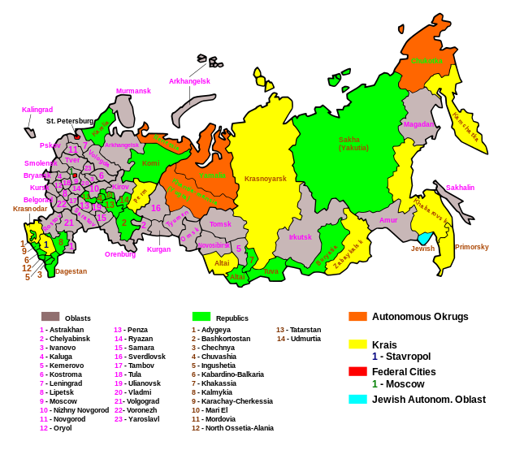
Political Structure
Discussion Question: Why does Russia have asymmetric federalism? What purpose does it serve?

Slide 4
Political Structure
Discussion Question: Why does Russia have asymmetric federalism? What purpose does it serve?
To deal with ethnic/regional cleavages; an attempt to keep them from seeking independence
Republics have the right to establish their own official language and have their own constitution
Krais (territories) and Oblasts (provinces), aren't explicitly given this right
Central govt was weak under Yelstin, so many ruled themselves almost independently
Notes:
Federal System:
89 regions (subnational units)
21 are ethnically non-Russian by majority (republics)
Republics differ from other federal subjects in that they have the right to establish their own official language^{[1]} and have their own constitution. Other federal subjects, such as krais (territories) and oblasts (provinces), aren't explicitly given this right. The chief executives of many republics used to have the title of president, but in 2010 an amendment to the federal law was adopted that reserves such title exclusively for the head of the Russian state
Central govt was weak under Yelstin, so many ruled themselves almost independently
In the 1990s, Russia’s federal gov’t had difficulty controlling what happened in the regions. Regional laws sometimes deviated from federal law. Bilateral treaties with the fed gov’t granted some regional govts special privileges
During Putin’s term as pres, he has put measures in place to ensure a greater degree of legal and political uniformity throughout the country
Movements for independence always a threat – Chechnya

Slide 5
Political Structure
Putin’s Crack-Down on Regional Autonomy
Military crushed Chechen resistance
Power Vertical & Creation of Super-Districts
7 new federal districts
Headed by presidential appointee
Appointment of Governors
Ended direct election of regional governors
Nominated by pres, confirmed by regional legislatures
Removal of Governors
Changes in Federation Council
Notes:
Putin Reforms:
Power Vertical: Putin term to describe a unified and hierarchical structure of executive power ranging from the nat’l to local level
Super-Districts - In 2000, 7 new federal districts were created to encompass all of Russia. Each district was headed by a presidential appointee, who supervised the local authorities as Putin see fit
Purpose is to ensure compliance with federal laws & constitution
Appointment of governors – ended direct election of 89 regional governors. Now nominated by president, confirmed by regional legislatures
Removal of governors – Pres. may remove a governor who refuses to subject local law to nat’l constitution
Changes in Federation Council – governors now appoint one and regional legislature the other
Elimination of SMD in Duma – all proportional and threshold raised from 5 to 7%; BUT changing back to Mixed (SMD & PR) in 2016

Slide 6
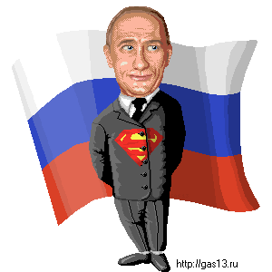
Semi-Presidential
Hybrid that borrows from pres/parliamentary systems
Strong President (focus of power)
Head of State – President
Vladimir Putin
Directly elected – majority/2 round model
Six year term*
Limit of two consecutive terms
Next election is March 2018
Notes:
No V.P., If Pres dies, Head of Gov’t (PM) takes over
*Six year term started in 2012 (before that 4 year term)
2 round system, must receive 50+% of vote, if not, top two candidates face off in 2nd round

Slide 7
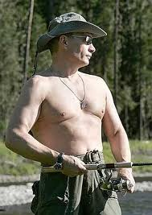
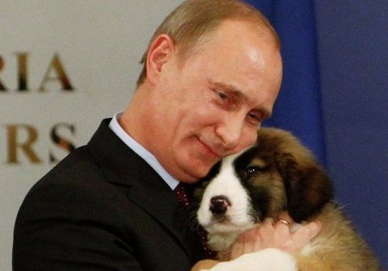
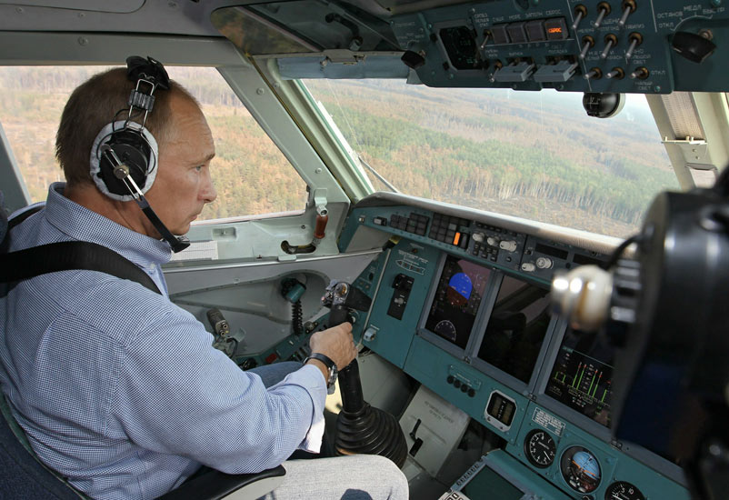
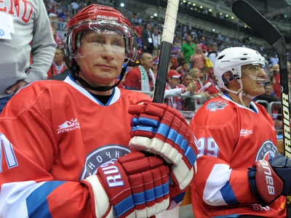
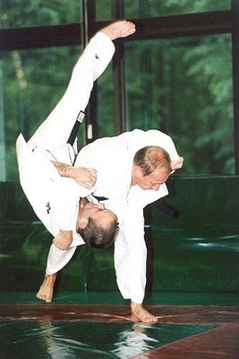
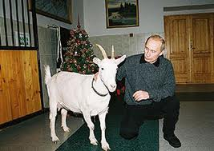
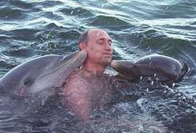
Notes:
Will be 63 in Oct 7, 2015

Slide 8
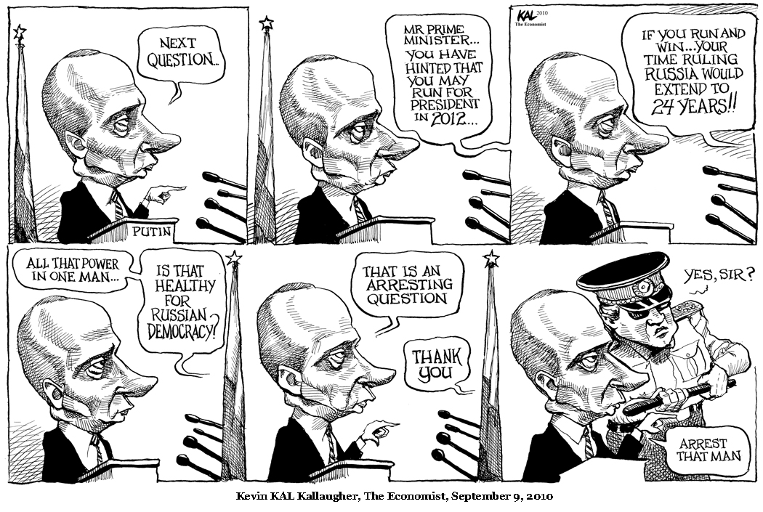

Slide 9
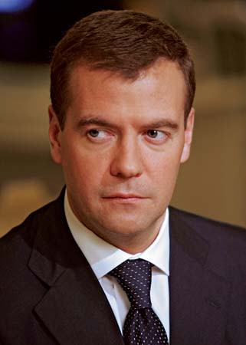
Semi-Presidential
Powers of the President
Appoint PM, Cabinet & Governors
Issue decrees that have force of law
Dissolve the Duma
Call state of emergency/impose martial law
Call referendums
Suspend actions of other state organs
President can be impeached BUT…
Head of Gov’t – The Prime Minister
Dmitri Medvedev
Can be removed with 2 repeat votes of no confidence within 3 mths
Notes:
Decrees:
The President has broad authority to issue decrees and directives that have the force of law without legislative review, although the constitution notes that they must not contravene that document or other laws
Dissolving the Duma:
The President may dissolve the State Duma if it either expresses no confidence in the Government of Russia or rejects his proposed candidate for the Russian Prime Minister three times.
The power to dissolve the State Duma has not been not exercised under the current Constitution of 1993.
Before the new constitution was enacted, President Boris Yeltsin had dissolved the Congress of People’s Deputies and Supreme Soviet of Russia during the Russian constitutional crisis of 1993, although he did not have the formal constitutional powers to do so.
Impeachment:
Involves two houses of legislative body, the Supreme Court, and the Constitutional Court
Presidential Succession
If pres dies or becomes incapacitated, PM fills the post until new pres elections can be held

Slide 10
Semi-Presidential
Discussion Question: What features of the Russian system make it presidential? What features make it parliamentary?

Slide 11
Semi-Presidential
Discussion Question: What features of the Russian system make it presidential? What features make it parliamentary?
Presidential:
There’s a president (duh!) that’s directly elected (fixed election cycle)
President may veto Duma legislation
President may be impeached
Parliamentary:
PM is head of gov’t
Votes of No Confidence

Slide 12
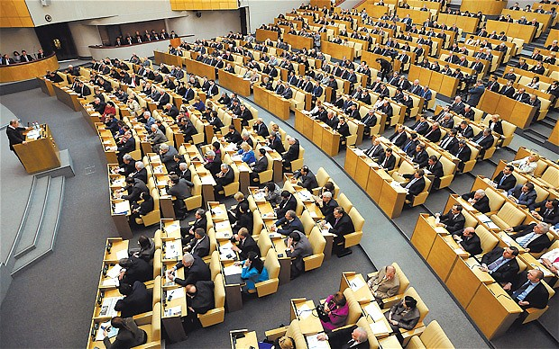
A Bicameral Legislature
Weak check on executive power
Duma – Lower House
450 Deputies (only about 13% women)
Selected by Proportional Representation (party list)* (changed in 2007 from mixed; NOTE: Will change back to Mixed in 2016 elections!)
5 year terms**
Powers
Passes bills
Approves budget
Confirms president’s appointments
Powers are limited
Pres may rule by decree
Duma’s attempts to reject prime ministers have failed
Has power to impeach President, but very cumbersome process
Notes:
Representation in Duma:
Women underrepresented: 1984 in Supreme Soviet legislature 33%, 2010 13%
Workers underrepresented: Russian politics primarily the domain of male elites
*Changed in 2007
PR since 2007 (half PR and half SMD before)
“Against all” option eliminated
No provision for minimum number of voters for election to be valid
7% threshold
BUT starting with 2016 elections – return to mixed!!
**Changed in 2011 elections (from 4 year terms)
Representatives are granted immunity from criminal prosecution
Impeachment:
Impeachment of president involves both houses of legislature, the Supreme Court, and the Constitutional Court

Slide 13
A Bicameral Legislature
Federation Council – Upper House
Represents regions
2 members from each of 85 federal subunits
1 chosen by governor of each region, other by regional legislature* (but remember…who appoints governors??)
Powers
Mostly delay bills (Duma overrides with 2/3 vote)
Approve presidential appointees and presidential decrees relating to martial law and states emergencies
May change boundaries among republics, ratify use of armed forces outside country, and appoint & remove judges
Notes:
*Changed under Putin
Was originally made of governors

Slide 14
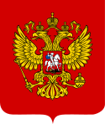
The Judiciary & Rule of Law
Constitutional Court
19 members, appointed by President, approved by Federation Council
Judicial review BUT…Court tries not to confront Presidency
Resolves conflicts regarding constitutionality of federal/regional laws & jurisdictional disputes between institutions
Pres, 1/5 of either house, citizens may request court to look at case
Supreme Court
Final court of appeals in criminal/civil cases
Does NOT have power of judicial review
Notes:
No independent judiciary existed under the old Soviet Union – courts/judges served as pawns of the Communist party
Current status of independence from executive is questionable
One problem – most prosecutors and attorneys were trained under Soviet legal system, so judiciary suffers from lack of expertise carrying out responsibilities in the Constitution
Putin moved constitutional court St. Petersburg - away from Moscow

Slide 15
The Judiciary & Rule of Law
Rule of Law
Putin initiated law reform – jury trials
Procedural codes for criminal and civil rights
BUT…
Movement toward rule of law continues to be blocked by corruption
Security police continue to operate autonomously
Trials of oligarchs indicate courts still under political control of Putin
Corruption Survey Results
At least ½ of population involved in corruption daily
Bribes for auto permits, school enrollment, proper health care and favorable court rulings
Notes:
“Innocent until proven guilty” is still not a reality

Slide 16
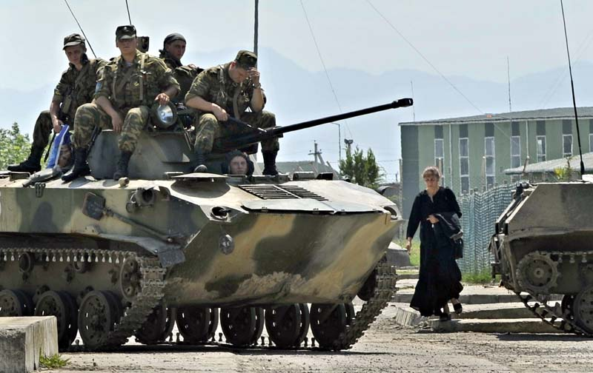
The Military
Source of Soviet strength during Cold War
Under Russian Federation historically weak and not a force
Showed some signs of strengthening (Georgia)
Importance has been elevated with invasion of Ukraine
Notes:
2008: Russia’s lightning war against Georgia looks like a military triumph: An armada of Russian tanks easily crushed Georgia’s modest army in a show of muscle intended to punish its U.S.-allied neighbor, scare others and reaffirm Moscow’s influence on its former Soviet turf.
But the conflict also revealed crucial weaknesses in Moscow’s military preparedness — including faulty intelligence, a shortage of modern equipment and poor coordination
Draft:
Universal male conscription
2008 reduced from 2 years to one
2013 Defense Minister indicated draft will remain necessary alongside a professional army, but soon draftees will not be used in combat

Slide 17
The Federal Security System
Successor to the KGB
Increased role under Putin
Why?
Putin has career background in KGB & drew many of his staff from this arena
Increase in terrorism
Failure of military to deal effectively with Chechnya
Notes:
Alexander Litvinenko
Former FSS agent and outspoken critic of Russian gov’t
Took political asylum in UK
Nov 2006, was fatally poisoned in London with a rare radioactive isotope (believed only to be found in Russia)
On his deathbed, Litvinenko accused the Kremlin of being responsible for his death (undocumented accusation)
UK tried to extradite Andrei Lugovoi, and ex-KGB agent and Russian politician to stand trial for the murder, but Russian govt wouldn’t allow for extradition

Slide 18
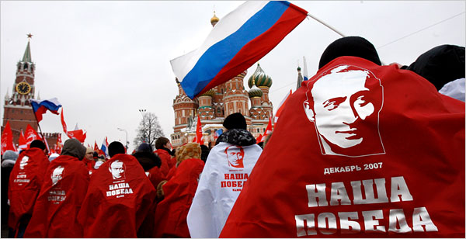
Linkage Institutions – Overview
Linkage Institutions – still not strong in Russia
Political Parties
Historically unstable…why?
No strong opposing political parties to dominating party
State Corporatism
State determines which groups have input into policymaking
Weak civil society means interest groups have no solid footing
Media
Some privately owned, but state controlled
Ranks 140th out of 178 in terms of press freedom
Notes:
Linkage institutions – groups that link citizens to government
Why are political parties unstable?
Put together quickly after Revolution of 1991
Most formed around particular leader(s)
1995 – 43 parties on the ballot, by 1999 only 26
Hard to develop loyalties
2007 electoral changes to all PR and threshold from 5 to 7%
Smaller parties with regional support lost representation
2007: only 4 parties gained seats
Media:
Strictly controlled under USSR
Some state-owned (Russia TV and Channel One)
Some privately owned, but controlled by state (NTV is owned by state-controlled Gazprom)
Some level of investigative reporting is allowed (like in China) for low-level corruption
Govt intervenes in some manner if government is criticized – suspicious deaths have taken place for
52 journalists have been murdered since 1992, making Russia the 3rd most dangerous country for journalists in the world

Slide 19
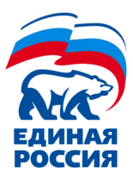
Linkage Institutions – Political Parties
Dominant Party System
A party system in which one large party directs the political system, but small parties exist and may compete in elections
United Russia
Founded in April 2001 as merger of Fatherland All-Russia Party & Unity Party of Russia
Hard to define ideology – Pro Putin
Political Party | Seats (2011 Duma Elections)
United Russia | 238
Communist party of the RF | 92
Liberal Democratic Party | 56
A Just Russia | 64
Notes:
Dominant Party System
Multiple parties and free and (more or less) fair elections exist but one party wins every election and governs continuously
Parties have to include regional representatives on list
Parties must have affiliates in more than half of regions, with a certain # of registered members in these regions
Choice of deputies on list must reflect strength of vote in region
Legally registered party
United Russia
Putin chair (not a member until recently)
Merger of several parties
Centrist, conservative, pragmatic,
Opposed to radicalism
State direction of economy
Catchall/Umbrella party
Market reforms are right-wing (pro-market and libertarian) and liberal (challenge status quo)
Conservative parties are leftist since they support strong state role in economy and society
Centrists: some reforms but preserving welfare state and gov’t intervention

Slide 20
Linkage Institutions
Discussion Question: How does United Russia dominate?

Slide 21
Linkage Instiutions
Discussion Question: How does United Russia dominate?
Putin!
Political machine that generates persuasive incentives for regional elites
Heads of Russian regions use their influence to bolster party’s votes (Pres appoints governors, remember?)
Election and political party requirements limit opposition
Parties have to include regional representatives on list
Parties must have affiliates in more than half of regions, with a certain # of registered members in these regions
Choice of deputies on list must reflect strength of vote in region
Legally registered party
7% threshold for Duma representation

Slide 22
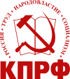
Linkage Institutions – Political Parties
The Communist Party of the Russian Federation (CPRF)
Formed from Communist party of Soviet Union
Strongest opposition party to United Russia
Less reformist than other parties
Emphasizes centralized planning and nationalism
Implies intention to regain territories lost when USSR broke apart
Supported by older Russians, economically disadvantaged and rural residents
Notes:
Dominant Party System
Multiple parties and free and (more or less) fair elections exist but one party wins every election and governs continuously
United Russia
Putin chair (not a member until recently)
Merger of several parties
Centrist, conservative, pragmatic,
Opposed to radicalism
State direction of economy
Catchall/Umbrella party
Market reforms are right-wing (pro-market and libertarian) and liberal (challenge status quo)
Conservative parties are leftist since they support strong state role in economy and society
Centrists: some reforms but preserving welfare state and gov’t intervention

Slide 23
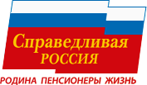
Linkage Institutions – Political Parties
A Just Russia
Formed in 2006 – merger (Motherland People’s Patriotic Union/Party of Pensioners/Party of Life)
Led by Speaker of Federation Council Sergei Mironov
Left of United Russia
Opposition in name only
Supported Presidents Putin and Medvedev
“We are the party of the working man”

Slide 24
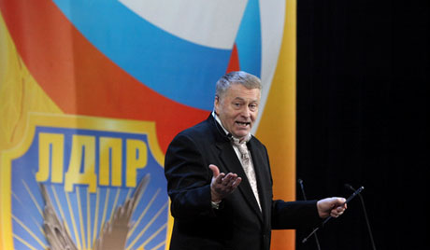
Linkage Institutions – Political Parties
Liberal Democratic Party
Misnomer!
Vladimir Zhirinovsky – extreme nationalist
Anti-Western
Nuclear threats against Japan, anti-Semitic, sexist
Strongest support from working-class men and military
Notes:
Strong support among working-class men
and military

Slide 25
Linkage Institutions? Oligarchs, Media & Mafia
Oligarchs
Wealthy elite that monopolized industries after privatization
At one point controlled over ½ of Russian GNP
Oil industry, media
Backed Yeltsin, but Putin now resisting their control
Ex: Mikhail Khodorkovsky (Yukos Oil)
Mafia
Controls underworld crime/black market and some reputable businesses
Gained power after Revolution of 1991
Notes:
Mikhail Khodorkovsky:
Chief executive officer and major shareholder of the giant Russian oil company, Yukos
2003 – was placed under arrest for fraud and tax evasion
May 2005 – sentences to nine years in prison
Dec 2013 – pardoned and released from prison – many believe it was an attempt to get Western approval leading up to Feb 2014 Winter Olympic Games in Sochi, Russia

