Slide 1
Powers of Congress (Article I)

Slide 2
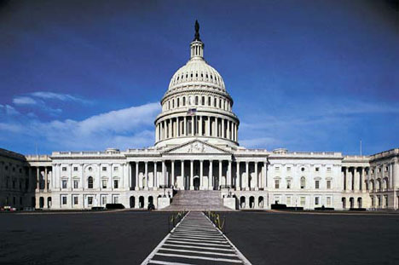
Powers of Congress
We know that Congress can make laws, but what other things specifically may Congress do under the authority of the Constitution???

Slide 3
Expressed Powers
Found in (Article I, Section 8, Clauses 1-18) of the U.S. Constitution.
These are the specific (expressed) powers granted to Congress (enumerated powers)
Of the 17 powers given by Congress, 6 are related to the military.

Slide 4
Expressed Powers
SPECIFICALLY listed in the Constitution
Power to tax
Power to borrow
Power to regulate trade and selling of goods (commerce)
Power to print currency and make coins
Notes:
Congress shall have the power to lay and collect taxes, duties, imposts and excises
Pay the debt
Provide for the common defense
And the general welfare of the U.S.
16th Amendment (1913): “The Congress shall have the power to lay and collect taxes on incomes, from whatever source derived”
Taxing and Spending/ Appropriations bills
Tax bills start in the House of Representatives
President makes budget
Congress approves
To borrow money on the credit of the United States
This led to the creation of our National Debt: all the money the U.S. has borrowed over the years and not yet paid back plus interest (Public Debt)
Today’s national debt is 22 Trillion and rising
There is no constitutional debt limit, but there is a statutory limit (law) set by Congress and raised every few years
Currency Power: to print and coin money and regulate the value of that money
Counterfeiting: the crime of a person printing or making their own money (federal offense)
Bankruptcy Power: to regulate the process of how the bankrupt person’s assets are distributed among those to who a debt is owed

Slide 5
More Expressed Powers – Specifically Listed in Constitution
Foreign Relations Powers
War Powers
Naturalization Powers
Postal Power
Copyrights and Patents
Weights and Measurements
Power over Territories
Judicial Powers – create lower courts
Notes:
War Powers:
Only Congress has the power to declare war. It also makes laws regarding captures on land and water
Raise and support armies
Provide and maintain a navy
Make rules for the government and regulation of the land and naval forces
Calling forth of the militia, which is known as the national guard today.
To provide for the organizing, arming and disciplining of the militia
1. Congress has the expressed power to establish post offices and post roads. Federal crime to tamper with mail, steal mail, or send certain items through the mail.
2. Patent: grants a person the sole right to manufacture, use, or sell any new and useful art, machine, manufacture, or composition. Patent may last up to 20 years
3. Copyright: the exclusive right of an author to reproduce, publish, and sell his or her creative work (last the life of the author + 70.

Slide 6
Implied Powers
Powers NOT WRITTEN in the Constitution, but suggested
Necessary and Proper Clause
Also known as elastic clause
Powers that Congress needs in order to conduct its business
Notes:
This clause is the source of congressional implied powers
The clause states that Congress has the power “to make all laws necessary and proper for carrying into execution the foregoing (expressed) powers”
The clause has been called the “elastic clause” because it allowed Congress to stretch its powers

Slide 7
Implied Powers
Examples include:
Establishing the Federal Reserve
Making tax evasion a crime
Establishing federal aid programs
Drafting an army
Setting minimum wages and maximum work hours

Slide 8
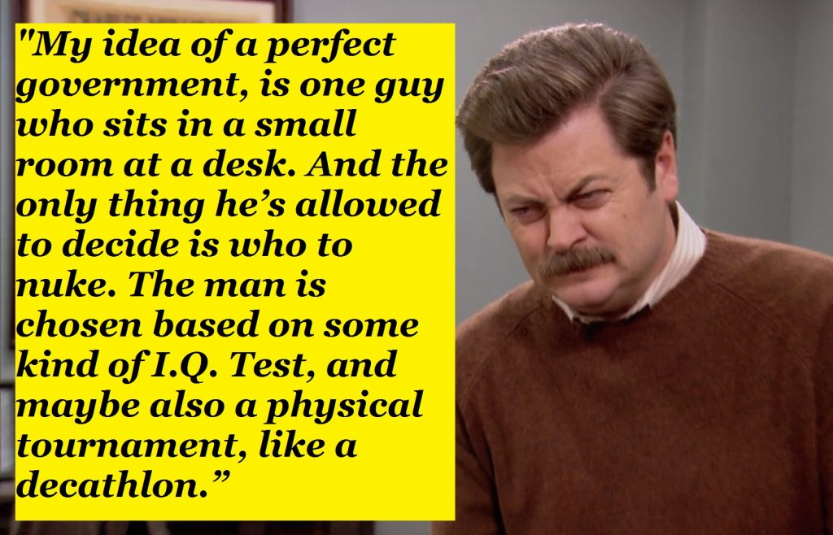
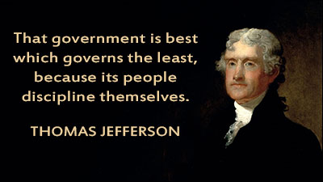
Strict vs Liberal Constructionism
Strict constructionists believe Congress should exercise only its expressed powers and those implied powers absolutely necessary to carry out those expressed powers
Ex. Thomas Jefferson, Ron Swanson (pop-culture)
Notes:
Believe that Congress should stick to their expressed powers and make very little use of their implied powers. Feel that since the 10th Amendment reserves to the states those powers not specifically granted to the national government, that implied powers are a USURPATION of state power. THOMAS JEFFERSON was the original strict constructionist.

Slide 9
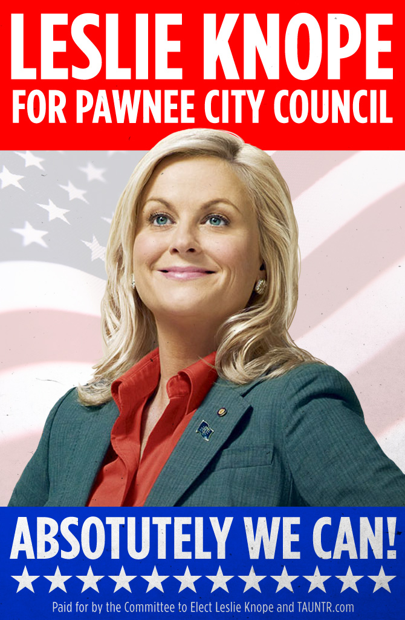
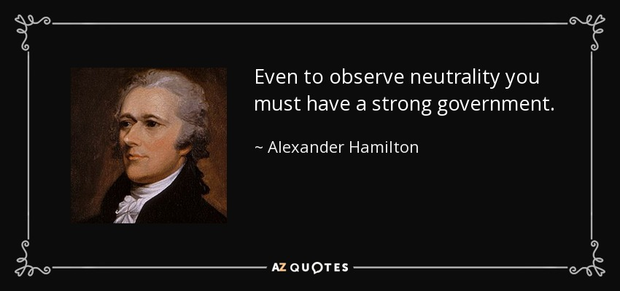
Strict vs Liberal Constructionism
the powers given to Congress, in interpretation Liberal Constructionists believe in a broad interpretation of that has extended the powers of the Federal Government far beyond the plans of the original Framers of the Constitution
Ex. Alexander Hamilton
Notes:
Believe that Congress should be allowed to make broad use of implied powers to help strengthen the national government. Feel that NATIONAL PROBLEMS DEMAND NATIONAL SOLUTIONS and that waiting for each state to act individually can be inefficient at best and dangerous to the best interests of the nation at worst. ALEXANDER HAMILTON was the original liberal constructionist.

Slide 10
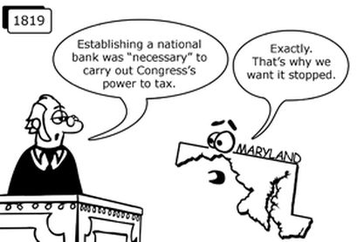
The Battle over Implied Powers
The battle over the meaning of the clause caused a conflict between Hamilton and Jefferson (between strict and liberal constructionists)
McCulloch v. Maryland (1819) – the Supreme Court backed Hamilton’s views and strengthened the notion that implied powers were necessary to conduct government for the benefit of the people

Slide 11
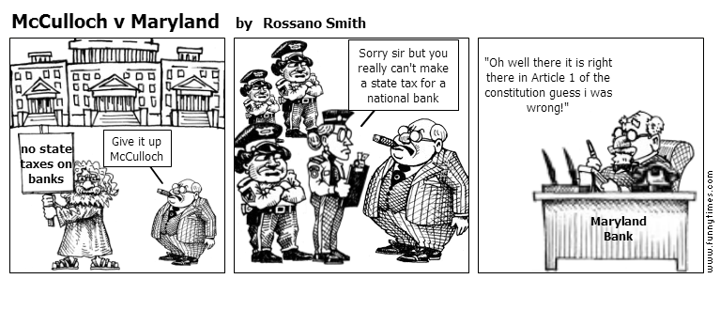
McCulloch v. Maryland (1819)
Implied Power of Congress being challenged:
Congress passed laws setting up a national bank, called The Bank of the United States. Nowhere in the Constitution did it specifically say that they could do this.

Slide 12
McCulloch v. Maryland (1819)
Strict Constructionist argument:
Since the Constitution does not specifically provide for the creation of a national bank, Congress cannot create one. The bank is an unconstitutional use of Congressional power and should be struck down.
Liberal Constructionist argument:
Congress has several expressed powers that put money directly in the hands of the government – taxing power, borrowing power, currency power, commerce power – all of these result in the government handling a whole lot of money. This being the case, it is “necessary & proper” to have a national bank to hold the money in.

Slide 13
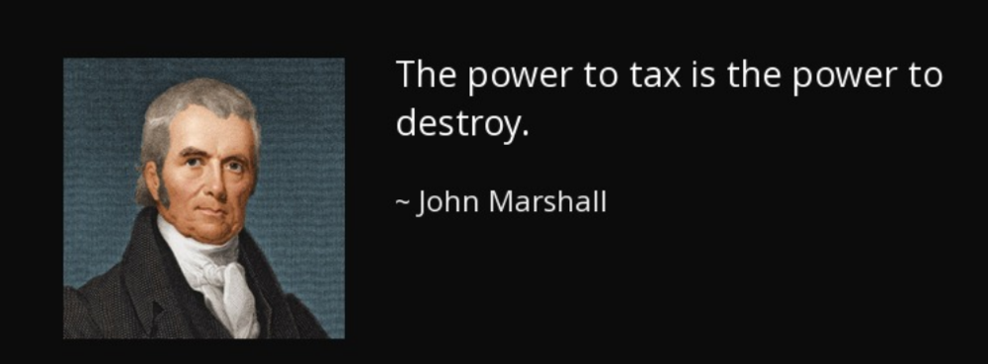
McCulloch v. Maryland (1819)
Decision of the Supreme Court/Significance of the outcome:
John Marshall and the Supreme Court ruled unanimously that the bank was constitutional and that it could exist. In doing so, the Court set a powerful PRECEDENT that implied powers DO exist and that Congress can do more than just what the Constitution specifically says.

Slide 14
The Battle over Implied Powers
The Doctrine in Practice – Today “necessary and proper” is generally interpreted to mean “convenient and useful” as long as the implied powers have their basis in the expressed powers

Slide 15
Expressed Power: Raise an Army
Implied Power: Establish a draft to raise and Army
Implied Power: Develop new armored tanks
Implied Power: Construct military bases
Expressed Power: Collect Taxes
Implied Power: Establish the IRS (Internal Revenue Service)
Implied Power: Establish a national bank
Implied Power: Punish those who fail to pay their taxes
Expressed Power: Regulate commerce
Implied Power: Prohibit the importation of certain goods
Implied Power: Prohibit the exportation of certain goods

Slide 16
Expressed vs. Implied Powers
Expressed Powers
Listed in the Constitution
The power to tax, borrow, commerce, currency, bankruptcy, foreign relations, war powers, naturalization, postal, copyrights and patents, weights and measurements, territories, and judicial
Implied Powers
Not listed in Constitution
Needed in order to have the expressed powers
The power to establish a federal reserve, draft an army, fix minimum wage and maximum work hours, make tax evasion a crime, and establish federal aid programs

Slide 17
LEGISLATIVE POWERS
Approving treaties
President makes
Senate approves
Notes:
The Senate must confirm all treaties made by the President. The President makes treaties "by and with the Advice and Consent of the Senate,... provided two thirds of the Senators present concur." Presently, the President often consults members of the Senate Foreign Relations Committee.

Slide 18
LEGISLATIVE POWERS
Creating and maintaining an army and navy

Slide 19
LEGISLATIVE POWERS
Declaring War
Congress declares war
President orders troops into battle

Slide 20
LEGISLATIVE POWERS
Regulating foreign and interstate commerce

Slide 21
LEGISLATIVE POWERS
Taxing and Spending/ Appropriations bills
Tax bills start in the House of Representatives
President makes budget
Congress approves

Slide 22
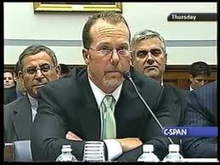
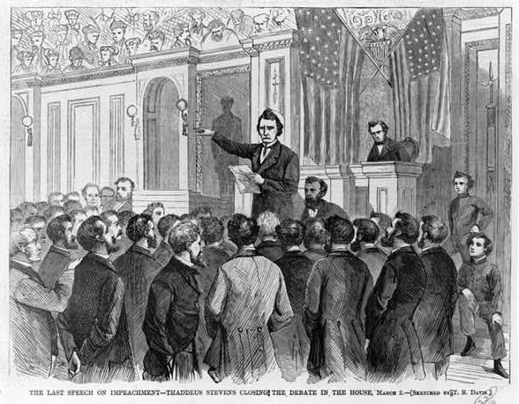
The Non-legislative Powers
Those powers not having to do with making law
Constitutional Amendments
Electoral Duties
Impeachment
The Power to investigate (holding hearings)
Executive
Notes:
Amending:
Congress has the power to propose amendments to the Constitution by a two-thirds vote in each house
Congress may call a national convention at the request of two-thirds of the States’ legislatures to propose an amendment
Election:
The House may be called on to elect the President if no candidate receives a majority of electoral votes
Under the same circumstances, the Senate may be called on to elect the Vice President
Impeachment:
The House has the sole power to vote articles of impeachment, or removal, of the President, Vice President, and all other civil officers of the United States.
2/3rds vote = 290 members.
The Senate has sole power to conduct a trial of those impeached by the House
2/3rds vote = 67 Senators.
Executive :The Senate must confirm all major appointments made by the President
The Senate must confirm all treaties made by the President. The President makes treaties "by and with the Advice and Consent of the Senate,... provided two thirds of the Senators present concur." Presently, the President often consults members of the Senate Foreign Relations Committee.
Congress holds the power to investigate matters related to its legislative powers
Congress may choose to conduct an investigation for five reasons
To gather information useful to Congress
To oversee operations of the executive branch
To focus public attention on an issue
To expose questionable activities of public officials
To promote the interests of some members of Congress

Slide 23
Constitutional Amendments
Congress has the power to propose amendments to the Constitution by a two-thirds vote in each house
Congress may call a national convention at the request of two-thirds of the States’ legislatures to propose an amendment.
Amendment must be ratified by ¾ of the state legislatures (38 out of 50 states) or ¾ of state conventions.

Slide 24
Election Duties (12th Amendment)
If no Presidential candidate receives a majority of the electoral votes needed to win the election (270 electoral votes or more)
House of Representatives (voting by state delegation) will elect the President (26 to elect)
This occurred in 1800 and 1824
If no Vice Presidential candidate receives a majority of the electoral votes needed to win the election (270 electoral votes or more)
The Senate will elect the Vice President (each Senator having 1 vote, 51 votes needed to elect)

Slide 25
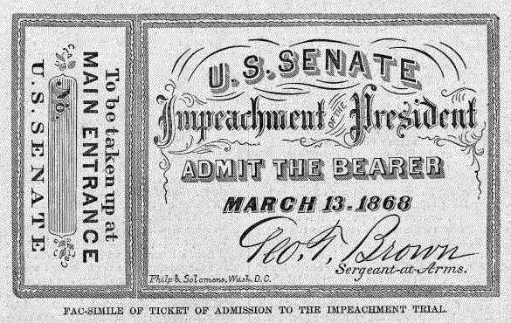
Impeachment
The House has the sole power to vote articles of impeachment, or removal, of the President, Vice President, and all other civil officers of the United States.
2/3rds vote = 290 members.
The Senate has sole power to conduct a trial of those impeached by the House
2/3rds vote = 67 Senators.
Andrew Johnson
Bill Clinton.

Slide 26
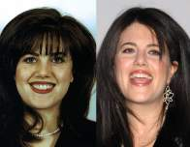
Impeachment of Bill Clinton
Bill Clinton (Impeached 1998)
House brought 2 articles of Impeachment:
1. Perjury (lying under oath): 228 to 206 vote
2. Obstruction of Justice: 221 to 212 vote
Result of affair Clinton had with a White House intern, Monica Lewinsky
Senate acquits Clinton on both charges (1999)
1. Perjury (45 to 55 vote)
2. Obstruction of Justice (50 to 50 vote)

Slide 27
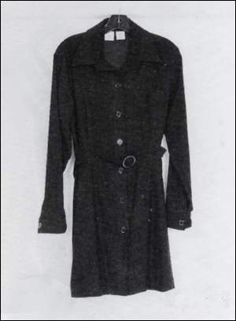
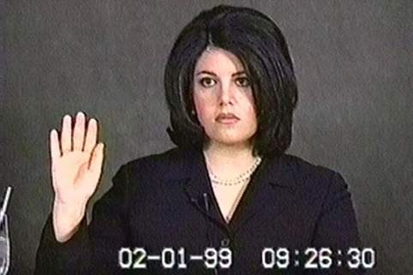
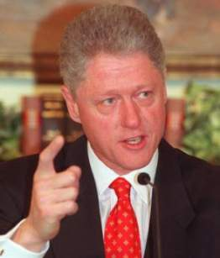
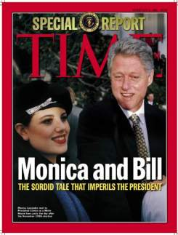
Bill Clinton Impeachment

Slide 28
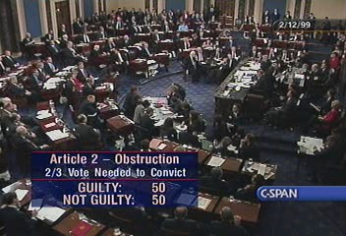

Slide 29
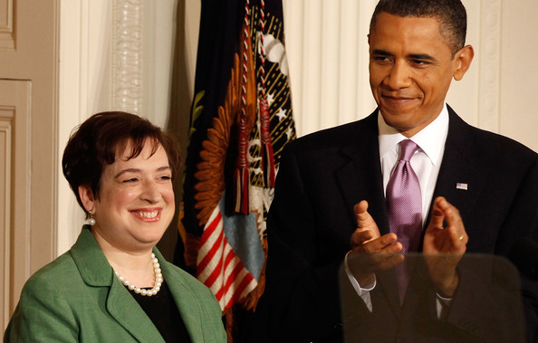
Executive Powers
The Senate must confirm all major appointments made by the President
President appoints: ambassadors, his Cabinet, federal judges, and the heads of agencies
Presidential appointments must be approved by a majority vote of the Senate

Slide 30
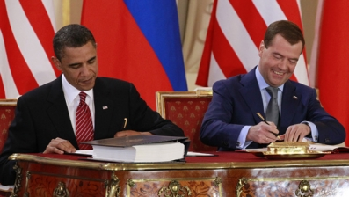
Executive Power
The Senate must confirm all treaties* made by the President. (* formal contract or agreement)
The President makes treaties "by and with the Advice and Consent of the Senate,... provided two thirds of the Senators present concur." Presently, the President often consults members of the Senate Foreign Relations Committee.
Treaty must be approved by a 2/3 vote by the Senate

Slide 31
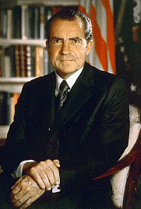
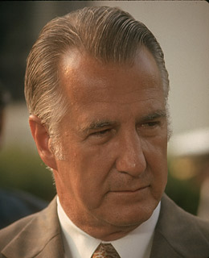
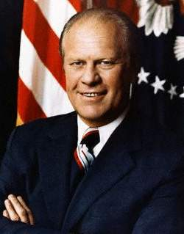
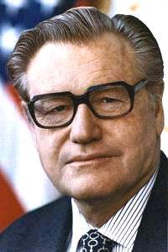
25th Amendment (Ratified 1967)
Section 2: “Whenever there is a vacancy in the office of the Vice President, the President shall nominate a Vice President who shall take office upon confirmation by a majority vote of both Houses of Congress”
Richard Nixon
Spiro Agnew
Gerald Ford
Nelson Rockefeller
Notes:
The office of vice president was empty for a couple of months in 1973 after Nixon's vice president, Spiro Agnew, resigned, until Gerald Ford was cleared to fill the spot. When Nixon later quit in August 1974, and Ford became president, he had no vice president for more than four months, until Nelson Rockefeller finally was confirmed by Congress.

Slide 32
Investigatory Power
Congress holds the power to investigate matters related to its legislative powers
Congress may choose to conduct an investigation for five reasons
To gather information useful to Congress
To oversee operations of the executive branch
To focus public attention on an issue
To expose questionable activities of public officials
To promote the interests of some members of Congress

Slide 33
POWERS DENIED TO CONGRESS
Cannot pass laws that violate the Constitution

Slide 34
POWERS DENIED TO CONGRESS
Cannot suspend the writ of habeas corpus
Police have to bring prisoner to court and explain why they are holding him.

Slide 35
POWERS DENIED TO CONGRESS
Prohibited from passing bills of attainder
Laws that punish a person without a jury trial

Slide 36
POWERS DENIED TO CONGRESS
No ex post facto laws
Laws that make an act a crime after it has been committed

Slide 37
Clauses 1-18: Congress has the power to…
Collect taxes (All federal taxes must be the same throughout the nation, however.), pay the national debt, and make sure the nation is well defended and looked after.
Borrow money from other nations or institutions.
Manage trade with other nations, trade between the states, and trade with the Native Americans.
Make laws about immigration and bankruptcy that will apply throughout the whole country.
Create the money, decide what value it will have, and establish which weights and measurements to base our system on.
Punish anyone who makes counterfeit money.
Establish post offices, run the federal postal system, and build roads.
Encourage scientific discovery and the arts by giving authors and inventors the sole rights (known as a Patent) to their creations for a limited time.
Create localized court systems that will be inferior to the Supreme Court.
Punish pirates and anyone who commits a felony at sea, as well as anyone who violates the laws between nations (otherwise known as international law).
Declare war, hire mercenaries, get revenge on the enemy in wartime, and make laws about the treatment of prisoners.
Raise an army, but with only enough funding to last for two years.
Establish and provide for a navy.
Make rules for the government, the army, and the navy.
Pull together a militia (today’s National Guard) when necessary to enforce the laws, quell uprisings, and stop any invaders.
Organize, train, and arm the militia, as well as govern the part used for national security. The states will get to appoint their officers and train the militia, but the militia will always be subordinate to the needs of the country as dictated by Congress.
Make all the laws that have to do with the new capital – an area less than ten miles square to be chosen at a later date – and its suburbs, including make sure there is a sufficient military presence to protect the new seat of the government.
Make any law they think necessary and proper to help them in performing these duties, and any others that this document grants them or any other department or office.

Slide 38
Assignment
All superheroes have powers. Think of a comic book character who comes to mind.
Choose one of the implied or expressed powers & make a Congressional superhero character. Explain the character & how his/her power is important!
Then, think of a villain. How is this power going to defeat the villain?

Slide 39
Electoral Duties
The House may be called on to elect the President if no candidate receives a majority of electoral votes
Under the same circumstances, the Senate may be called on to elect the Vice President

