Slide 1
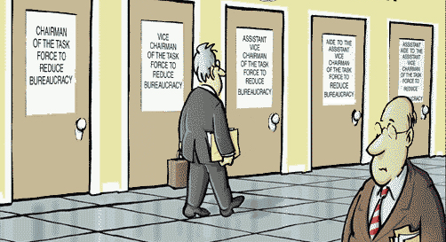
Executive Bureaucracy

Slide 2
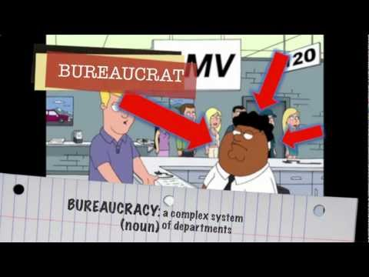
What is Bureaucracy?
Watch video: Bureaucracy (2 min)
What does this video say about Bureaucracy?

Slide 3
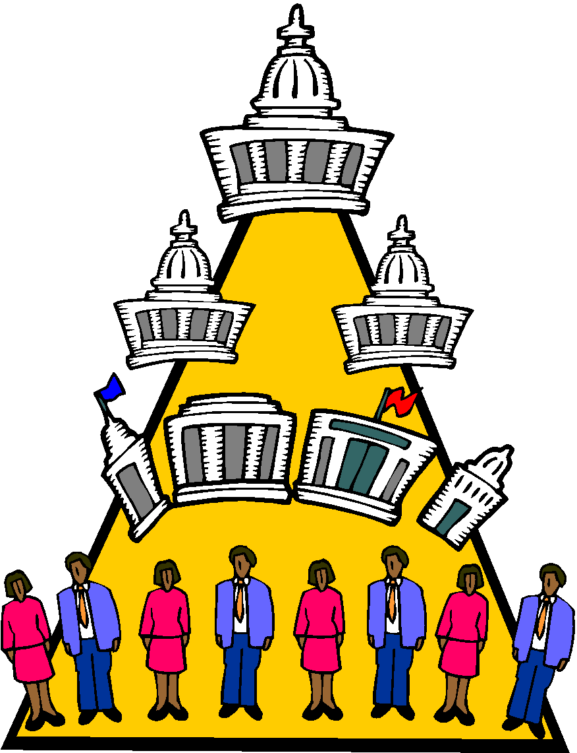
What is Bureaucracy?
A large, complex organization composed of appointed officials.
Bureaucracies feature a hierarchical authority structure, job specialization, and established rules and procedures.
Much of the federal bureaucracy operates on the principle of “government by proxy” = pay other people to do the work (state and local govt’s, etc.)

Slide 4
The “4th Branch” - Federal Bureaucracy
The Federal Bureaucracy is connected most to the Executive Branch.
Video: Organization of the Bureaucracy (6 min)
Video: Crash Course - Bureaucracy Basics (6 min)
Video: Crash Course - Types of Bureaucracies (6 min)
The following notes will explore these questions:
1. Who is the Federal Bureaucracy?
2. What has caused the Federal Bureaucracy to grow?
3. What functions and powers does the Federal Bureaucracy have?

Slide 5
Question 1: Who is the Federal Bureaucracy?
Who are They
Executive Office of the President & White House Staff:
Alphabet soup = OMB, NSC, etc.
Chief of Staff, National security advisor, etc.
2. Executive Cabinet/Departments (15) : Agriculture, Commerce, Defense, Education, Energy, Health and Human Services, Homeland Security, Housing and Urban Development, Interior, Labor, State, Transportation, Treasury, Veterans Affairs, and the Attorney General (Justice).
3. Independent Executive Agencies: EPA, SEC, FEMA,
FAA, FCC, FDA, Federal Reserve, Post Office, etc.
All Total = 3 million + Civilian Employees
Over 4 million if military is included!

Slide 6
Question 1: Who is the Federal Bureaucracy?
Who are They
Executive Office of the President & White House Staff:
To provide the President with the support that he or she needs to govern effectively. (Do not need to be confirmed by Senate)
(Executive Office of the President (EOP) was created in 1939 by President Franklin D. Roosevelt).
The EOP has responsibility for tasks ranging from communicating the President’s message to the American people to promoting our trade interests abroad.
White House staff tend to be loyal allies to the President.
White House Chief of Staff oversees the EOP
Examples: National Security Advisor, Office of Management and Budget, Council of Economic Advisors

Slide 7
Question 1: Who is the Bureaucracy?
Who are They
2. Executive Cabinet/Departments (15)
Provide advice to the President
Do not carry a lot of influence regarding decision making
Appointed by the president (do require senate confirmation)
1 cabinet officer for each of the 15 major executive departments
Ex. Secretary of State (dept of state), attorney general (dept of justice)
15 Executive Departments / Cabinet advisors
Agriculture, Commerce, Defense, Education, Energy, Health and Human Services, Homeland Security, Housing and Urban Development, Interior, Labor, State, Transportation, Treasury, Veterans Affairs, and the Attorney General (Justice).

Slide 8
Question 1: Who is the Bureaucracy?
3. Independent Executive Agencies:
Why independent?
1) The goals / tasks of the agencies don’t fit into the EOP (Executive office of the President) or Executive Departments.
2) No political or partisan influences.
Independent Agencies are divided into 3 groups.
1) Independent Executive Agencies (EPA).
2) Independent Regulatory Agencies: regulate or police the nations economy (FCC, SEC).
3) Government Corporations (USPS, Amtrak, TVA).

Slide 9
Question 2: What has caused the Bureaucracy to grow?
History of the Bureaucracy
George Washington creates the first cabinet. Precedence.
Department of State, War, and Treasury.
2. Spoils System (patronage) shifts to Civil Service.
3. Switch from tax collector to big business helper, to business
regulator, then to welfare state.
4. Huge increase in size follows a change in the size and expectations of society.
(1790): 8 members, (1829): 20,000, (1865): 53,000, (1884): 131,000, (1891): 166,000
Etc. . . . (today 4 million +). Bureaucratic expansion is geometric.
It grows along with population, urbanization, and specialization.

Slide 10
Question 3: What functions and powers does the Federal Bureaucracy have?
What rule-making powers do executive regulatory agencies possess?
Implementation - carry out laws of Congress, executive orders of the President
Regulation (Rulemaking)- issue rules and regulations that impact the public (ex: EPA sets clean air standards) Adjudication to challenge rules if needed.
Administration - routine administrative work “red tape”; provide services (ex: SSA sends social security checks to beneficiaries)

Slide 11
Question 3: What functions and powers does the Federal Bureaucracy have?
What control do presidents exercise over the federal bureaucracy?
appointing agency directors and subheads (with Senate approval)
issuing executive orders compelling an agency to do/not do something
increasing or decreasing an agency's budget (through the Office of Management and Budget)

Slide 12
Summarize the Federal Bureaucracy
What is a bureaucracy?
Who is the Federal Bureaucracy?
What has caused the Federal Bureaucracy to grow?
What functions and powers does the Federal Bureaucracy have?

