Slide 1
NIGERIA
Part 3: Citizens, Society & the State

Slide 2
Citizens, Society, and the State
Necessary condition for democratization: citizens need to have time to pay attention and participate in the political process
Problem for Nigeria:
60% live in poverty
Large gap between rich and poor (Gini = 50.6)
Health issues – AIDS epidemic (1 in 11 AIDS carriers are Nigerian)
Literacy – Overall 68% (75.7% for men, 60.6% for women)
Notes:
AIDS:
Gov’t has general made AIDS a secondary priority, leaving much of the challenge to a small group of underfunded NGOs
the gov’t has provided medications through a small number of clinics, but they reach only a few thousand in a country where several million people are estimated to be HIV positive
Literacy
Higher than many other nations in Africa, but below the world average of 87% for men, 77% for women

Slide 3
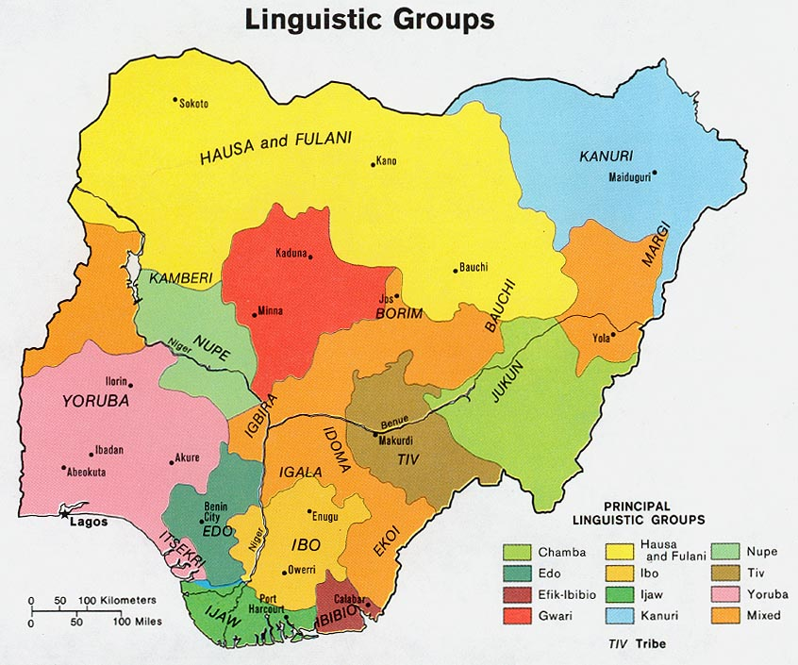
Cleavages
One of the most fragmented societies in the world
Ethnicity – 250 to 400 distinct ethnic groups (different languages, religion)
3 Major Ethnic Groups:
Hausa-Fulani – 29%: Muslim groups which dominate the northern half of country
Yoruba – 21%: split btw Muslim, Christian, and indigenous religions; dominate SW third of country (including Lagos)
Igbo (Ibo) – 18%: mostly Christian; live in SE oil-producing region
Notes:
Hausa-Fulani, Igbo, and Yoruba tribes are largest, but can’t speak each other’s languages and have no contact generally

Slide 4
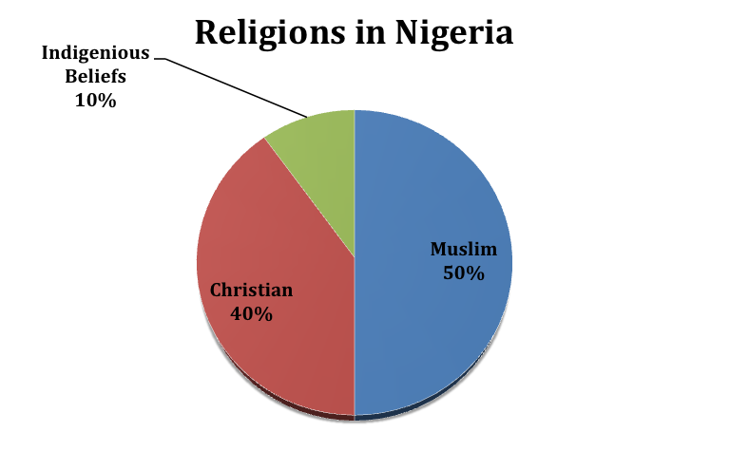
Cleavages
Religion – 50% Muslim, 40% Christian, 10% various native religions
Disputes rooted in preferential treatment British gave to Christians, role of sharia in Nigerian law

Slide 5
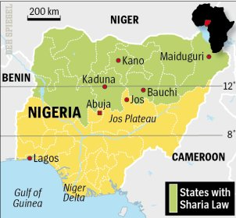
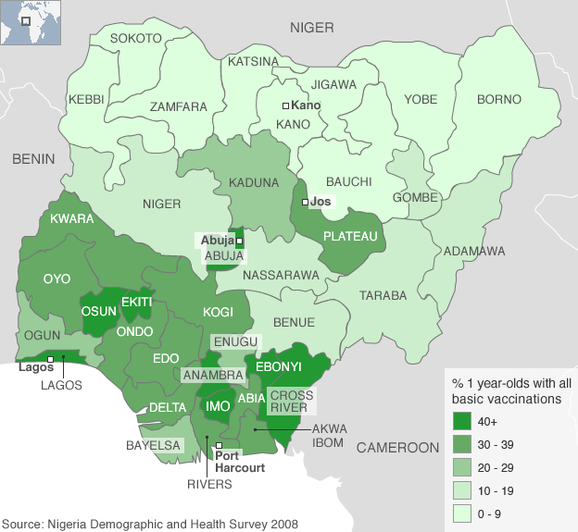
Cleavages
Region – North v. South
North:
Predominantly Muslim
Less educated
Poorer
Less industrialized
Poorer healthcare
South:
Predominantly Christian
More educated
Wealthier (oil reserves)

Slide 6
Cleavages
Urban/rural differences – political organizations, interest groups, media only operate in cities
Social class – Educated elite are those with ties to the state, who often use the treasury to benefit themselves
Notes:
Social Class:
Wealth of elites stems from control of state and resources of the country
Have maintained power by appealing to ethnic and religious identities

Slide 7
Civil Society
Open and Free
Mostly centered around ethnic identity and religion
Elite – private clubs and professional organizations
Soldiers and veterans belong to military support groups
NGO’s

Slide 8
Participation - Elections
Independent National Election Commission (INEC)
Created to help legitimize Nigerian election process
Viewed as corrupt during 2007 election
New reforms helped make 2011 election free and fair (first in Nigerian history)
Same day registration
Local result verification
Cleaning up voting rolls

Slide 9
Participation - Elections
2011: More than 3% of votes declared invalid; approx. 54% turnout
Jonathan (south) 53%; Buhari (North) 32%
Goodluck Jonathan did not win one of the 12 northernmost states out of 36
Buhari did not win more than 25% in Southernmost state

Slide 10
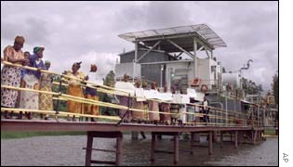
Protests & Demonstrations
Since the return of democracy in 1999, a number of ethnic-based & religious movements have mobilized to pressure the federal gov’t to address grievances
Target international oil companies in Niger Delta
July 2002 – unarmed Ijaw women occupied ChevronTexaco’s Nigerian operations
Ended when officials agreed to provide jobs for women’s sons & set up credit plan to help village women start business
Notes:
Under Obasanjo, many protests were violently suppressed

Slide 11
Protests & Demonstrations
Protest grew in 2006
Groups organized to attack foreign based oil companies
Armed rebel gangs blew up pipelines, disabled pumping states, and kidnapped foreign oil workers
After election of 2011, protests erupted in North b/c Jonathan, a Christian from the South, retained the presidency
Many people believed the informal rule of rotating presidents from north and south had been violated
Notes:
Nigeria is the world’s 8th largest oil exporter, so these events affected int’l energy markets, contributing to higher prices and tighter supplies
Some companies left b/c of instability
2009 amnesty signed, which calmed things down

Slide 12
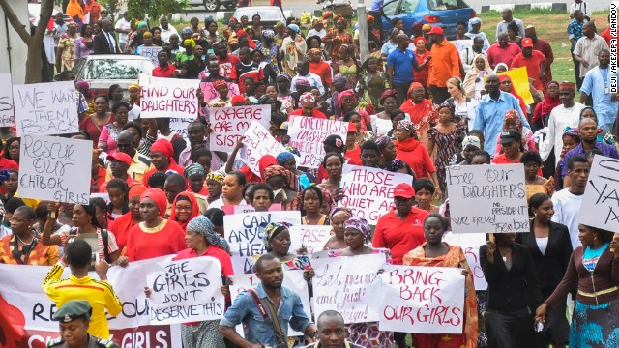
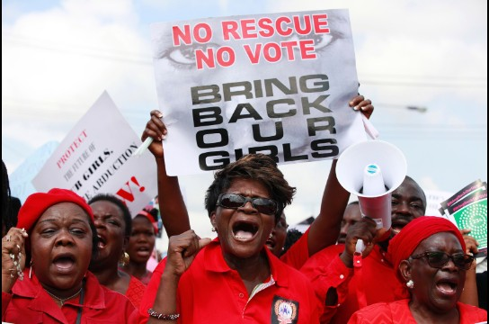
Protests & Demonstrations
2014: Multiple demonstrations/protests broke out calling on the Nigerian government to rescue schoolgirls kidnapped by the Islamist militant group Boko Haram
In April, more than 200 girls were abducted from their boarding school in northeastern Nigeria
More on Boko Haram
Notes:
April 30 – Million Woman March

