Slide 1
NIGERIA
“Nigeria is not a nation. It is a mere geographical expression.”
--Chief Obafemi Awolow
Part 1: The Making of the Modern State

Slide 2
Just for Fun…
http://www.theonion.com/video/in-the-know-situation-in-nigeria-seems-pretty-comp,14171/

Slide 3
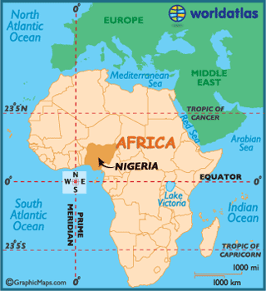
Why Study Nigeria?
LDC trying to democratize
History of colonialism, military rule, parliamentary democracy & presidential democracy
Ethnic/Religious/Regional Cleavages
Largest population in Africa
Federalism
Resource curse (oil)
Patron-Client Relations (Prebendalism)

Slide 4
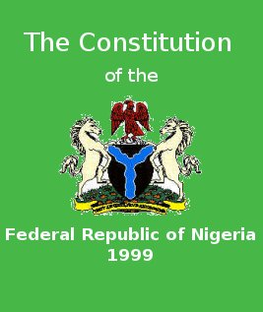
Sovereignty, Authority, and Power
Constitutionalism – eluding Nigeria so far
First constitution in 1914
8 more since (latest in 1999)
Military and civilian leaders alike have never felt the need to obey constitutions, and often write new ones upon taking power
Notes:
Constitutionalism: acceptance of a constitution as a guiding set of principles.

Slide 5
Sovereignty, Authority, and Power
Legitimacy
Newly independent (1960)
Highly fragmented along ethnic, regional, religious lines
The sole stable national institution is the military
Leads to legitimacy of military’s right to rule
Most leaders have been generals
Extremely low legitimacy of government, overall
Massive corruption, distrust of government

Slide 6
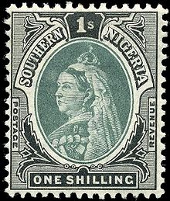
Influence of British Rule
Deepened ethnic and regional divisions
Indirect rule in the north (Muslim leaders)
Direct rule in south
Christianity
(Islam already in North from Arab traders)
Western-style education
Mostly in south (Christian missionaries)
Independence – 1960
Since then…the ”National Question”
Should we even be a country?
Notes:
Authoritarian rule – British established chiefs to rule on their behalf
Interventionist state – no “free market”… chiefs expected to rule to meet economic goals set by the British
Individualism – self-interest of capitalism was mixed with state-domination of the economy
Intensification of ethnic politics – Hausa-Fulani, Igbo, Yoruba competed for “rewards” from British

Slide 7
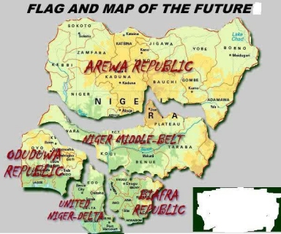

Slide 8
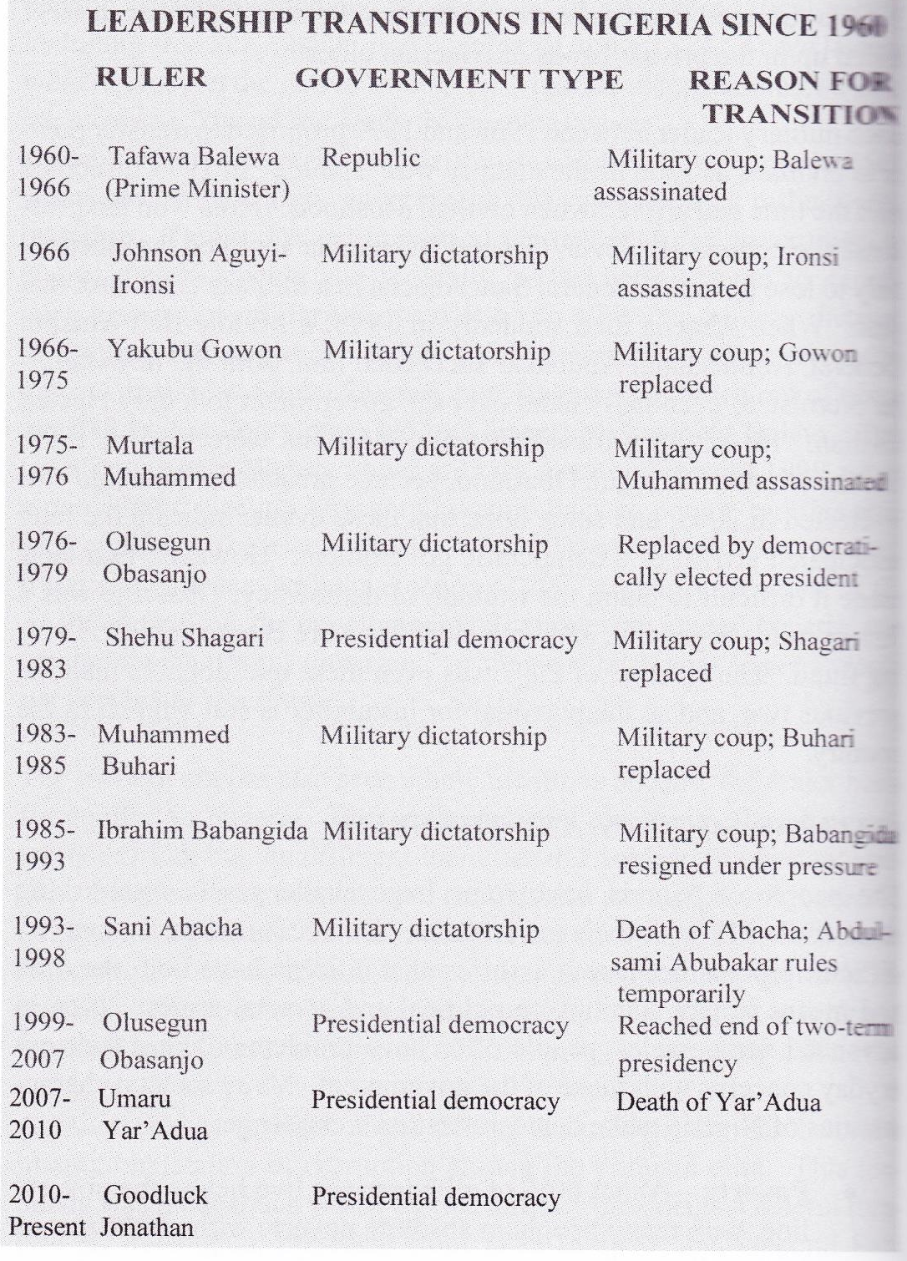
Since Independence
1960-1979 – British parliamentary style democracy
Why didn’t it work?

Slide 9
Since Independence
1960-1979 – British parliamentary style democracy
Why didn’t it work?
Ethnic divisions made it difficult to identify a majority party or allow a PM to have necessary authority

Slide 10
Since Independence
1967-70 Biafran Civil War
First military ruler, Ironsi, justified his authority by announcing his intention to end violence and stop political corruption
Killed in a coup by a 2nd general
Coup sparked the Igbo to fight for independence for their land – called Biafra
Country did remain together, but only under military rule
1979 – Presidential System
Both systems experienced frequent interruptions/periods of Military Rule –frequent coups

Slide 11
Since Independence
Other Trends
Intensification of ethnic conflict – Hausa-Fulani formed a majority coalition with Igbo, angering the Yoruba
Personalized rule and corruption
Govt revenue goes to Nigerian elite through patron-client system/prebendalism
Federalism – attempt to pacify ethnic tension, though military leaders did not allow much local power
Economic dependence on oil – enriches those in power, who ignore other sectors of the economy
Notes:
Corruption:
Two military presidents: Babangida and Abacha maintained large foreign bank accounts with regular deposits diverted from Nigerian state (oil $)
Loyalty Pyramids
Senior govt officials are supported by a broader base of loyal junior officials
State control of resources means that those in the pyramid get the spoils, and they alone have access to wealth and influence

Slide 12
Economic Development
Rentier State based on oil revenue
Debt because of over-reliance on oil and corruption
1980s Nigeria was forced to turn to international organizations for help in managing its huge national debt
World Bank/International Monetary Fund helped develop economic structural adjustment program
Restructure and diversify Nigerian economy to decrease dependence on oil
Notes:
Rentier state, like Iran

