Slide 1
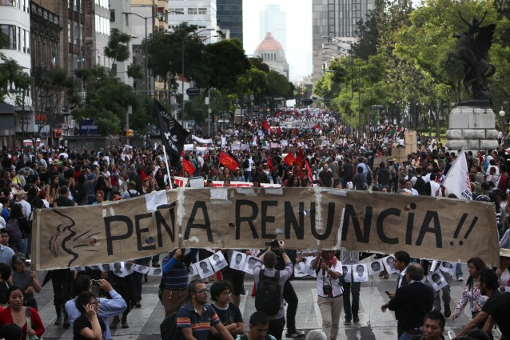
MEXICO
Part 3: Citizens, Society, & State

Slide 2
Social Cleavages
Urban v. Rural
Under PRI, Mexico was mostly rural and the patron-client system controlled peasants
Today Mexico is more than 75% urban & literacy rate is about 90%
North v. South
North is more prosperous bc more involved with trade from US, more industrialized, more middle class, higher education
South has more Amerindian, lower incomes, less education
Social Class
High economic inequality, but starting to see some growth of middle class (but may be in informal economy)

Slide 3
Social Cleavages
Mestizo v. Amerindian
About 30% think of themselves as Amerindian
Amerindian more likely to live in marginalized, rural areas and live in poverty
Most of Mexico’s wealth is in the hands of the mestizos
Discussion Question: Which cleavages are coinciding?

Slide 4
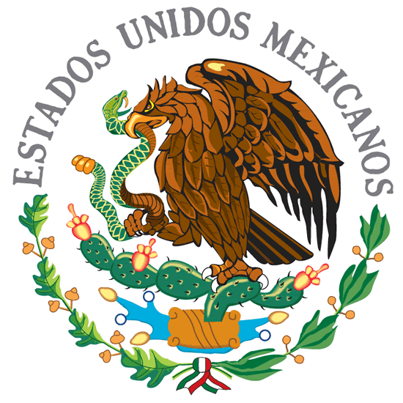
Political Participation
Patron-Client System
Strong under rule of PRI
Lessened with modernization
Protests
1968 Student Protests in Tlatelolco Plaza
Gov’t responded by co-optation – accommodating protesters demands by including them in political process
1994 Zapatista Uprising in Chiapas
Chiapas = poor southern Mexican state
Amerindians upset, feeling ignored after NAFTA
President Fox attempted to incorporate Zapatistas into gov’t
Federal gov’t currently supplies electricity & water to villages Zapatistas control
2006 Protest in Oaxaca (teachers’ strike turned protest of elections and authoritarian rule) Demanded resignation of governor
Notes:
Tlatelolco Plaza:
President recruited large number of student activists into his administration; increased spending on social services, put many young people to work, expanded antipoverty programs in countryside/urban slums

Slide 5
Political Participation
Voting Behavior
Before 1990s, PRI controlled elections on local, state, and national levels
Voting rates were high (patron-clientelism: political support for economic favors)
Competing parties since 1930s
Highest voting turnout in 1994 (78%) but have declined since then (around 60%)

Slide 6
Interest Groups
PRI practiced state corporatism
Interest groups were divided into three sectors
Labor
Peasants
Middle class

Slide 7
Civil Society
History of civil society even under PRI
Political parties are primary civil society organization in urban Mexico
They sponsor sports clubs, youth activities, and celebrations for communities
PRI’s downfall started in civil society with discontented businessmen who were not incorporated into the gov’t system
Growth of Protestant churches in recent decades demonstrates openness of civil society
NGOs & Professional organizations are common and esp active in Mexico City
Unions are powerful (esp those associate with PRI)

