Slide 1
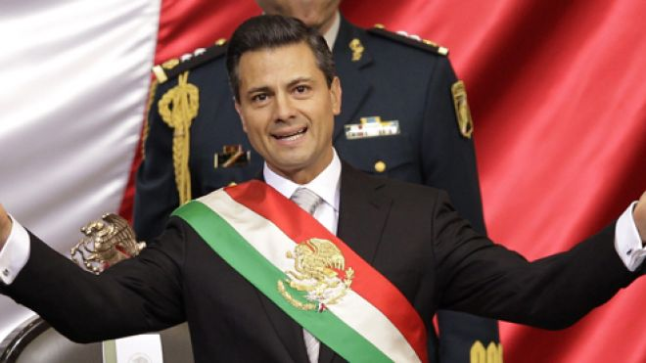
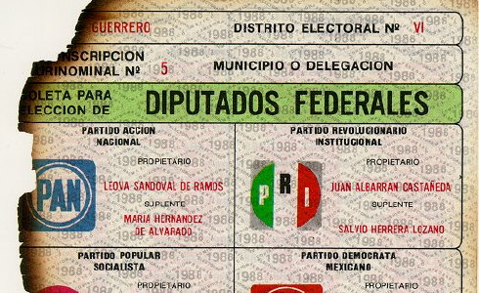
MEXICO
Part 2: Institutions

Slide 2
The Basics
Developing/Transitional Democracy (since 2000)
Newly Industrialized Country
GDP/Per Capita – PPP $15,600
Moderately globalized economy
Federal – strong central gov’t
Territory divided into 31 states and one federal district (Mexico City)
Presidential
Bicameral Legislature
Independent Judiciary on Paper, Not in Practice
Corporatist Interest Group System
Multiparty (with history of one-party dominance)
Notes:
63% of workers are in service sector

Slide 3
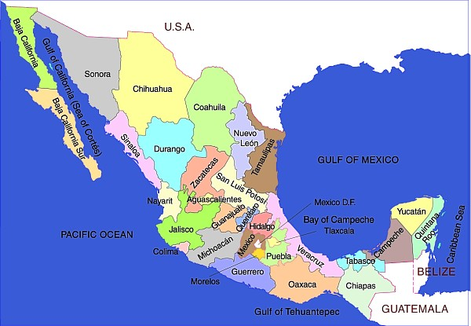
States
31- Governors Popularly Elected
6 year term, but can never serve a second term
Every governor from PRI (1929-1989)
President can have Senate remove governor of any State in which law and order cannot be maintained
President then appoints interim governor to finish term
Notes:
Gubernatorial elections are evenly distributed throughout a sexenio , so that ordinarily no more than six governorships are contested in any given year
State and municipal legislators also have substitutes elected to reward party members and to fill any possible future vacancies
One removed per year (1917-1964)
One removal per presidential term since 1964 but each president has pressured 1 to 3 governors to voluntarily resign when political crises got out of control

Slide 4
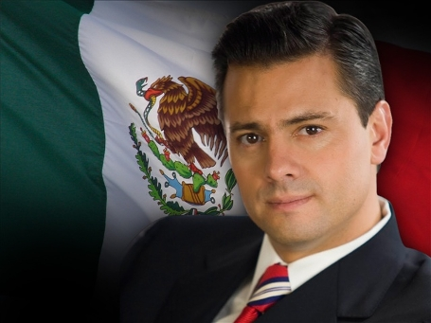
The Executive
President is Head of State/Govt
No V.P.
Current President: Enrique Pena Nieto (2012)
Serve 1 six year term only – Sexenio
Directly elected, simple majority (FPTP, no run-off, Nieto won with about 1/3 of vote)
Until 1990s, incumbent selected next presidential candidate (dedazo)
Notes:
President:
Native-born Mexican of native-born parents (amended in 1994 to allow offspring of naturalized citizens, effective 1999)
35 years old
No Vice President
If death or resignation, federal Congress elects an interim president
Directly elected, simple majority
Under PRI’s domination, almost always named winning candidates for governors, senators, deputies, local officials
Priests and ministers of religious denominations are barred from holding public office

Slide 5
The Executive
Presidential Powers – Very Strong
Initiate legislation by introducing bills into either house (90%)
Assign legislative priorities
Extensive appointment powers
Foreign policy
Create government agencies
Make policy by decree
Grant pardons
Names cabinet and can replace them
Veto legislation
Manages patronage system (informal power)
Between 1929-1992, all presidential legislation was approved by Mexican Congress (rubber stamp!)
Notes:
Presidential Decree:
create income tax, Cabinet ministries, government corporations, major public-works projects, significant budget changes, public policies, such as nuclear energy and family planning

Slide 6
The Executive
Discussion Question: How does the role of the Mexican president compare to the Russian president?
RUSSIA:
BOTH:
MEXICO:

Slide 7
The Executive
Discussion Question: How does the role of the Mexican president compare to the Russian president?
RUSSIA:
BOTH:
MEXICO:
Limited to 2 consecutive terms
Head of State only
Election is 2 round model
Weak check of power by legislative branch
Can dissolve Duma
Directly elected
6 year terms
Power has been unchecked by judiciary
Power of appointments
Power of decree
Power to remove governors
Sexenio – no re-election
Head of State and Head of Gov’t
Election is simple majority (plurality)
Starting to be challenged by legislature (Congress)

Slide 8
The Executive
Bureaucracy
Huge - 1.5 million people (most in Mexico City)
Patronage driven
Lower level people are guaranteed jobs
Higher level only allowed to stay in office as long as their superiors have confidence in them (confidence employees)
Parastatal Sector
A government-owned corporation or agency
Produce goods/services usually carried out by private individuals in other countries (ex: PEMEX)
Huge sector under PRI, Reforms have trimmed # of parastatals
Notes:
Bureacracy:
Staff schools, state-owned industries, positions in state/local governments
Parastatal Sector:
Government started and owned many businesses in the 1940’s.
Includes businesses that are owned or subsidized by the government.
In 1982 Mexico had 1,155 businesses in the Para-Statal sector. In 1994 most of those businesses were sold and the Mexican government owned only 215 (Includes PEMEX and the electricity)
PEMEX now allows some foreign investment

Slide 9
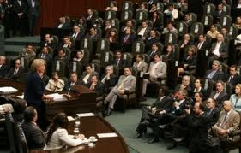
The Legislature
Congress was under President’s power during dominant rule of PRI
Chamber of Deputies (Lower House)
500 members
Directly elected, 3 yr terms, no consecutive terms
300 SMD, 200 PR
Senate (Upper House)
128 members
Directly elected, 6 yr terms, no consecutive terms
3 senators from each state + fed district (FPTP – 2 majority, 1 next highest vote)/Rest PR
Notes:
Congress:
Becoming more active in policymaking
Started negotiating with and blocking the president’s bills
Started introducing their own bills
Less experienced than US counterparts
Chamber of Deputies has greater discretion in budgetary matters
Senate stronger say in foreign policy
Most bills must pass through both houses
Can override presidential veto
Less oversight of executive
Fewer powers to challenge executive’s control of government appointments
Senate:
The Mexican Senate's 128 members are directly elected for a six-year term of office, and may not be immediately re-elected either. Each one of Mexico's 32 federal entities chooses three senators: in each entity, the party or coalition with the largest number of votes receives two seats, and the party or coalition in second place obtains one seat. The remaining 32 seats are apportioned in a single, nationwide constituency by the largest remainder method of proportional representation, among lists polling at least two percent of the vote, taking into account invalid ballots.

Slide 10
The Legislature
Discussion Question: Should members of the Mexican Congress be allowed to get immediately re-elected? Why or why not?

Slide 11
The Judiciary
Weakest Branch of Govt
Code Law, Explicit
Supreme Court:
Justices nominated by President and approved by Senate
11 (reduced from 26 in 1994)
Has power of judicial review on paper, but does not go against government action/policy
Supposed to serve for life, but justices often resigned after an election so president could handpick new judges
Amparo – Writ of Protection
2008 introduced reform
Oral trials replaced process that was conducted on paper
Notes:
Amparo:
Writ of protection claiming their constitutional rights have been violated by specific government actions and laws
Stays (suspends) disputed governmental action until appeal can be heard by Supreme Court
Compel officials to carry out constitutional obligations
Force judges to tell a defendant the specific charges against him
Political disputes over elections are excluded
1/3 of 5,500 writs (1917-1980) won by citizens
Oral Trials:
1st Oral Trial held in 2005 at state level
Drunk driving case
In the past:
Defense lawyers and prosecutors investigate cases, interview witnesses, gather evidence and pass their findings in writing to judges, who review the bulky files before issuing a written verdict. Information often was kept secret and there was corruption

Slide 12
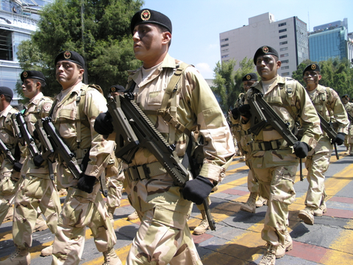
The Military
Marginalized from centers of political power (under civilian control)
Used for:
Repress student protests (1968)
Deal with earthquake (1985)
Break labor strike (1989)
Deal with protest over electoral fraud
Manage Mexico City police (1997)
Combat drug trafficking
Repression, torture, killing in 1970s and 1980s

Slide 13
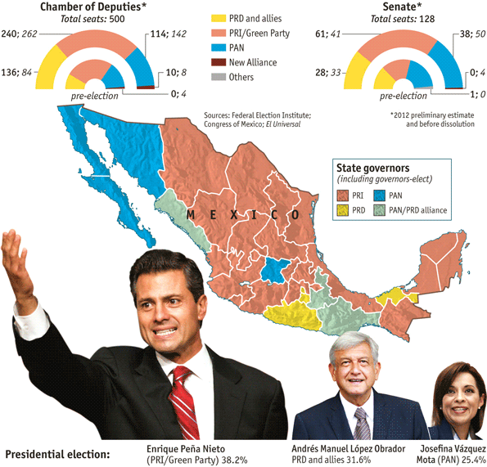
Political Parties
Multiparty State since 2000 (end of PRI domination)
PRI, PAN, PRD

Slide 14
Political Parties
PRI (Institutional Revolutionary Party)
Founded as a coalition of elites; trading favors & power from one to another
Ruled as 1-Party System until 2000
(lost power from 2000-2012, but regained Presidency with election in 2012)
Corporatist Structure, brought competing elites into cabinet
Clientelism/Patron-Client System
Appeals to:
rural people
residents in South
Less educated
Older
Poorer
Notes:
PRI:
Values of revolution especially land reform and empowerment of peasants
Three legged stool: laborers, peasants, bureaucrats
Anticlerical
Centralization of power
Typical Voter:
Rural area or small town
Less education than other party voters
Older and poorer than other party voters
Also includes liberals, radicals, conservatives
As country became urbanized, PRI did not have as much rural support
New generations less beholden to patronage
Internal dissension between dinosaurs and modernizers
Voters are now younger, more educated and more middle class

Slide 15
Political Parties
PAN (National Action Party)
Party to PRI’s Right
Created to Represent Business Interests
Advocates Regional Autonomy & Less Govt Intervention in Economy
Good Rapport with Catholic Church
Strength in Northern Mexico
Also appeals to:
Middle class professional/business
Urban
Those with higher levels of education
Religious
Little impact until the 1990’s – won a few governor’s races

Slide 16
Political Parties
PRD (Democratic Revolutionary Party)
Party to PRI’s Left
Split off from the PRI party, but suffers from internal division and lack of focus (has failed to win presidency)
Wanted more reform and more social justice
Appeals to:
Young
Politically Active
From Central States
Some Education
Small Town or Urban
Drew some Middle Class/Older Voters in 2006

Slide 17
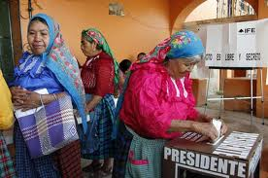
Electoral Reforms
Creation of an electoral commission to regulate campaigns and elections (1990)
All parties receive government funding and have access to the media
Increase in the number of Senate seats (from 68 to 128) (1993)
Presence of foreign electoral observers was legalized (1994)
Creation of a fully independent Federal Electoral Institute (IFE) (1996)
A limit was set on how many seats one party can hold in the Chamber of Deputies (60 percent, or 300 of the 500 seats) (1996)

Slide 18
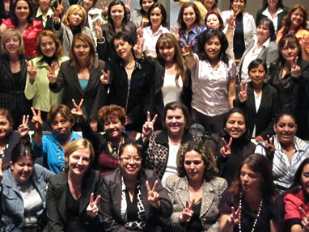
Electoral Reforms
PR was incorporated in the Senate for 32 of 128 seats (1996)
A limit was set on party spending for campaigns
A party threshold for participation in PR was set at 2 percent (Senate and Chamber) (1996)
Priests were legally allowed to cast votes
Legislation “recommending” that parties establish a gender quota for candidate lists (1996)
2002 – Election law requires 40% of congressional ballot for each party is made up of women
Notes:
Political parties are required to guarantee that women constitute at least 40 percent of candidates. This applies to both lists of candidates for the PR election, and the candidates for the constituency elections. However, parties who democratically elect their candidates are exempt from the regulations (COFIPE, Article 219). Legal sanctions for non-compliance: Electoral law Parties not complying with the articles 219 & 220 will have 48 hours to rectify their lists. After this period if they are still in non-compliance they will be publicly reprimanded from the General Council of the Federal Electoral Institute (IFE) with an extra period of 24 hours to rectify their list. Finally, if the 24 hours pass and the party is still in a state of non-compliance its electoral lists will be rejected from the IFE. Rank order/placement rules: Electoral law For the PR elections, each segment of five candidates on the list shall have two candidates of each sex, alternating men and women (COFIPE, Article 220).

Slide 19
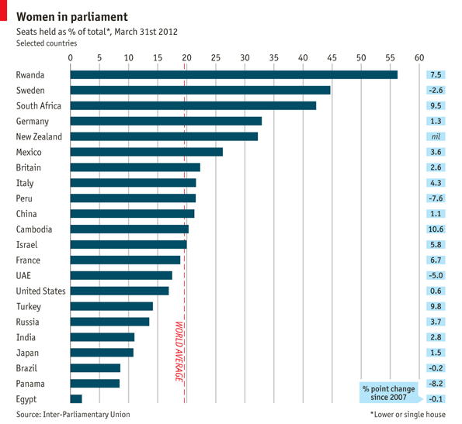

Slide 20
Media
Little power under PRI rule (gov’t run)
Media part of the rewards of the patron-client system
More independence in the 1980s
Access to satellite TV
Much more open today
Some issues with cartel pressure on critical investigative journalism

