Slide 1
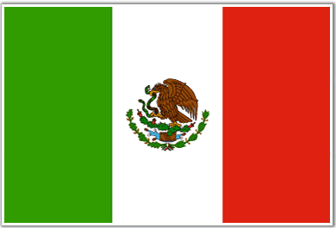
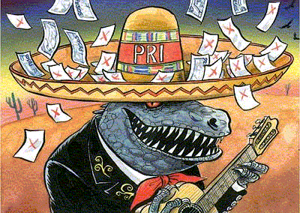
MEXICO
Part 1: The Making of the Modern State

Slide 2
Why Study Mexico?
History of…Revolution, One-Party Dominance, Authoritarianism
But has ended one-party rule, democratized, and is now considered a newly industrializing country…but many problems still exist

Slide 3
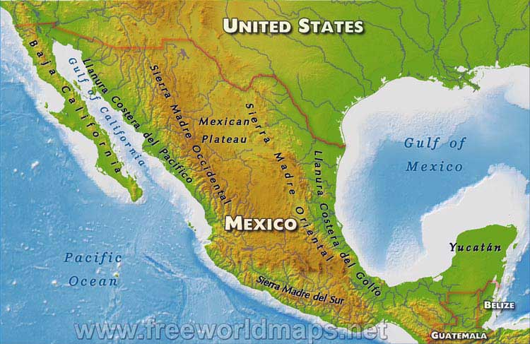
Geography & Population
One of the most geographically diverse countries
Slightly less than three times size of Texas
2,000 mile border with USA and 600 mile border with Guatemala, 160 mile border with Belize
Major Natural Resources:
oil and silver
Notes:
Geography:
Includes high mountains, coastal plains, high plateaus, fertile valleys, rain forests, and deserts within an area about 3x the size of France

Slide 4
Geography & Population
Discussion Question: How has Mexico’s geography impacted its development?
Notes:
Geography:
Includes high mountains, coastal plains, high plateaus, fertile valleys, rain forests, and deserts within an area about 3x the size of France

Slide 5
Geography & Population
Discussion Question: How has Mexico’s geography impacted its development?
Mts and deserts separate regions, and make communication/transportation difficult
Rugged terrain has limited agriculture
All this feeds into regionalism in the political culture
Notes:
Geography:
Includes high mountains, coastal plains, high plateaus, fertile valleys, rain forests, and deserts within an area about 3x the size of France

Slide 6
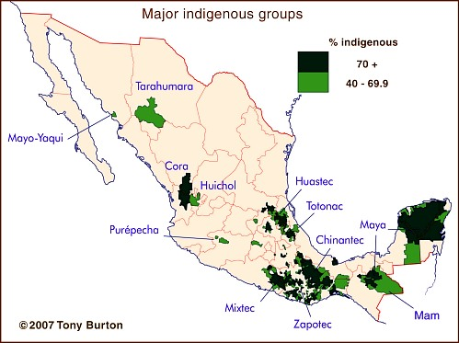
Geography & Population
Over 114 million inhabitants makes Mexico the 2nd largest country in Latin America
60% Mestizo (mixed Amerindian & Spanish descent)
30% Amerindian (indigenous descent)
Largest Spanish speaking country in the world
78% live in urban areas
Mexico City has over 20 million people
83% Catholic
Notes:
92.7% speak Spanish
5.7% Spanish/Indigenous
.8% Indigenous only

Slide 7
Geography & Population
Northern areas much better off than the southern and central areas
Southern and Central Regions
denser population
poorer land
more ejidatarios (borrowers of land from government)
Most of indigenous population lives in south
Migration is a major issue
economic opportunities in the industrial cities of the north lead many to seek jobs in the maquiladoras, (assembly factories)
Notes:
Maquiladoras: factories that produce goods for export, often located along the U.S./Mexico border

Slide 8
History – Colonialism & Independence
Colonialism
Spain ruled Mexico for three centuries
Colonial policy was designed to extract from “New Spain”
Independence
1810 Miguel Hidalgo began first of a series of wars for independence
1821 gained independence BUT struggled to create a stable gov’t for decades
Chaotic period – Mexico lost half its territory
Notes:
Independence
Instability – between 1833 and 1855, 36 presidential administrations came to power
In many regions local strongmen (caudillos) had more authority than govt
Central America rejected rule from Mexico City in 1823
Northern territory of Texan won independence in 1836
Texas became a U.S. state in 1845
1848 – treaty gave New Mexico, Utah, Nevada, Arizona, California, and part of Colorado to US

Slide 9
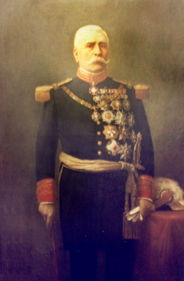
History – The Porfiriato
The Porfiriato (1876-1911)
Dictatorship under Porfirio Diaz
Came to power by military coup
Ruled for 34 years - Stablility
Authoritarianism
Cientificos (scientists)
Foreign investment and economic growth
Growing gap between rich/poor
Notes:
Porfirio Diaz
Retired general
Instituted himself as the president of Mexico with a promise he would not serve more than one term…turned in to 34 years
Porfiriato
Ruled with cientificos – group of young advisors that believed in bringing scientific and economic progress to Mexico
Allowed foreign investment (mostly from US) – period of rapid growth and development
Introduction of wealth did not insure that all would benefit. Many of elite became quite wealthy, but most people in Mexico remained poor.

Slide 10
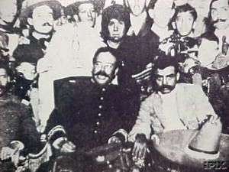
History – The Revolution 0f 1910
Revolution of 1910 - Reformers End Dictatorship
Revolution turned into Civil War
Caudillos (political/military strongmen) challenged one another for power
Emiliano Zapata led peasant revolt (central/southern states)
His manifesto became cornerstone of radical agrarian reform
Francisco (Pancho) Villa in the north
Combined military/warlordism
Notes:
Revolution of 1910
Díaz promised to retire and open election for president
1910 Madero presented himself as a candidate (backed by reformers)
Díaz cancelled election due to increasing opposition, but it was too late
Díaz forced into exile and Madero elected
Madero resorted to military to suppress other revolutionaries
Madero assassinated (1913)
Revolution turned into Civil War
Rise of patron-client system under caudillos
Zapata
A peasant revolt had roots in legislation that made it easy for wealthy landowners to claim lands of peasant villagers
Villagers joined forces under Zapata

Slide 11
History – The Constitution of 1917
Mexican Constitution of 1917 was forged out of diverse/conflicting factions from Revolution
Guaranteed:
agrarian reform, social security, right to organize in unions, minimum wage, eight hour workday, universal secular education, adult male suffrage
Limited the power of foreign investors
Only Mexican citizens/govt could own land or rights to other natural resources
Limited the power of Catholic Church
Anticlericalism – opposition to power of churches/clergy in politics
Notes:
Women do not get the right to vote in national elections until 1958

Slide 12
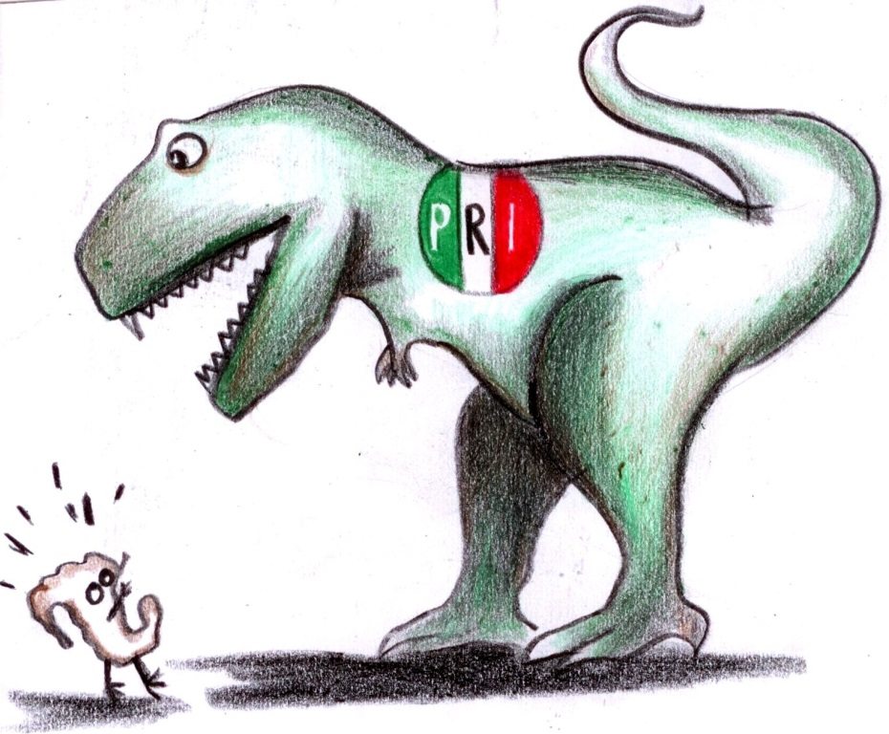
History – PRI, Sexenio, & Import Substitution
Plutarco Elias Calles (1924-28)
Establishes the Institutional Revolutionary Party (PRI)
Each president could have only 1 six year term - Sexenio
Lazaro Cardenas (1934-40)
Land reform – Ejidos (collective land grants)
Nationalized the oil industry – PEMEX
Investments in public works
Import Substitution Industrialization
Employs high tariffs to protect locally produced goods from foreign competition, govt ownership of key industries, govt subsidies to domestic industries
Notes:
Calles and the PRI
1929, Calles brought together many of the most powerful contenders for leadership to create a political party
Plan was to bring all caudillos under one big political party – intended to bring stability through agreement to “pass around” the power from one leader to the next as presidency changed hands
Each pres would have only 1 6yr term, other leaders would be given major positions in govt
Cardenas
Hand picked as a candidate for pres by Calles
Sometimes called the “Roosevelt of Mexico”
Gave voice to peasant demands from Revolution
Redistribution of land
land was taken away from big landlord and foreigners and redistributed as ejidos – collective land grants to be worked by the peasants
Ejidatario – recipient of ejido land grant in Mexico
Public works – govt built roads, provided electricity, created public services that modernized Mexico

Slide 13
History – Rapid Development
Clientelism to oil (1940-1982)
PRI and Patronage
Oil in Gulf of Mexico/fluctuating prices/debt
Crisis and Reform (1982 – 2000)
Presidents Miguel de la Madrid (1982-1988) and Carlos Salinas (1988-1994) introduce major reversal of the country’s development strategy, limiting the government’s involvement in the economy
From import substitution to neoliberalism
1994 – NAFTA – committed Mexico, the U.S., and Canada to elimination of trade barriers between them
Notes:
Clientelism
An informal aspect of policy-making in which a power patron (for example, a traditional local boss, govt agency, or dominant party) offers resources such as land, contracts, protection, or jobs in return for the support and services (such as labor or votes) of lower status and less powerful clients
Corruption, preferential treatment, and inequality are characteristics of clientelist politics
Neoliberalism:
strategy that calls for free markets, balanced budgets, privatization, free trade, and limited govt intervention in the economy

Slide 14
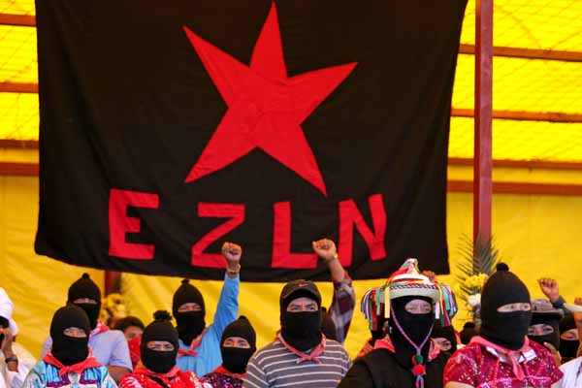
History – Instability
Economic Crisis of 1994
Rebellion in Chiapas (1994)
Zapatistas seized 4 towns in southern state of Chiapas
Demanded land, democracy, indigenous rights, & repeal of NAFTA
Assassination of Luis Donaldo Colosio (1994), PRI candidate for President
Notes:
Globalization led to greater economic vulnerablitity
1994 – Mexico’s economy shrank by 6.2%, inflation soared, taxes rose, wages frozen

Slide 15
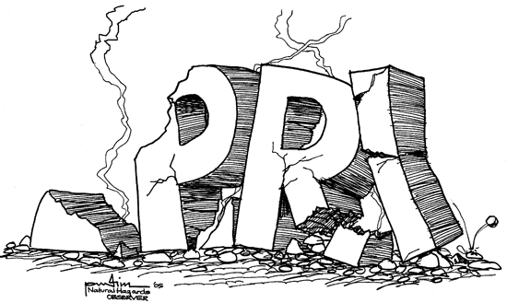
History – Weakening of the PRI
1997 – first time in modern Mexican history PRI lost absolute majority in Chamber of Deputies (lower house)
Dec 1, 2000 Vincent Fox became President
Why is that important?
For the first time in 71 years, the President of Mexico did not represent the Institutional Revolutionary Party (PRI)
Fox is from the National Action Party (PAN)
The other major party in Mexico is the PRD
Notes:
Why the Change?
Mexicans questioned the right of the PRI to monopolize political power
Wanted fairer elections, more responsive public officials
Demanded the right of opposition parties to compete with the PRI on an equal basis
Said the president had too much power and the PRI was corrupt
Not ready for change in 1994 when Ernesto Zedillo (PRI) easily won, but by 2000 they had had enough

Slide 16
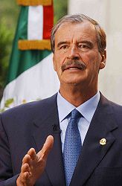
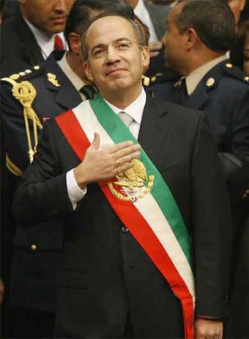
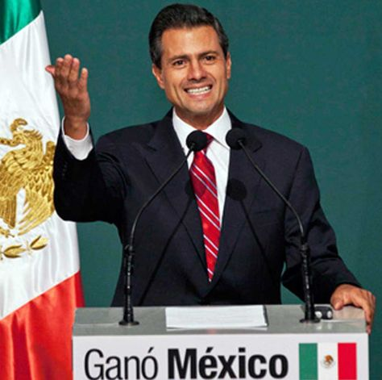
Recent Presidents
2000 = Vicente Fox (PAN)
2006 = Felipe Calderón (PAN) – 2nd Pan President (contested by Obrador of PRD)
2012 = Enrique Peña Nieto (PRI) – current president
Notes:
2006 election was very close and questionable. Contested by Obrador. Presidency suffered from legitimacy issues.

Slide 17
