Slide 1
Karl Marx

Slide 2
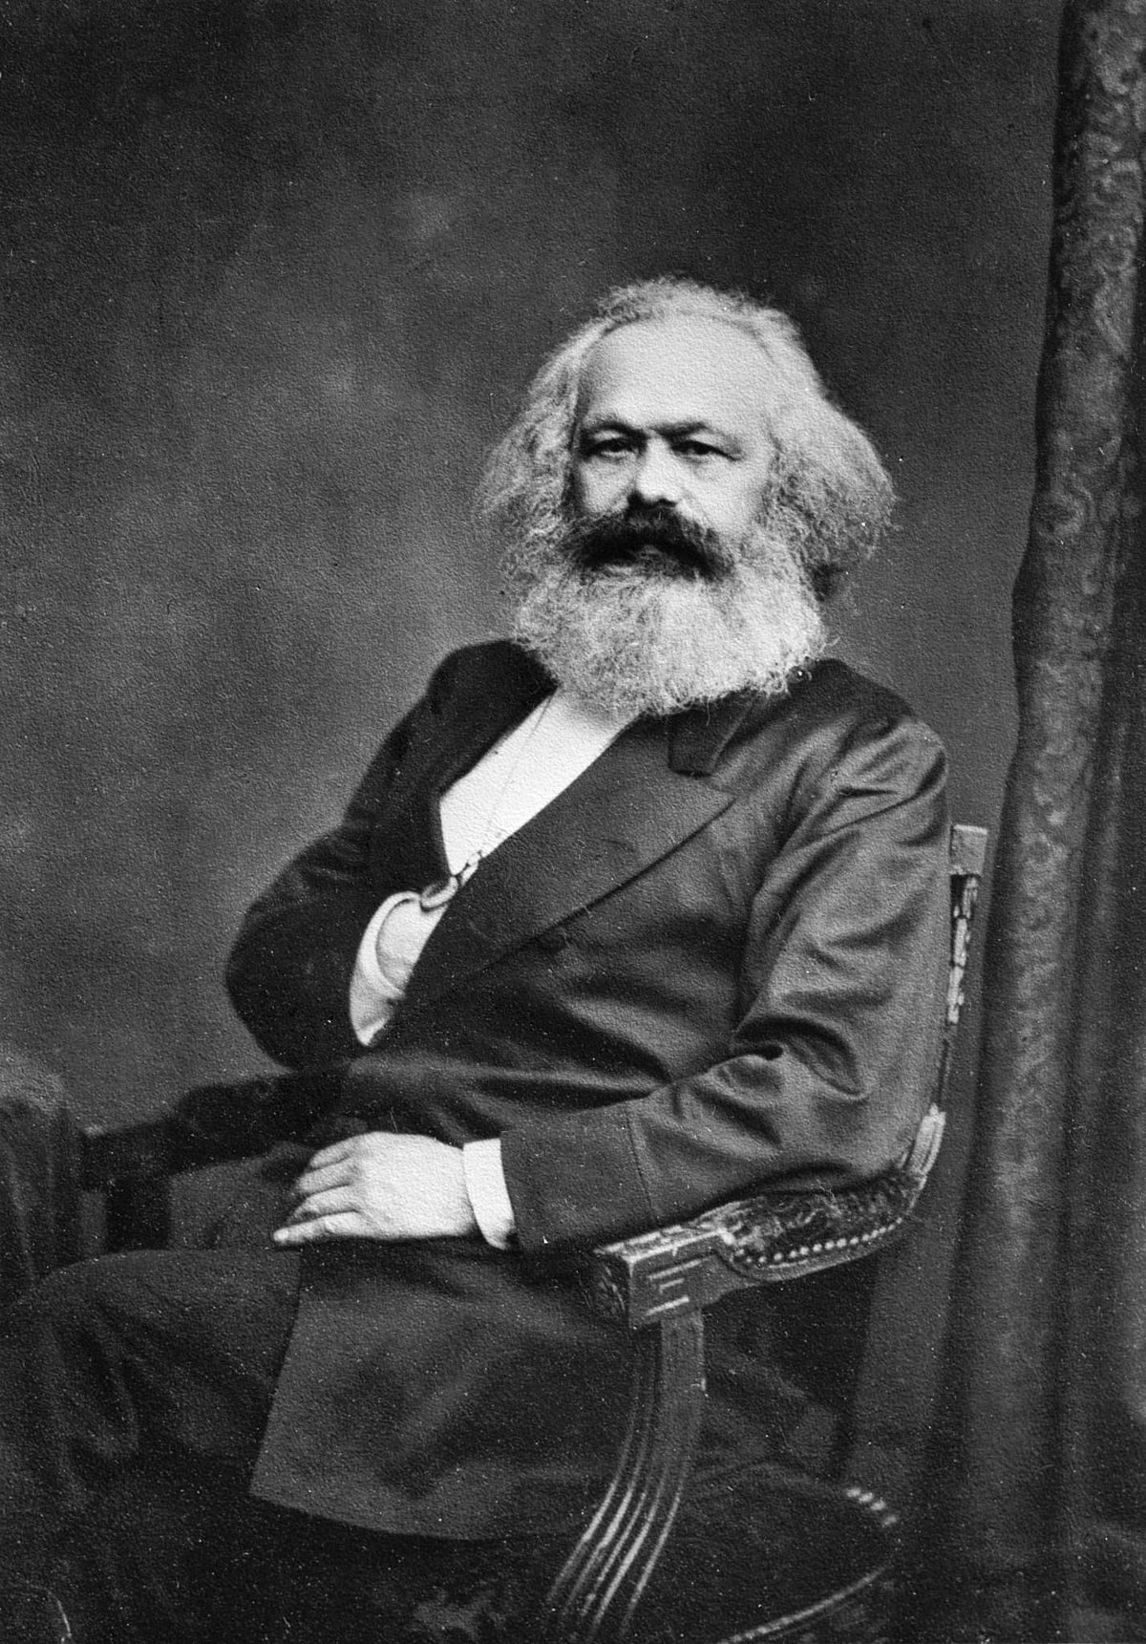
Karl Heinrich Marx
Background:
Born May 5th,1818 in Trier Prussia Trier, Prussia
Died March 14, 1883 at age 64
Known most as the “Father of Communism”
He was a German He was a German Philosopher, Social Scientist, Prophet, and Professional Revolutionary

Slide 3
Background
Both Parents were Jewish - he later changed to Christianity
Father was a lawyer
Went to University of Bonn in 1835 to study law, the next year he transferred to University of Berlin where he became much more interested in Philosophy, a highly political subject in Prussia, where citizens were not permitted to participate directly in public affairs.
He joined a radical group at school whose views implied strong criticism of the severe way in which Prussia was Governed.
1841 obtained a doctorate in Philosophy from the University in Jena
Tried to get a teaching job but failed due to his opposition of the Tried to get a teaching job but failed due to his opposition of the Prussian Government. He then became a free lance journalist.
Married in 1843 on June 19th, to Baroness Jenny von Westphalen.
Died in 1883 in London having only written 3 of the planned 8 volumes of Das Died in 1883 in London having only written 3 of the planned 8 volumes of Das Kapital.

Slide 4
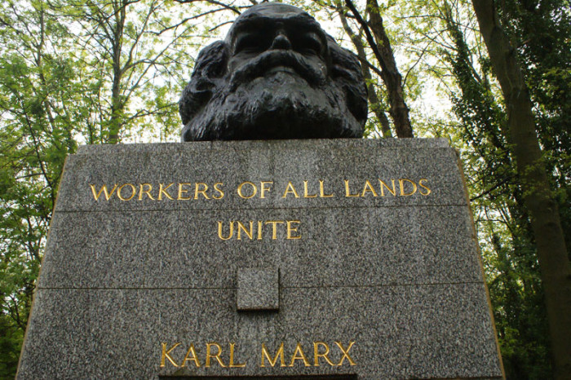
Background
Karl Believed in the Social Power of the People Power of the People
Advocated a socialistic society
Male workers can all Male workers can all work and produce similar amounts of output
The workers are the foundations of the Capitalist Structure
“Workers of All Lands Unite” on Headstone

Slide 5
Influenced By
What is Communism?
Comes from the Latin word “Communis” which means common or belonging to all.
Greek Philosopher Plato
It is a socioeconomic structure that promotes the establishment of a classless society based on common ownership of the means of production and property in general.
They are opposed to Capitalist economies.
Communism argues that in order to establish a peaceful, Communism argues that in order to establish a peaceful, free society without classes or government, the working class must replace the wealthy ruling class.
Currently, communism is still prominent in North Korea, Cuba, and some small countries in Africa. Since the Fall of the Soviet Union Russia has been known as a federal socialist republic.

Slide 6
Other Major Influences Other Major Influences
Marx studied changes in society.
Feudalism - early modern period, medieval Europe Political System, comprised of a set of reciprocal legal and military obligations among warrior nobility, consists of lords, vassals and fiefs.
Capitalism- is an economic system in which the means of production are owned by private persons and operated for profit production are owned by private persons, and operated for profit, and where investments, distribution, income, production and pricing of goods and services are predominantly determined through the operation of a free market or in a regulated market.
Socialism-refers to a broad set of economic theories of social organization advocating state or collective ownership and administration of the means of production and distribution of goods.

Slide 7
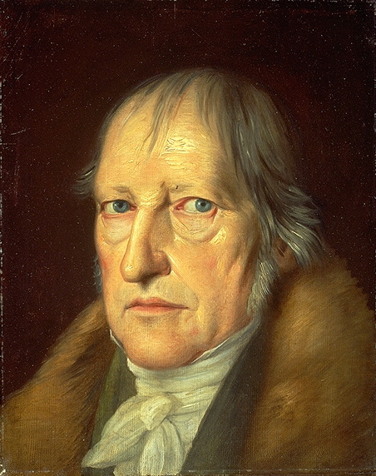
Marx was influence by the Following Philosophers
Georg Wilhelm Friedrich Hegel - German Philosopher, his view was that the world was all embracing the world was all embracing, ever evolving system. Two opposites work together to form a synthesis
Ever Evolving - the past synthesis became the new thesis, which developed into an antithesis and into a new synthesis and so on..

Slide 8
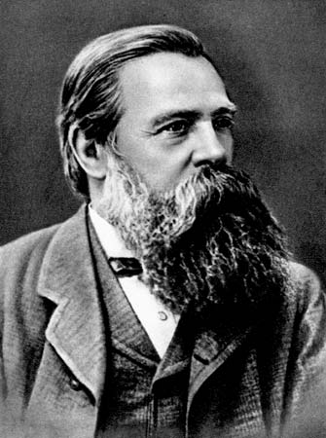
Marx was influence by the Following Philosophers
Friedrich Engels (1820 – 1895), was a German social scientist and a philosopher who and a philosopher, who developed communist theory “The Communist Manifesto” alongside his ” alongside his best known collaborator Karl Marx.

Slide 9
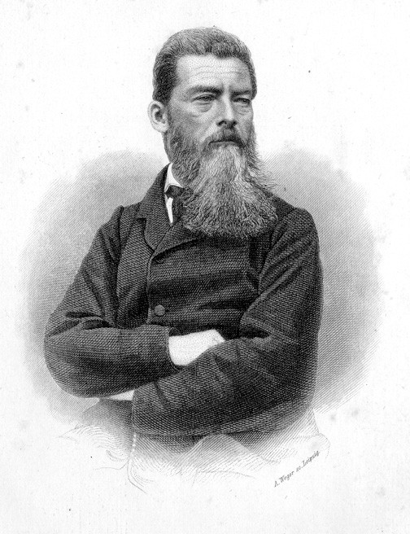
Marx was influence by the Following Philosophers
Ludwig Andreas Von Feuerbach (1804– 1872), German Philosopher and Anthropologist and Anthropologist.
Marx saw in Feuerbach's emphasis on people and human needs a movement toward a movement toward a materialistic interpretation of society.

Slide 10
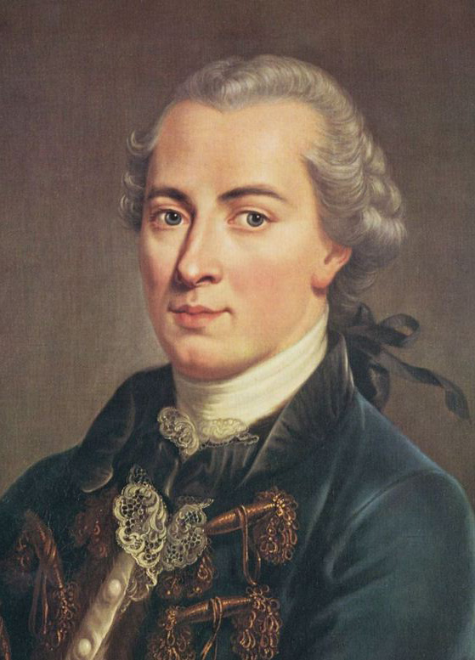
Marx was influence by the Following Philosophers
Immanuel Kant - (1724, 1804), German philosopher, believed to have had the to have had the greatest influence of any philosopher of modern times.
Kantian philosophy was the basis on was the basis on which the structure of Marxism was built.

Slide 11
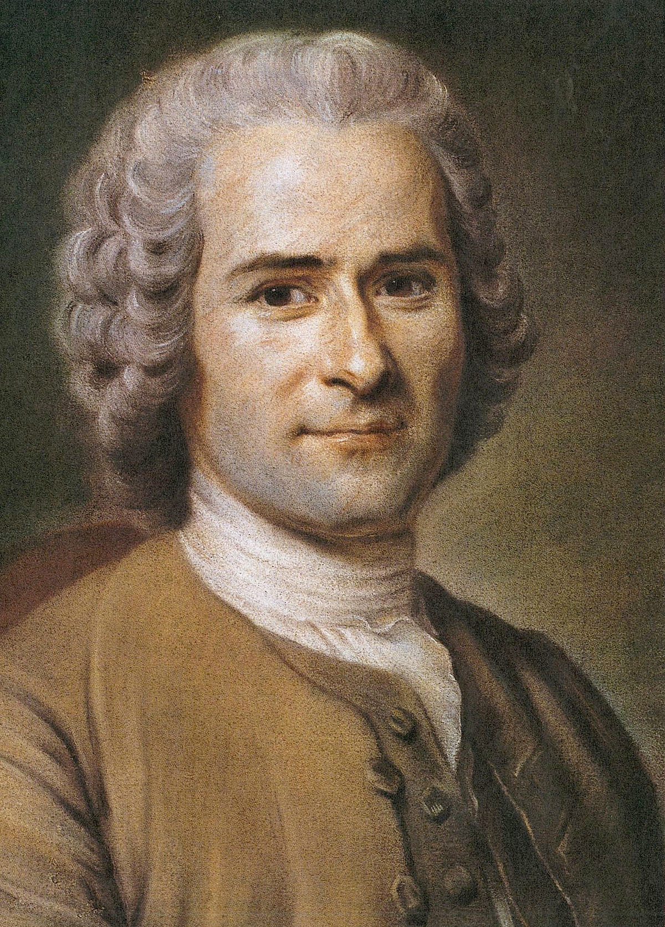
Marx was influence by the Following Philosophers
Jean-Jacques Rousseau - (1712 – 1778), French Philosopher.
Attacked Institutions of private property.
Considered a forbear of Socialism and Communism.
Brought the idea of Egalitarian Brought the idea of Egalitarian Democracy.
Argued that the goal of government should be to secure freedom, equality, and justice for all within the state, regardless of the will of the majority.

Slide 12
Feudalism=>Capitalism=> Socialism =>Communism
Marx- socialism would be achieved through class struggle and proletarian revolution being the transitional stage between capitalism and communism capitalism and communism.
However- Capitalism still holds strong to this day, and is the best way to distribute income within a society.
Why? - has to do with equality of opportunity
Marx said- “from each according to his ability, to each according to his needs”, that in his utopian society that everyone would his or her just desserts.
The phrase summarizes the idea that, under a Communist system, every person shall produce to the best of their ability in accordance their talent, and each person shall receive the fruits of this production in accordance with their need, irrespective of what they have produced.

Slide 13
Communism and Marx
Both advocate The Power of the working class
Making g a living was harder under capitalism
Leisure and culture are stripped from you stripped from you through industrialization of labor
Personal Freedom of Personal Freedom of labor changed.
To the right… a map of countries ran by communist parties at least once in the past

Slide 14
Contributions of Marx theories of Communism
Marx theories of Communism
Production and Society - he believed socialism is inevitable
The class struggle - social organizations have not kept up with the pace of means of production. When they do they can revolt against
Capitalism and have a proletariat revolution. Capitalism and have a proletariat revolution.
Political strategy - Marxism is extremely vague he just states what could be he does not show any evidence or statistical data to prove his points. Capitalism was just growing immensely during this time and spreading across the world, poverty was high too and I think Marx was trying to remind laborers the value of their work, that capitalism feeds off your labor and exploits you in the mean time.
Marx’s overall contribution to economics is Normative!, what should be..

Slide 15
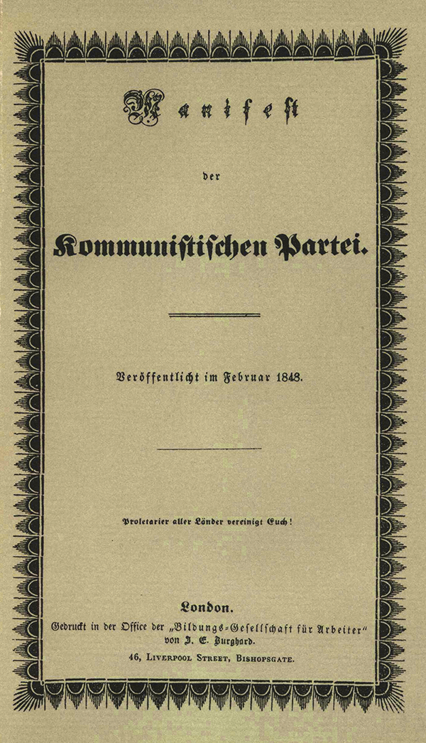
Contributions of Marx’s theories of Communism
The Communist Manifesto The Communist Manifesto by Karl Marx.
First Published February 21st 1848.
One of the worlds most One of the worlds most influential political manuscripts.
Friedrich Engel's mentions in the introduction that this is mostly Marx’s work.
What is this all about?

Slide 16
Contributions - The Communist Manifesto continued
First section- The Bourgeois vs. The Proletariat
Second section - Proletariats and Communism Proletariats and Communism
Third section- Socialist and Communist Literature

Slide 17
10 Planks of Communism According to the Manifesto
1.Abolition of property in land and application of all rents of land to public purposes.
2.A heavy progressive graduated income tax.
3.Abolition of all right of inheritance.
4.Confiscation of the property of all emigrants and rebels.
5.Centralization of credit in the hands of the State, by means of a national bank with State capital and an means of a national bank with State capital and an exclusive monopoly.
6.Centralization of the means of communication and transport in the hands of the State.

Slide 18
Planks continued.
7.Extension of factories and instruments of ; production owned b y the State; the bringing into cultivation of waste-lands, and the improvement of the soil generally in accordance with a common plan. •
8 Equal liability of all to labor Establishment of 8.Equal liability of all to labor. Establishment of industrial armies, especially for agriculture.
9.Combination of agriculture with manufacturing industries; gradual abolition of the distinction between industries; gradual abolition of the distinction between town and country, by a more equable distribution of the population over the country.
10.Free education for all children in public schools. Abolition of children's factory labor in its present form. Combination of education with industrial production,

Slide 19
Contributions Marx and Economics
Very unconventional way of studying economics
If you were to substitute an economist for a philosopher If you were to substitute an economist for a philosopher you would have the basis of his economic approach.
Looked at the economy as a whole and tried to analyze them by figuring out their influence on their components, instead of looking at parts of the economy like households, firms, and prices in markets to explain and understand the economy as a whole.
He applied his theory of history to the society of his time. he searched for contradictions between the forces and relations of production.
These contradictions manifested the class struggle

Slide 20
Contributions - Marx’s Labor Theory Of Value
Marx argued that - the amount of labor time necessary to produce commodities is what governs their relative prices.
To Marx - the only social cost of producing commodities was labor.
He disregarded the differing skills of labor - he called the aggregate amount of labor homogenous quantity, or abstract labor.
Argued how labor was reduced to hourly wage - how labor is measured by hours of time worked for how labor is measured by hours of time worked, for example two different workers one is average one is skilled the skilled can produce twice the amount the average can, therefore each hour the skilled laborer worked counted as two for the average.

Slide 21
Contributions - Surplus and Exploitation
Marx used the labor theory of value to develop this concept. • “Surplus Value”- the difference between the goods price and its cost of production.
Marx’s Message- any economy will produce more goods and services needed to pay the real social costs of production. The residual given from total output – all real costs, is what he calls the surplus value. Similar to net product.
Argued that workers were exploited because the surplus created by labor was taken from the workers because of its lack of ownership in the means of production.
Modern economists argue that exploitation of workers is that Modern economists argue that exploitation of workers is that they are not paid the full value of there marginal product of labor. The large profits that are made from monopolistic firms are thus an exploitation of labor because they are taken from the workers the workers
Marx never accounted for depreciating capital or investment in which firms use profits to expand their output. This actually produces more jobs In the long run.

Slide 22
Contributions - The Reserve Army of The Unemployed
According to Marx- there is always an excess supply of labor in the market. This has an effect of depressing wages, and keeping surplus value, and profits positive.
Capitalist Quest For Machines!- capitalist are always searching for means of production that reduce labor the are capital searching for means of production that reduce labor, they are capital machine hungry. This lowers the amount of human capital needed for production and increases the unemployed.
Marx believed- that the workers displaced by the new technology would not be absorbed into new jobs. He said that indirect recruitment is only from new workers entering the labor force. HE IS WRONG.

Slide 23
Contributions - Falling Rate Of Profit
Marx believed this to be the ultimate collapse of Capitalism.
Followed Smith, Ricardo and Mill who had all predicted that the rate of profit would fall over time. rate of profit would fall over time.
They all come to a similar conclusion that the rate of profit would fall because diminishing returns would offset technological improvements.
Will technological improvements take place in the future at a rate sufficient to offset Diminishing returns from capital accumulation?
Economist have no theory that explains the rate of technological development.
Example of rate of profit Vs. Capital

Slide 24
Contributions – The Origin of Business Crises
Similar to what we call “Depressions.”
Marx did not clearly distinguish among his various insights into Marx did not clearly distinguish among his various insights into the source and nature of economic fluctuations.
Marx attacked say’s law – (says law “that a capitalist economy tends to operate at a level of full employment.”) he said that its an historical view o f capitalism.
Says law implies that there is no basic difference between a barter economy and a capitalist economy and that money is merely g a medium of exchange that facilitates the division of labor and trade.
Marx argues that in a barter economy goods will only be produced for people who want to consume those goods. There can be no over can be no over -production Under capitalism over production. Under capitalism over -production becomes a possibility because of profits and exchange values.
Marx concludes that economic fluctuations can be studied by changes in rates of profit, he says changes in rates of profit will result in changes in investment spending It is the volatility of result in changes in investment spending. It is the volatility of investment spending that is the major cause of these economic fluctuations.

Slide 25
Contributions Cyclically Recurring Cyclically Recurring Fluctuations
Hypothesized - that a burst in technological change could generate a business cycle. The burst would increase capital accumulation and increase demand for labor. The size of the accumulation and increase demand for labor. The size of the reserve army would fall, wages would rise, surplus value would fall, and the rate of profit would decrease. The falling rate of profit would reduce capital accumulation as the economy spirals downward into depression.
According to Marx - depressions were the source of new economic expansion, as output falls the reserve army increases, the pressure of more unemployed will bring down wages and provide greater profit opportunities. These profits will increase capital and this will stimulate the upward part of the cycle again.

Slide 26
Contributions - The Concentration and Centralization of Capital
The reduction of competition is through concentration The reduction of competition is through concentration and centralization of capital, the more capital accumulated by a firm can force other firms out of the market who cannot compete with average total market who cannot compete. i.e. with average total costs.
More concentration and Centralization of capital meant development of economies of scale. meant development of economies of scale.
Marx argued - this was the foundations of growth in monopolies and That through these two forces, fewer and fewer hands would producers in the market.
According to Marx - the growth of the large firm with its monopoly power is merely another contradiction within capitalism between the forces and relations of production that will lead to the ultimate destruction of capitalism.

Slide 27
Contributions - Increasing Misery of the of the Proletariat
Marx believed - that this was another main contradiction in Capitalism that would lead to its collapse.
1st Real income decreases of the mass society decreases with the development of capitalism. History has clearly prove d him wrong!
2nd Proletariats share of national income decreases over time. Real income could increase individually yet relative income would decrease. Also again history has shown in developing countries that wages have constituted a remarkably constant proportion of national income over time. So if this is what Marx meant He Was Wrong Again!.
3rd he argues that the quality of life declines when then are chained to the industrial process According to marx it makes no difference if income of the industrial process. According to marx it makes no difference if income of the proletariat increases or decreases, because “in proportion as capital accumulates, the lot of the laborer, be his payment high or low, must grow worse”
Marx argues that growth of Capital accumulation brings accumulation of Marx argues that growth of Capital accumulation brings accumulation of misery, agony of toil, slavery, ignorance, brutality, and mental degradation.
At this point in time there was no measure of quality of life

Slide 28
Critique - “Practice What You Preach”
Marx’s “Gossip”
Never physically worked a day in his life, he free lanced off of his best friend Engels.
It is alleged that he treated his own maid poorly, paid her very little and got her pregnant and blamed it on his best friend.
Owned stock, which is personally owning capital, so he was going against all his words and selling out to capitalism
Pawned off his last pair of trousers for cigars

Slide 29
Impact - Marx’s Impact
Socially he started a revolution of Marxist thinkers, unions, and rallied workers to stand up for themselves.
A couple of the Planks of the Communist Manifesto are still relevant today things such as progressive are still relevant today, things such as progressive taxes, free public education for children.
Ultimately though Marx has had little economic impact, he has had more of an impact on philosophy then economics.

