Slide 1
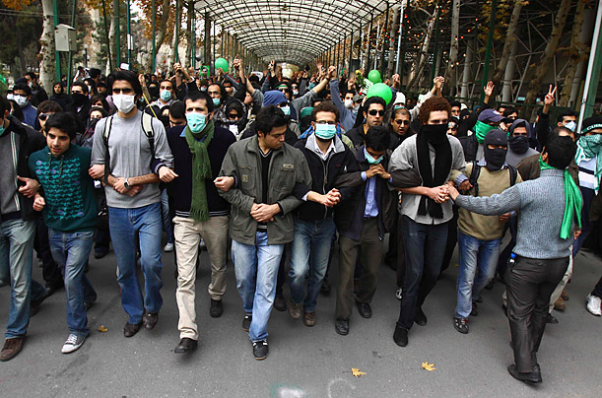
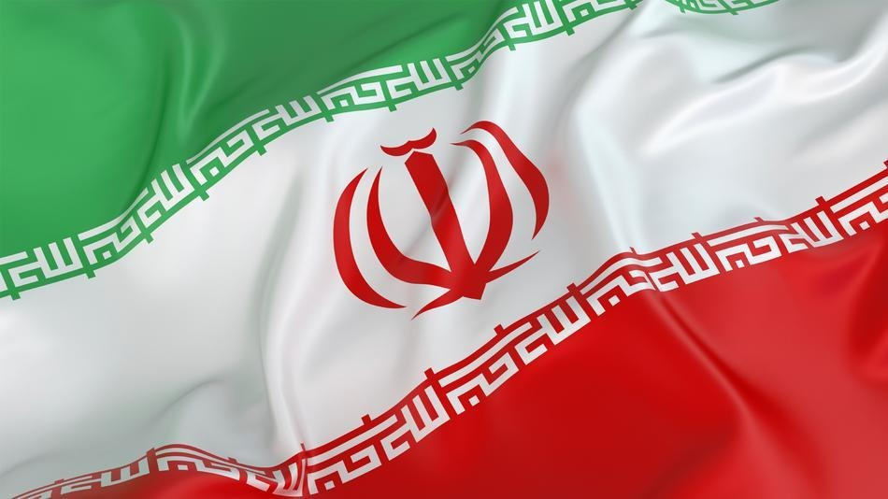
IRAN
Part 3:
Citizens, Society, & the State

Slide 2
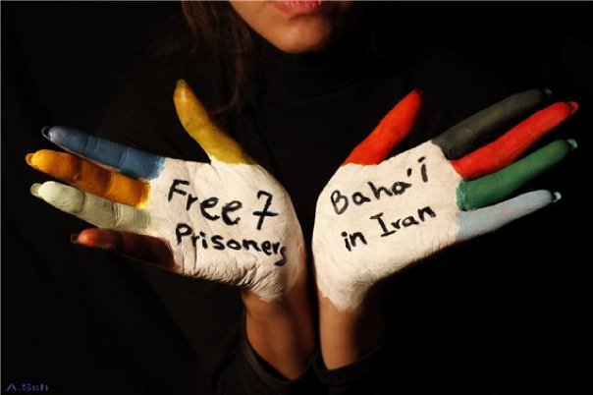
Cleavages
Religion
90% are Shia Muslim
10% are Sunni Muslim
1% = Jews, Christians, Zoroastrian, Ba’hai
Although the constitution recognizes religious minorities (not Sunnis) and protects their rights, many fled the country since the founding of the Islamic Republic in 1979
The Ba’hai faith has suffered persecution
Seen as an unholy offshoot of Islam
Leaders have been executed, imprisoned, tortured
Their schools have been closed and their community property taken by the state
Notes:
Unlike Jews, Christians, and often, Zoroastrians, as well, the Baha'i are not considered People of the Book by Muslims and thus they aren't in the "protected category." The Baha'i in fact are considered Islamic heretics in Iran. Iran, also says the Baha'i are agents of the "notorious" Zionists. They point to the fact that their faith is today headquartered in Haifa and has pretty good relations with the Israelis, so there. There is also the troublesome fact that the Baha'i have no priests and place "the responsibility for spiritual interpretation entirely in the hands of individuals." Ooops, this doesn't fit in real well with a State run by Mullahs and the like...whose "responsibility" is apparently to tell everyone else how to live and what to believe. A report released in March by the Baha'i International Community documented hundreds of incidents of torture, assault, arson, vandalism, abuse of schoolchildren, etc. against Baha'i since 2005 in Iran.
Source: http://oreaddaily.blogspot.com/2013/05/iran-free-bahai-seven-now.html

Slide 3
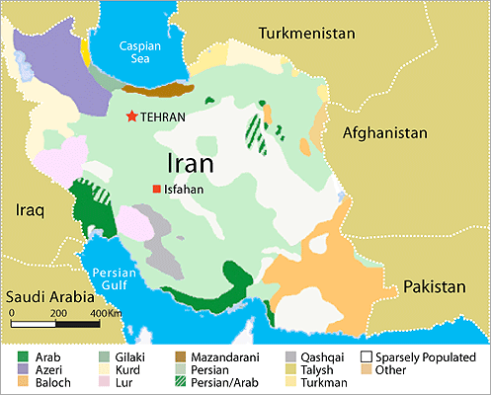
Cleavages
Ethnicity
51% Persian
24% Azeri
8% Gilaki and Mazandarani
7% Kurds; 3% Arabi
Azeris live in NW close to Azerbaijan
Iran worries Azeris will want to form larger state by taking away territory from Iran
Azeris do not speak Persian, BUT are strongly Shiite; (Supreme Leader is Azeri)
Coinciding or Cross-Cutting?
Kurds & Arabs tend to be Sunni Muslim
Coinciding or Cross-Cutting?

Slide 4
Cleavages
Social Class
Peasantry and lower middle class are sources of support for the regime
Partly b/c they have benefitted from the government’s special programs that have provided them with electricity & paved roads
Middle and upper-middle class are largely secularized
Tend to be critical of clerics and their control of society
Reinforced by the fact that many middle class people have not fared well economically since founding of Republic

Slide 5
Cleavages
Reformers v. Conservatives
Conservatives:
Want to keep the regime under control of clerics/sharia law
Reformers:
Want to see more secularization and democracy
Most reformers do NOT want to do away with basic principles of an Islamic state; but vary on how much and where secularization & democracy should be infused into system

Slide 6
Cleavages
Pragmatic Conservatives v. Radical Clerics
Pragmatic Conservatives:
Clergy that favor liberal economic policies that encourage free markets
Radical Clerics:
Call for measures to enhance social justice, esp in terms of providing welfare benefits in Iran’s poor

Slide 7
Civil Society
Suppressed under Pahlavi shahs and still under Republic
Under presidency of Khatami, Iranians experienced some loosening of freedom of speech and press, but didn’t last long
Under Ahmadinejad, gov’t closed down newspapers, banned/censored books & websites and did no tolerate peaceful demonstrations and protests
Currently, some indication of minimal civil society may be found among Iran’s growing number of young people
Many are sons/daughters of disillusioned middle-class professionals; are very attracted to western popular culture

Slide 8
Protests & Demonstrations
1999 – protests erupted in universities all across the country when the gov’t shut down a reformist newspaper
2002 – demonstrations by students when courts ruled a death sentence for a reformist academic
2003 – student mass protests over privatization of university system
2007 – security forces attacked striking bus drivers in Tehran/arrested hundreds
2007 – police beat hundreds of men/women who assembled to commemorate International Women’s Day

Slide 9
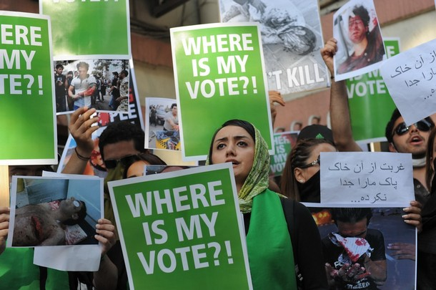
Protests & Demonstrations
The 2009–10 Iranian Election Protests
A series of protests following the 2009 Iranian presidential election against the disputed victory of Iranian President Mahmoud Ahmadinejad and in support of opposition candidates Mir-Hossein Mousavi and Mehdi Karroubi
Called the Green Movement after Mousavi’s campaign colors
Gov’t sent tens of thousands of Revolutionary Guards and Basij to disperse crowds; violence followed; death toll disputed
Ayatollah Khamenei declared that society had been “vaccinated” against these “germs”

Slide 10
Women & the Political System
Granted the right to vote in 1963
First admitted into Iranian universities in 1937
Now account for over half of Iran's university students
Women can run for seats in Majles (about 3%), but are constitutionally barred for the presidency
The constitution states that “the president will be elected from religious-political men, or "rijal," a plural for man in Arabic”
Well represented in some areas: doctors and government employees
But very difficult to get hired – represent 33% of labor force

Slide 11
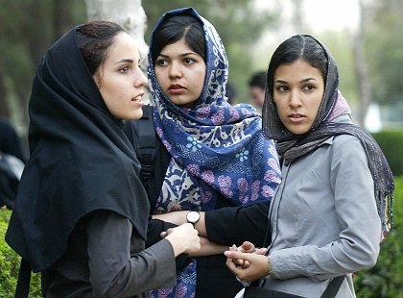
Women & the Political System
The Islamic Republic calls its policy toward women “equality-with-difference”
Means divorce and custody laws follow Islamic standards that favor males
Women must wear scarves and long coats in public
Must wear hijab; “bad hijab” is the exposure of any body part except for the hands or face; Punishable by either 70 lashes or 60 days in prison
Women cannot leave the country without the consent of male relatives
Occasional stoning of women for adultery has taken place, though gov’t recently issued a ban on them
Ban on public discussion of women’s issues in a way that contradicts Islamic law

