Slide 1
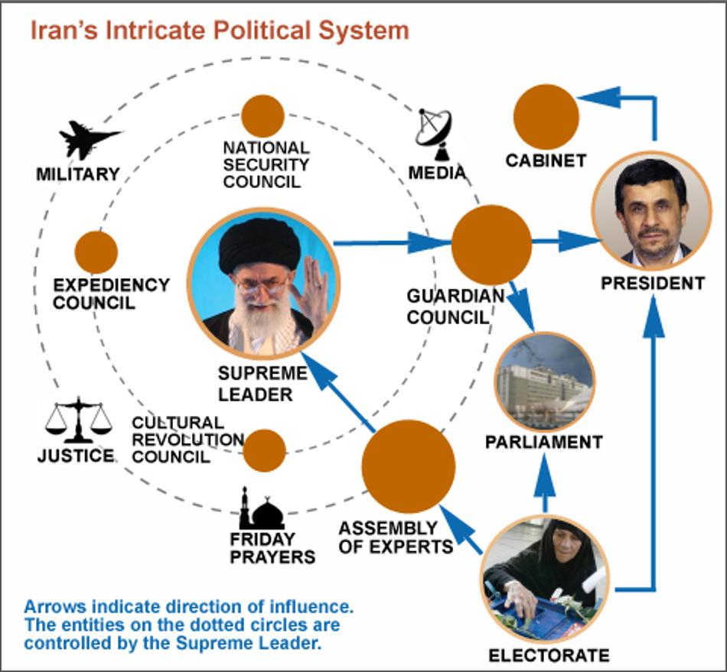
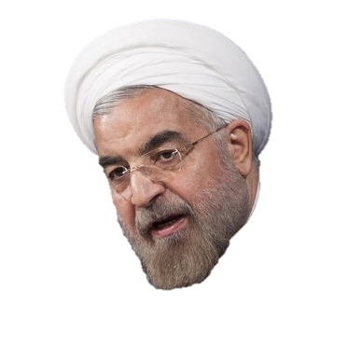
IRAN
Part 2: Governance & Policymaking

Slide 2
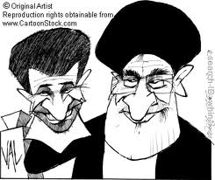
The Basics
Theocratic Republic
Theocracy with democratic elements
Theocratic Institutions:
Supreme Leader
Guardian Council
Assembly of Religious Experts
Expediency Council
Highly Centralized Unitary State
But is divided administratively into provinces, districts, sub-districts, and local areas (local elections allowed since 1999)
Dual Executive (HOS, Supreme Leader; HOG, President)
Unicameral Legislature
Judiciary not independent; Based on Sharia Law
Notes:
Local government elections more democratic

Slide 3
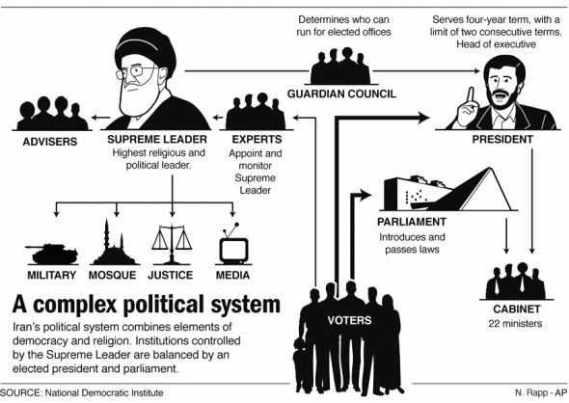

Slide 4
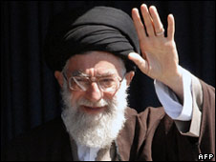
The Supreme Leader (Head of State)
Currently: Ayatollah Ali Khamenei
Most powerful political figure
Chosen by the clerics who make up the Assembly of Experts
Appointed for Life
Expected to act as a trustee of community by supervising politics and ensuring laws conform to Islam
Faqih – leading Islamic jurist to interpret the meaning of religious documents/sharia law
Notes:
1989 change from qualification to be supreme leader of being highest-ranking Shi’ite cleric to whoever was an established member of the clergy
Faqih (Fah-key)

Slide 5
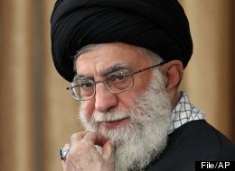
The Supreme Leader
He links 3 branches of gov’t together
Powers:
Limit Presidential candidates
Authority to overrule/dismiss president
Command of armed forces
Declaration of war and peace
Issue decrees for national referenda
Appoint head of judiciary
Appoint half of the members of the Guardian Council
Appoint Friday prayer leaders and the head of radio and TV
Notes:
1989 change from qualification to be supreme leader of being highest-ranking Shi’ite cleric to whoever was an established member of the clergy

Slide 6
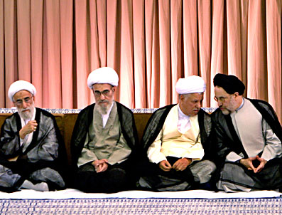
The Guardian Council
12 (all male) member council, serve 6 year terms
6 clerical members appointed by supreme leader
6 lay members (lawyers) recommended by head of judiciary, subject to approval of parliament
Council has power to veto any legislation passed by parliament that is at odds with basic tenants of Islam
Vetting Power
Has right to determine who can run in local, presidential, parliamentary, and Assembly of Religious Experts elections
2012/13: they disqualified thousands of candidates for Majles/Presidential elections
Notes:
6 lawyers vote mainly on question of constitutionality of legislation & clerical members consider the conformity of legislation to Islamic principles
Council operates like an upper house of parliament

Slide 7
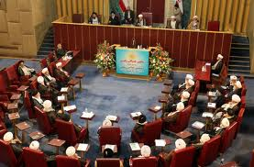
The Assembly of Religious Experts
86 members (no females)
Directly elected by people for 8 year terms
Elects Supreme Leader & has right to dismiss him
Candidates are subject to approval by Guardian Council
Notes:
The Assembly of Experts for the Leadership (Majles-e Khobragan Rahbari) is Iran’s only constitutional body with the authority to appoint and dismiss the supreme leader.
The 86 members are popularly elected every eight years. But candidates, all Islamic scholars and jurists, have been vetted to exclude reformers or critics since 1991.
For all its powers, the assembly has served as a rubber stamp organization that has never seriously questioned the actions of either of the two supreme leaders who have led Iran since the 1979 revolution.
The absence of a real check has allowed the office of leadership, even under Ayatollah Khamenei who began as a relatively weak political and religious figure, to become increasingly powerful.
Government screened; candidates must pass a religious examination
Meets for at least two days twice a year

Slide 8
The Expediency Council
32 members appointed by Supreme Leader
Includes President, chief judge, speaker of the Majles, jurists from Guardian Council
Serve 5 year terms
Designed to settle disputes between Majles and Guardian Council
May originate its own legislation
Why might this be a concern??
Notes:
Collectively the most powerful men in Iran

Slide 9
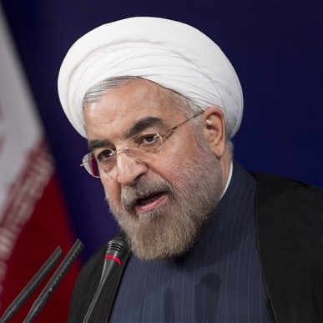
The President
Head of Government
Currently: Hassan Rouhani
4 year term
8-year consecutive term limit
Directly elected by the people
Universal suffrage (18 or older)
Absolute majority of votes
Top two run a week later
Candidates approved by Guardian Council
2005 Election disqualified 1,000 candidates (left only 7 to run)
2009 Election – Accusations/Protests about voter fraud

Slide 10
The President
Qualifications:
Between ages of 25 and 75
“Well-known personality clause” in constitution allows Guardian Council to bar women
“Shi’ite sect” qualification bars Sunni Muslims, Christians, Jews, Zoroastrians and other religious minorities
Historically a cleric, but not Ahmadinejad
Powers:
Selects vice presidents & cabinet members
Devises budget & presents legislation to parliament
Signs treaties, laws & agreements
Chairs National Security Council
Appoints provincial governors, town mayors & ambassadors
Notes:
President must demonstrate “administrative capacity and resourcefulness” and have a “good past record”
Can be overruled, even dismissed, by the Supreme Leader
Has no single vice-president
President may select “presidential deputies” to help with “consitutional duties”
Currently 10 vice presidents
One is designated as the “first vice president”
Others have specific responsibilities, such as presiding over atomic energy or veterans affairs
One is a woman – she has a Phd in geology and is in charge of environmental policy

Slide 11
The Bureaucracy
Headed by President
Grown since the revolution
Dominated by clergy
Most important ministries:
Culture and Islamic Guidance (controls media and enforces “proper conduct” in public life)
Intelligence (replaced shah’s SAVAK)
Heavy Industries (manages nationalized factories)
Reconstruction (expands social services and takes “true Islam” to countryside)

Slide 12
The Legislature/Majles
290 deputies, 4 year terms, SMD
Five guaranteed seats for recognized religious minorities: Christians, Jews, and Zoroastrians
Nonrecognized religious minorities (e.g., Baha’is) cannot run
Direct Elections
Elections held on a nonpartisan basis (ballots do not have party identification or philosophy)
28 multimember districts (based on population size)
Two round voting:
Candidate must receive at least 25% on first ballot
If more candidates clear this threshold to fill a district’s seats: second round held several months later for top two candidates with the most support
Notes:
Campaign period only one week long
Campaign literature 4 by 6 inches maximum
37% drop in clerics elected to Majles between 1980 and 2000

Slide 13
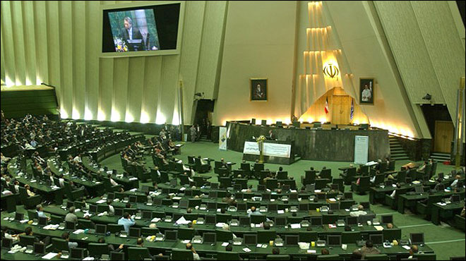
The Legislature/Majles
Qualifications
Candidates submit their names to subcommittee of Guardian Council, which determines who can run
Age 30-75
Those running for first time must have equivalent of university degree
Notes:
Guardian Council:
In 1992 and 1996, kept 1/3 off ballot
In 2000, kept only 11% off the ballot
In 2004, almost 3,000 kept off ballot
Qualifications:
Must have a “belief in and commitment in practice to Islam and the sacred system of the Islamic Republic of Iran”

Slide 14
The Legislature/Majles
NOT a rubber-stamp institution
Powers
Enact/Change laws (with approval of Guardian Council)
Appoint 6 of 12 members of Guardian Council, chosen from a list drawn up by chief judge
Investigate cabinet ministers and public complaints against executive and judiciary
Remove cabinet members (not president)
Approve budget, cabinet appointments, treaties & loans

Slide 15
The Judiciary
Based on Sharia (Islamic) Law – supersedes all other
Qanun – law passed by the Majles – may not contradict Sharia Law
Not independent
Supreme leader appoints head of judiciary who appoints senior judges
Penal Code (Retribution Law)—very strict/harsh
Stoning, death penalty for many “crimes” (adultery, homosexuality, habitual drinking)
Evidence of one male Muslim = evidence of two female Muslims
Modernized penalties, but high rate of executions
Notes:
Regime gradually has broadened interpretation of the sharia. Adopted modern method of punishment – imprisonment – rather than traditional corporal public punishment
Although those found guilty of serious crimes, esp murder, armed violence, terrorism, and drug smuggling were often hanged.
Iran, after China, has the highest number of executions per year & highest per capita in the world

Slide 16
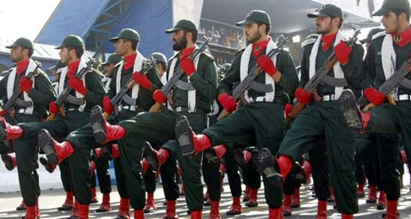
The Military
Regular army of 370,000
According to Constitution, regular army defends the borders, while the Revolutionary Guards protect the republic
Revolutionary Guards (est after 1979)
125,000 active troops, commanders appointed by Supreme Leader
Has its own ground forces, navy and air force, and oversees Iran's strategic weapons.
Controls the volunteer paramilitary Basij Resistance Force
Control around a third of Iran's economy through a series of subsidiaries and trusts

Slide 17
Bonyads (Charitable Foundations)
Autonomous (directed by clerics/appointed by Supreme Leader) tax exempt charity organizations that control large amounts of money
Foundation for the Oppressed & Disabled
Martyrs Foundation
Most supervise property and state owned businesses
After the Revolution, they were nationalized
Supposed to redistribute income to poor and families of martyrs (i.e. those killed in the service of the country)
Over 100; Monopolize many sectors of the economy (e.g., cement, sugar)
Patronage-oriented holding companies that ensure the channeling of revenues to groups and milieus supporting the regime

Slide 18
Linkage Institutions – Political Parties
Constitution gives citizens the right to organize/assemble
Constitution allows political parties, but they did not emerge until after 1997 election of Khatami
Weak parties have formed – organized around personalities
Parties are unstable & change from election to election
Two major coalitions: Conservative vs Reformist
Parties led by former dissidents (leaders are in exile)

Slide 19
Linkage Institutions – Interest Groups
Very weak
Workers House – one of the few prominent interest groups in Iran
Factory workers
Reform minded
Few business interest groups have formed – the Iranian government controls between 65%-80% of the economy

Slide 20
Linkage Institutions – Mass Media
Speech against the government was a criminal offense after the 1979 revolution
Some of these have been lifted over time
Still a major issue between conservatives & reformers (in terms of access to media/what info is shared by media, etc)
Major radio and TV is gov’t-run by the Islamic Republic of Iran Broadcasting
Some newspapers and magazines are privately owned
Most are non-political (more scholarly)
All publications must have licenses from gov’t – can be revoked at any time; every website must be registered
Since 2010, the gov’t has been building a national network as a substitute for the Internet
Social Media sites from outside of Iran are normally not accessible

Slide 21
Review
Discussion Question: What elements of Iran’s political system make it theocratic? Which elements make it democratic?
Theocratic
Democratic

