Slide 1
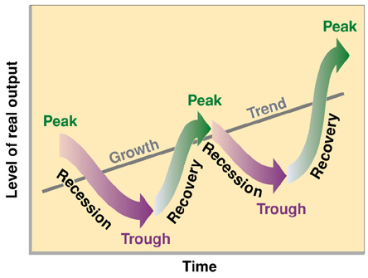
Business Cycle
Is the economy getting better or worse?

Slide 2
Micro vs. Macro
Microeconomics: The study of personal, or small finances.
Individuals, families or businesses
Macroeconomics: The study of economic systems on a large scale
National or Global economies

Slide 3
Gross Domestic Product
Def. The total value, in dollars, of all final goods and services produced within the nation each year
Abbreviated as the GDP

Slide 4
What does the GDP tell us?
If the GDP is larger than last year the economy is expanding (getting bigger)
If the GDP is smaller, the economy is shrinking (getting smaller)

Slide 5
Business Cycle
The Business Cycle allows people to understand the direction the economy (GDP) is going (growing or shrinking) and plan accordingly.
The economy follows the Business Cycle regularly.

Slide 6
Phases of the Business Cycle
Expansion (Growing)
Peak (Top)
Contraction (Shrinking)
Trough (Bottom)

Slide 7
Business Cycle
Peak
Peak
Expansion
Contraction
Contraction
Expansion
Trough

Slide 8
Expansion
During a period of expansion:
Wages increase
Low unemployment
People are optimistic and spending money
High demand for goods
Businesses start
Easy to get a bank loan
Businesses make profits and stock prices increase

Slide 9
Peak
When the economic cycle peaks:
The economy stops growing (reached the top)
GDP reaches maximum
Businesses can’t produce any more or hire more people
Cycle begins to contract

Slide 10
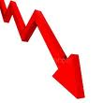
Contraction
During a period of contraction:
Businesses cut back production and layoff people
Unemployment increases
Number of jobs decline
People are pessimistic (negative) and stop spending money
Banks stop lending money

Slide 11
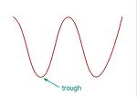
Trough
When the economic cycle reaches a trough:
Economy “bottoms-out” (reaches lowest point)
High unemployment and low spending
Stock prices drop
But, when we hit bottom, no where to go but up!
UNLESS….

Slide 12
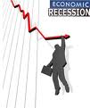
Recession/Depression
A prolonged contraction is called a recession (contraction for over 6 months)
A recession of more than one year is called a depression

Slide 13
What keeps the Business Cycle Going?
4 variables cause changes in the Business Cycle:
Business Investment
When the economy is expanding, sales and profit keep rising, so companies invest in new plants and equipment, creating new jobs and more expansion. In contraction, the opposite is true

Slide 14
What Keeps the Business Cycle Going?
Interest Rates and Credit
Low interest rates, companies make new investments, adding jobs. When interest rates climb, investment dries up and less job growth
Consumer Expectations
Forecasts of an expanding economy fuels more spending, while fear of a recession decreases consumer spending

Slide 15
What keeps the Business Cycle Going?
External Shocks
External Shocks, such as disruptions of the oil supply, wars, or natural disasters greatly influence the output of the economy
Ex. 1992-2000 was the longest period of expansion in U.S. history. Early in 2001, signs of contraction appeared, though the Bush administration denied it. The Sept. 11th 2001 terrorist attacks quickly caused the business cycle to shift into a contraction.

Slide 16
Who Cares?????
Why should you care about the business cycle and economy?
Lots of reasons!

Slide 17
“Don’t quit that job!”
If the economy is going into a contraction, jobs will become more scarce. If you quit, you may not find another job!
But, if the economy is in a period of expansion, jobs are readily available. It may be a good time to switch careers.

Slide 18
“Should I make a big purchase?”
Only if you know that you won’t lose your job in a contraction. So, buy your house during an expansion.
HOWEVER,
When the economy starts to slow down (contraction), interest rates will decrease. Wait to buy a house until the rates drop to a low point, if you are sure you won’t lose your job.

Slide 19
Quick Review!
What phase of the business cycle do wages go up?
Expansion
What phase of the business cycle do wages go down?
Contraction

Slide 20
Review cont.
When are wages at their highest?
Peak
When are wages at their lowest?
Trough

Slide 21
More Review
When will borrowing decrease?
Contraction
When will borrowing increase?
Expansion
When will borrowing be at it’s lowest?
Trough

Slide 22
Even More Review!
When will unemployment be at its lowest?
Peak
When will business profits be the highest?
Peak
When should you look for a new job?
Expansion

