Slide 1
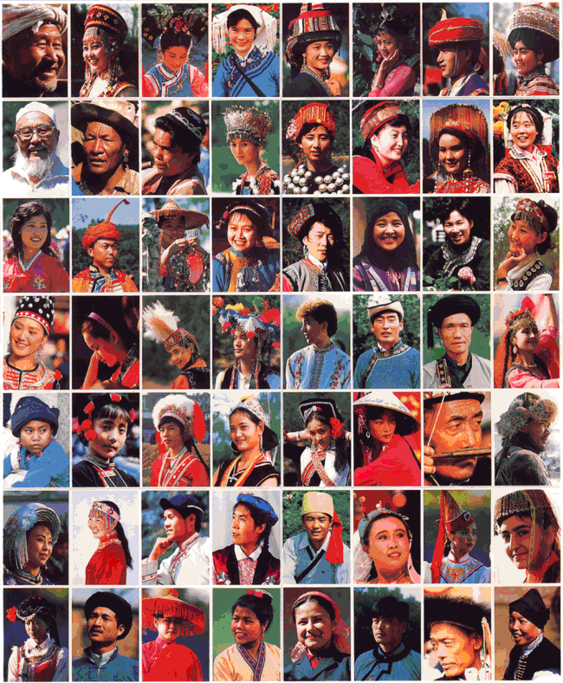
CHINA
It’s all about NOT challenging the Party/State!
Part 3: Citizens, Society & the State

Slide 2
Cleavages - Ethnic
Ethnic population is primarily Han Chinese (92%)
Minority ethnic groups = 8% of pop (abt 100 million citizens)
55 officially recognized minority groups
Most live on/near borders with other countries
Most live autonomous regions
Govt policy: encourage economic development/suppress dissent
Tibetans/Dalai Lama
(see student presentation)
Uyghurs
Muslims of Turkish descent living in Xinjiang
Militants want separate Islamic state
Notes:
Minority Ethnic Groups
Most are in 5 autonomous regions: Guangxi, Inner Mongolia, Ningxia, Tibet, and Xingjiang
No one minority group is very large
Most of their areas are sparsely populated BUT they occupy about 60% of total land area of PRC
Some autonomous regions are resource rich
Because dissidents are a long way from areas of dense population, China is worried that they may encourage independence, or join with neighboring countries
Some autonomy in cultural matters: use of minority languages in media/literature, bilingual education, minority religions (through state approved organizations)
Tibetans:
Under Chinese military occupation since early 1950s
Former gov’t of Tibet never recognized Chinese authority
Practice a unique form of Buddhism – most fiercely loya to Dalai Lama, priest believed to be the incarnation of the divine being
1959 Dalai Lama fled to exile in India following a failed rebellion by his followers
Mao – suppressed Tibetan culture
Since late 1970s – Buddhist temples/monasteries have been allowed to reopen; more cultural freedom
BUT Chinese troops have crushed several anti-China demonstrations
Tensions exploded in 2008 in the run-up to the Olympic Games in Beijing. Clashes between anti-Chinese protesters and security forces began in the Tibet's capital, Lhasa, and spread to Tibetan communities elsewhere in China.
Beijing said 19 people were killed in the rioting, while Tibetan exile groups said nearly 100 people had been killed by security forces
Uyghurs
Live in Xinjiang, very close to borders with Afghanistan and Pakistan
Their language is related to Turkish and they regard themselves as culturally and ethnically closer to Central Asia than the rest of China
In recent decades there has been increasing Han Chinese migration to the region and many Uighurs complain of discrimination. Han Chinese make up roughly 40% of Xinjiang's population, while about 45% are Uighurs.
In 2010 riots and fighting between Uyghurs and Han
150 deaths, 1,000 injuries, 1500 people arrested (almost all Uyghurs) – 12 sentenced to death
Militants want to create a separate Islamic state of “East Turkestan” – use violence, including bombings and assassinations
More information can be found at:
http://news.bbc.co.uk/2/hi/asia-pacific/8136043.stm

Slide 3
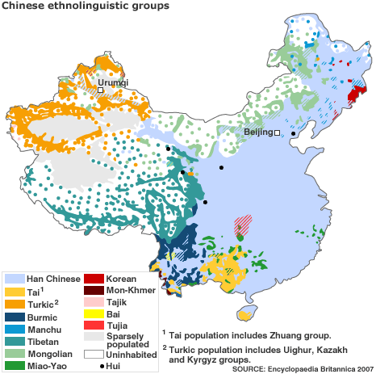
Notes:
Shared written language for centuries
Since its inception, Communist regime has tried to make Mandarin the official language of govt and education
2006 China stepped up its repression of Cantonese, a language which, in its various forms, is native to abt 100 mil people
Rules required most people in the public sector, including teachers/broadcast media, to use Mandarin when addressing public

Slide 4
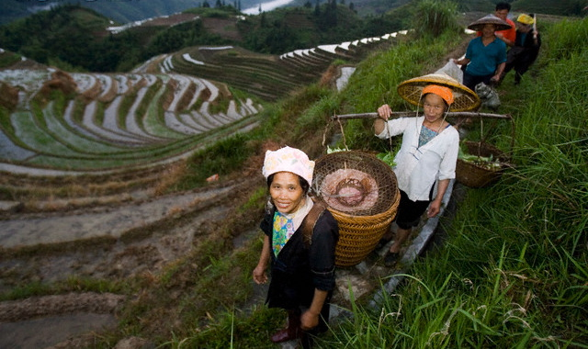
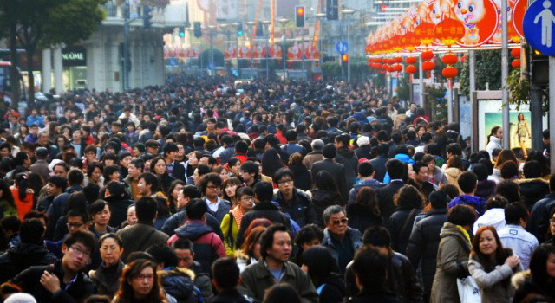
Cleavages – Urban/Rural
Economic growth has led to “Two Chinas”
Urban (52.6% of pop, higher incomes, education, social class)
2011 – 1st time urban population was great than rural population
Increasing inequality
Notes:
Rate of urbanization: 2.3% annual rate of change (2010-15 est.)
2006 Wen Jiabo introduced “a new socialist countryside” program to increase govt funding to lift the lagging rural economy
JAN 2012 – Update: http://www.bloomberg.com/news/2012-01-17/china-urban-population-exceeds-rural.html
China’s urban population surpassed that of rural areas for the first time in the country’s history after three decades of economic development encouraged farmers to seek better living standards in towns and cities.
The world’s most-populous nation had 690.79 million people living in urban areas at the end of 2011, compared with 656.56 million in the countryside, the National Bureau of Statistics said today in Beijing. That puts the number of people residing in China’s towns and cities at double the total U.S. population.

Slide 5
Cleavages – Urban/Rural Facts
China only had 172 million urban residents in 1978 (when Deng Xiaoping started economic reform). By 2006, this number mushroomed to 577 million urbanites.
Between 1990 and 2005, an estimated 103 million Chinese people migrated from rural to urban areas.
By 2015, China’s urban population is expected to exceed 700 million
In 2010, China’s rural per capita net income ($758 a year) was less than a third of its urban equivalent—the worst showing since China’s market reforms began in 1978
Nearly 500 million Chinese people live on less than $2 a day.
85% of China’s poor live in rural areas, with about 66% concentrated in the country’s west
Almost half of China’s population lives in rural areas…but they share less than 12% of the country’s wealth.
China’s poverty among ethnic minorities is two to three times higher than among the Han Chinese
China currently has about 145 million migrant workers (or about 11 percent of China’s total population in 2010)…larger than the entire workforce of the United States.
225 million rural-born migrant workers—one fifth of China’s population—work in urban areas but are denied benefits enjoyed by city dwellers, which has resulted in “a metastasizing underclass of rural migrants living as second-class citizens in China’s cities…the divide has sparked anger among the rural poor.”
Notes:
Rate of urbanization: 2.3% annual rate of change (2010-15 est.)
China only had 172 million urban residents in 1978 (when Deng Xiaoping started economic reform). By 2006, this number mushroomed to 577 million urbanites.
Between 1990 and 2005, an estimated 103 million Chinese people migrated from rural to urban areas.
By 2015, China’s urban population is expected to exceed 700 million…marking the first time China’s urban population will surpass its rural population.
In 2010, China’s rural per capita net income ($758 a year) was less than a third of its urban equivalent—the worst showing since China’s market reforms began in 1978
Nearly 500 million Chinese people live on less than $2 a day.
85% of China’s poor live in rural areas, with about 66% concentrated in the country’s west
Over half of China’s population lives in rural areas…but they share less than 12% of the country’s wealth.
China’s poverty among ethnic minorities is two to three times higher than among the Han Chinese
China currently has about 145 million migrant workers (or about 11 percent of China’s total population in 2010)…larger than the entire workforce of the United States.
225 million rural-born migrant workers—one fifth of China’s population—work in urban areas but are denied benefits enjoyed by city dwellers, which has resulted in “a metastasizing underclass of rural migrants living as second-class citizens in China’s cities…the divide has sparked anger among the rural poor.”

Slide 6
Political Participation
Discussion Question: Describe three different forms of political participation in authoritarian systems.

Slide 7
Political Participation
Discussion Question: Describe three different forms of political participation in authoritarian systems.
Joining political parties, standing for office
Voting
Protests/demonstrations
Civil disobedience
Coups d’etat, revolutions, political violence
Joining interest groups, NGOs, Citizens policy meetings (mass line)

Slide 8
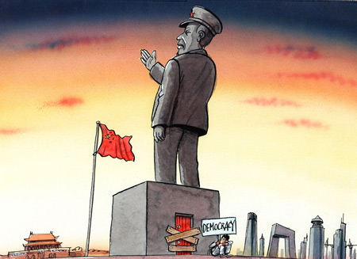
Political Participation – Political Parties
CCP and Participation
Largest political party in world
Only 8% of citizens age 18+ are members
2001 – capitalists allowed to become members
CCP’s Youth League
More than 75 million members
CCP allows existence of eight “democratic” parties
Each party has special group it draws from (intellectuals, etc)
Tightly controlled by CCP
Advisory role only
Notes:
The eight parties of the United Front, which are also known as "democratic parties" include:
The China Revolutionary Committee of the Kuomingtang
The China Democratic League
The China Democratic National Construction Association
The China Association for the Promotion of Democracy
The Chinese Peasants and Workers Party
The China Zhi Gong Party
The Jiu San Society
The Taiwan Democratic Self Government League
These parties are overseen by the United Front Work Department, which is in turn overseen by part of the CPC.
None of these entities has real power apart from the CPC, and many United Front members are also CPC members.
Each party is associated with a certain interest. For example, the Jiu San Society tends to focus on scientific development, while the China Democratic League focuses on modernization and democracy and the China Zhi Gong Party works to protect the interests of Chinese living overseas, among other things.
The United Front also includes the All-China Federation of Industry and Commerce (ACFIC), which provides the government with input on business matters.

Slide 9
Political Participation – Elections
PRC holds elections to legitimize govt and CCP
Party controls the commissions that run elections and approves lists of candidates
Direct elections held at the local level only
Voters choose deputies to serve on county people’s congresses
Since 1980s CCP has allowed more than one candidate to run for county positions
Move toward democracy at village level
Local officials are no longer appointed from above, but are chosen in direct, secret ballot elections
Notes:
Village CCP committee closely monitors grass-roots elections.
In many cases, the local Communist Party leader has been chosen to serve simultaneously as the village head in a competitive election

Slide 10
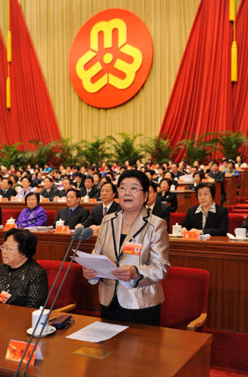
Political Participation – Interest Groups & Social Control
Organized interest groups/social movements are not permitted unless under party-state authority
State corporatism
Party-state forms mass organizations
People express view within strict limits
Form around occupations and social categories
Ex: Most factory workers belong to the All-China Federation of Trade Unions; Women’s interests represented in All-China’s Women’s Federation
Urban areas party maintains social control through danwei
Social units based on person’s place of work
Notes:
Truly independent interest groups and social movements are not permitted to influence the political process in the PRC in any significant way.
Mass Organizations:
Def: Organizations in a communist party-state that represent the interest of a particular social group, such as workers or women but which are controlled by the communist party
Examples of Interest Groups:
Most factory workers belong to the All-China Federation of Trade Unions
All women’s interests are represented in All-China Women’s Federation
Danwei
People depend on units for jobs, income, promotion, medical care, housing, daycare centers and recreational facilities

Slide 11
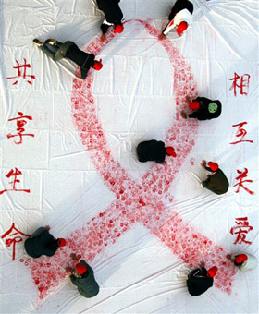
Political Participation – Civil Society
Non-existent under Mao
Private organizations growing in recent years
Focus on social issues that do not directly challenge authority of state
1990s NGOs could register with govt
China has thousands (ping pong clubs, environmentalist groups)
Christianity and Buddhism rebounding
Govt keeps close control on these groups
Esp Falun Gong (see student presentation)
Notes:
NGOs are less directly subordinate to the CCP than official mass organizations
Variety of local and national NGOs
Deal with environment, health, charitable work, and legal issues
Must register with gov’t, but have latitude to operate without direct party interference IF they steer clear of politics and do not challenge official policies

Slide 12
Political Participation – Protests
Few since 1989 Tiananmen massacre
Falon Gong (see student presentation)
Labor unrest
Mostly at village level
Protests in Autonomous Regions:
Tibet
Riots/demonstrations in Lhasa in March 2008 (49th anniversary of failed uprising against China in 1959); Continued with 2008 Olympics
Xinjiang
2009 – riots sparked by Uyghur dissatisfaction with Chinese gov’t handling of the deaths of 2 Uyghur workers during previous disruptions
Notes:
Falun Gong
Authorities have destroyed FLG books
Xinjiang: (NW China)
President Hu Jintao left the G8 summit to return to China to give his full attention to the violence
Police tried to stop rioters with tear gas, water hoses, roadblocks, and armored vehicles
Internet services were shut down/cell phone service was restricted
Media reported death toll was 197; hundreds more hospitalized

Slide 13
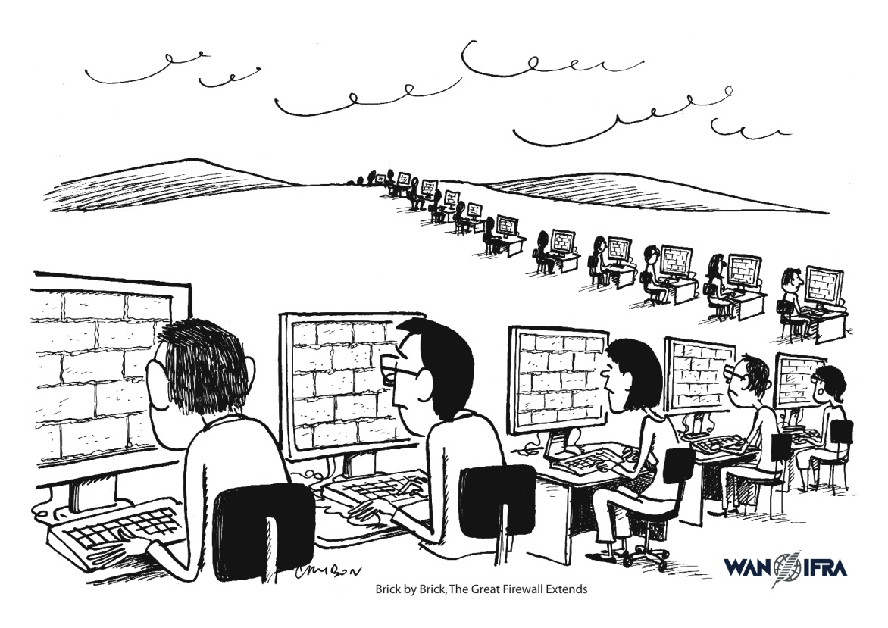
Media
Most are state-run and controlled
Some independent media today
Investigative reporting has had the most growth –but in limited scope – ex. Corruption
Xinhua is the official state press agency
All are subject to heave censorship by the state
Internet is strictly controlled
Notes:
Internet – most aggressive firewall in the world

