Slide 1
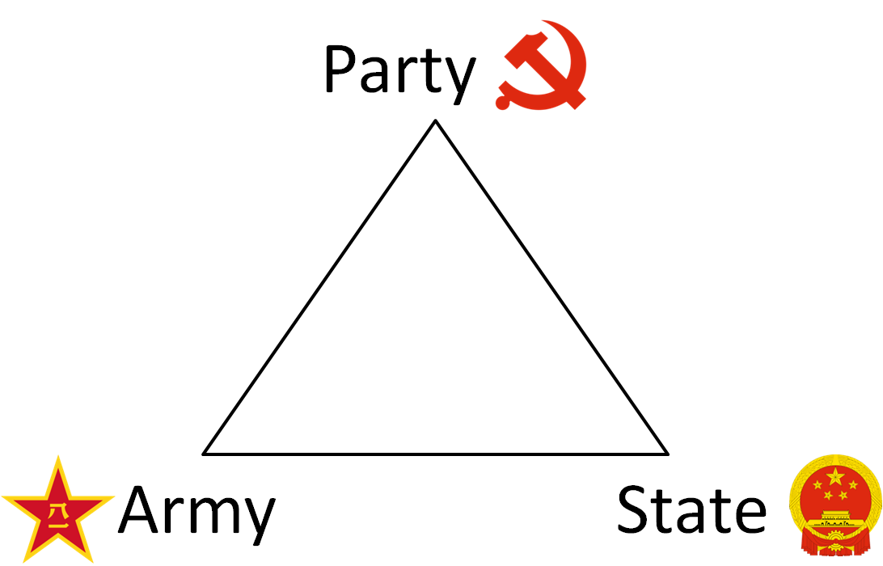
CHINA
It’s all about the PARTY!
Part 2: Political Institutions

Slide 2
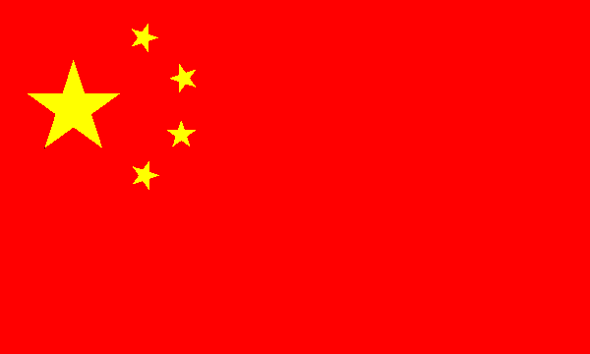
The Basics
Authoritarian/ Single Party Communist Rule
Officially “A socialist state under the people’s democratic dictatorship”
Unitary
Electoral System: N/A Controlled by CCP
Constitution: Established in 1982
Current Head of Party and State: President Xi Jinping
Head of Government: Premier Li Kequiang
Legislature: Unicameral (Rubber Stamp)
Judiciary: Not independent, no judicial review
Notes:
V.P. Li Yuanchao - pronounced:Lee Yoo-ahn-chow (as in how)

Slide 3
Parallel Hierarchies
The political structure of the People’s Republic of China can best be seen as 3 parallel hierarchies:
The Communist Party
The state or government
The People’s Liberation Army (PLA)
Separate but interact
The CCP dominates

Slide 4
Three Political Structures
Military
Communist Party
The State/Government
General Secretary
Standing Committee
Politburo
President/VP
Premier (PM)
Central Military
Commission
State Council
Ministry of State Security
Ministry of Public
Security, People’s Armed
Police
Central Committee
Central Govt
Ministries, Bureaus
National Party
Congress
National People’s
Congress
Provincial Party
Congresses/Committees
Provincial People’s
Congresses
Local Level Party
Organizations
Local Level
People’s Congresses
Primary Party
Organizations
Village Councils
Notes:
http://www.npc.gov.cn/englishnpc/news/index.htm
http://www.china.org.cn/english/congress/225438.htm

Slide 5
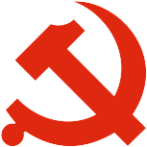
The Chinese Communist Party - CCP
Democratic Centralism
Society is best led by an elite vanguard party with a superior understanding of the Chinese people and their needs
Hierarchical structure
Village/township
County
Province
Nation
Head of the party is General Secretary
Notes:
Head of the Party called “Chairman” under Mao –title abandoned after Mao’s death

Slide 6
The Chinese Communist Party - CCP
National Party Congress
More than 2000 delegates
Meets every 5 years
Rubberstamps decisions made by party leaders
Elects members of Central Committee
Central Committee
About 340 members
Elected for 5 year term by National Party Congress
Secret ballot/candidates limited
Meets annually (plenums)
Carries out business of National Party Congress between sessions
Notes:
National Party Congress
Essential function is to approve decisions already made by the top leaders and to provide a showcase for the party’s current policies
Little debate
Does not serve as a “check” on party’s executive
Central Committee
Meets annually for about a week

Slide 7
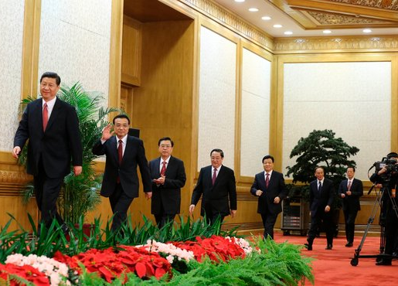
The Chinese Communist Party - CCP
Politburo
Chosen by Central Committee
Dictates government policies
Meets in secret
About 25 members
Standing Committee
Most powerful political organization in China!
Elite of the elite (7 members), chosen by Politburo
Membership is mirror of faction influence
General Secretary is chosen from the Standing Committee
Head of the CCP
Recent Secretaries have been educated (technocrats)
Notes:
Politburo
Political Bureau
Formally elected by the Central Committee from among its own members under carefully controlled and secretive conditions
Top leaders work/live in a huge walled compound on lakes in the center of Beijing.
Heavily guarded but has no identifying signs – not identified on public maps

Slide 8
Factionalism
Guanxi (“connections”)
Chinese term that means “connections” or “relationships”
Describes personal ties between individuals based on such things as common birthplace or mutual acquaintances
Key to getting things done (cut red tape), but can feed corruption
Factions
Conservatives (hard-liners)
Reformers/open door
Liberals (out of power since 1989)
Princelings: aristocracy of families with revolutionary credentials from days of Mao (Xi Jingping)
Shanghai Gang – associates of former leader Jiang Zemin - emphasis on guanxi
Chinese Communist Youth League (Hu Jintao)
Notes:
Guanxi
Like “good old boys networks” in the west
Show importance of personal career ties among individuals as they rise in bureaucratic/political structures
Based on ideological differences/similarities – source of factions within the party
Also pervasive at local level, where ordinary people link up with village leaders and lower party officials
Factions:
Conservatives – wants to preserve power of the party and central govt
Reformers- supports major capitalist infusion in PRC’s economy and open door trade policy (pushed for membership in WTO and courted US to grant “most-favored trading status” to China)
Liberals: (been out of power since 1989) – more accepting of political liberties/dem movements. Support economic and political reform
Princelings: many new leaders come from this class – aristocracy of families with revolutionary credentials from days of Mao. Use their political connections and western education to build lucrative business careers
5/7 of Standing Committee from Shanghai Gang, 2 Princelings

Slide 9
Conclusion
Discussion Question: Why is the possibility for corruption great under the PRC’s system of governing?

Slide 10
Conclusion
Discussion Question: Why is the possibility for corruption great under the PRC’s system of governing?
Lack of transparency (secret ballots/meetings)
Lack of accountability (no checks on PRC’s power)
Existence of guanxi

Slide 11
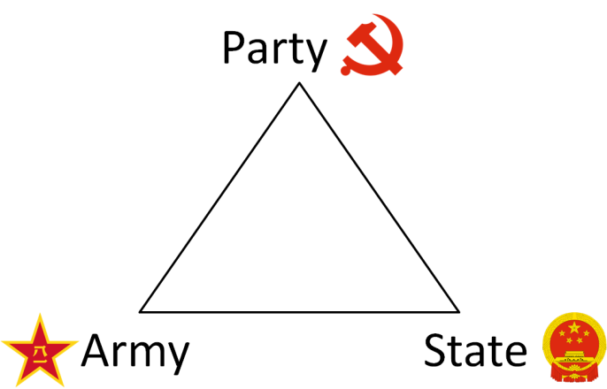
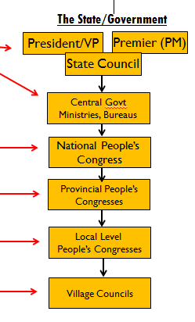
The State/Government
3 branches BUT all branches controlled by party
Not independent
No checks/balances

Slide 12
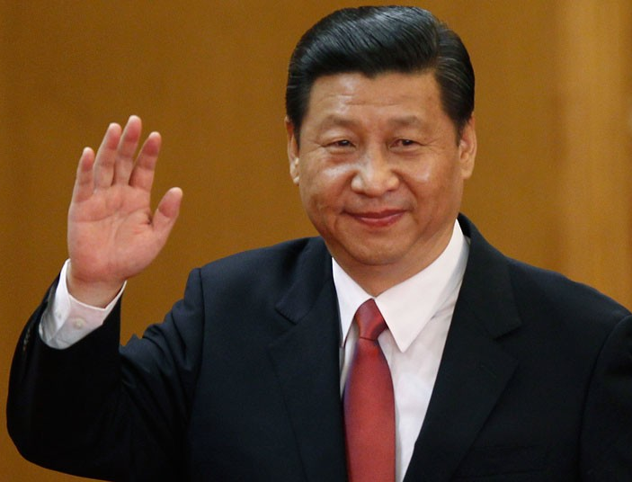
The Executive
Head of State
President
Serve 5 year terms, limited to 2
At least 45 years old (same for VP)
Senior Party Leaders
Recently General Secretary and President are the SAME
Head of Government (Le Keqiang)
Premier (like a PM)
Formally appointed by Pres, but always from Standing Committee
Directs the State Council (like a cabinet)
Made up of ministers who direct bureaucracy
Notes:
V.P. Li Yuanchao - pronounced:Lee Yoo-ahn-chow (as in how)
In recent years, position of VP has been to be “groomed” for party leadership.
Premier Le Keqiang (Lee Kee-kang)
In 2002, then-President Jiang Zemin tried to clear the ranks at the top of the party by instituting retirement age limits: 68 for top leaders and 65 for senior level officials.

Slide 13
The Bureaucracy
Exists on all levels
Immense in size and scope
Made up of cadres – 30 million!
Person who exercises a position of authority in communist govt
May or may not be Party members
Most must now retire between ages of 60-70
China recruits leaders through Cadre List (nomenklatura)
System of choosing cadres from lower levels of party hierarchy for advancement based on their loyalty/contributions to party
Dual Role
Bureaucracy is supervised by higher bodies in govt and comparable bodies in CCP
Notes:
Cadres
30 million cadres in China
The cadre list covers millions of important positions in govt and elsewhere (universities, banks, trade unions, newspapers)
Any personnel decision involving an appointment, promotion, transfer or dismissal that affects a position on this list must be approved by a party organization dept, whether or not the person involved is a party member

Slide 14
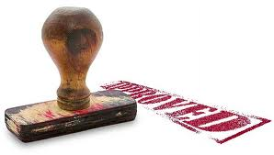
The Legislature
National People’s Congress
“Formal” authority of government to rule on people’s behalf
Meets once a year in March for two weeks
3,000 members – “deputies”, 5 year terms
Chosen from lower people’s congresses
Chooses President/VP – but only one candidate for each
Has little power, but announces Politburo’s policies
Notes:
National People’s Congress “On Paper” (in Constitution) has the power to:
Enact/amend laws
Approve state budget
Declare/end war
Elect/recall president and VP, chair of state Central Military Commission, head of China’s Supreme Court, and procurator-general
Final approval over selection of premier and members of State Council
In Fact:
Powers are only exercised as allowed by Communist Party
Deputies include:
Reps from SARs
Rep with Taiwanese ancestry represents Taiwan
Marjority are members of CCP
Some members of noncommunist (& powerless) political parties
Workers/farmers (20%)
Women – 20%
Ethnic Minorities – 15%
3 migrant workers to represent about 150 million were elected in 2008
More than 90% have junior college decrees or above, more than ½ have advanced degrees

Slide 15
The Judiciary
Peoples Court System
Peoples Procuratorate – supplies lawyers
No rule of law under Mao, but acknowledged today
Business liberalization has demanded it
Party uses system as a weapon
Criminal Justice system works quickly and harshly – 99% conviction rate
World leader in use of death penalty

Slide 16
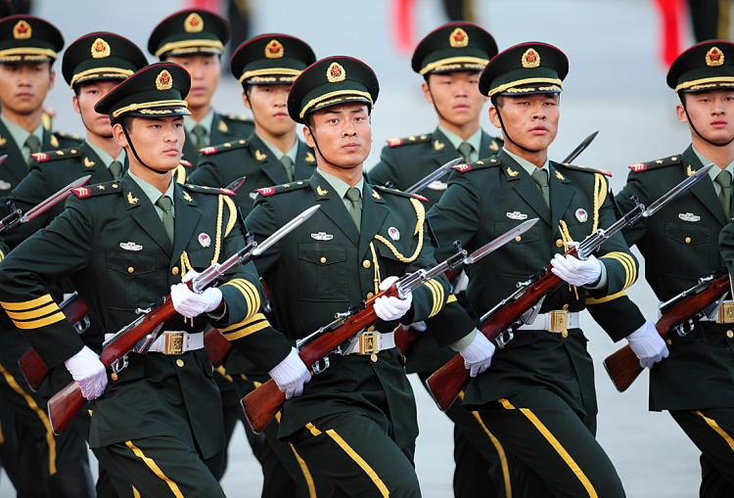
The People’s Liberation Army
Discussion Question: Read the following quote and explain its meaning in terms of power in China.
“Political power grows out of the barrel of a gun. Our principle is that the party commands the gun and the gun must never be allowed to command the party.” – Mao Zedong

Slide 17
The People’s Liberation Army
Discussion Question: Read the following quote and explain its meaning in terms of power in China.
“Political power grows out of the barrel of a gun. Our principle is that the party commands the gun and the gun must never be allowed to command the party.” – Mao Zedong
The CCP controls the military, and will use the power of the military to stay in power. The military should never have more power than the CCP.

Slide 18
The People’s Liberation Army
World’s largest military force – 2.3 million active personnel
Includes all ground, air and naval armed forces
Key organization is Central Military Commission (CMC)
12 members: 10 of highest ranking officers of PLA + Pres/GS (chair) and /VP
Chair is commander-in-chief and has always been highest ranking party member
Notes:
12 million in reserves
BUT U.S. spends about 4x what they spend on military

