Slide 1
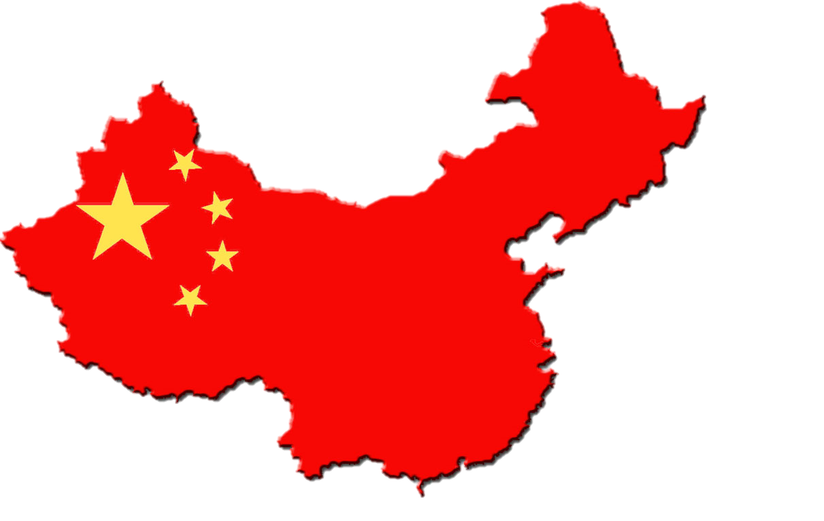
CHINA
“Let China sleep. For when China wakes, it will shake the world.”
--Napoleon
Part 1: The Making of the Modern State

Slide 2
Why do we study China?
Unique history greatly shapes political culture
One of the few remaining communist nations
Successful move towards capitalism BUT remains highly authoritarian
Questions to ponder…
Will democratization follow economic reform success?
Will human rights violations keep China from global partnerships?
What type of change (if any) will Xi Jinping bring?
Notes:
Other Communist Nations:
North Korea, Cuba, Vietnam, Laos
China’s Flag
Red = revolution
Yellow Stars to stand out brightly against the red ground
Larger star = CPC
Four smaller stars = Chinese people.
Great unity of the Chinese people under the leadership of the CPC.

Slide 3
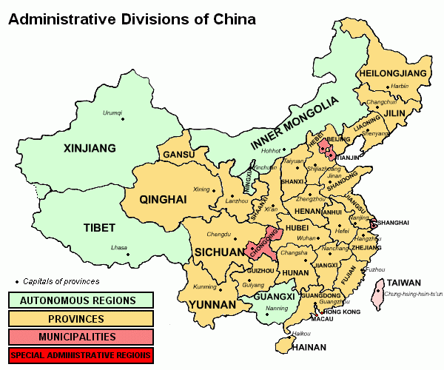
Geography Basics
Officially, the People’s Republic of China (PRC)
4th largest country
9,596,961 sq mi
Less than 15% of land good for agriculture
Largest population
1.3 billion
*23 provinces
5 autonomous regions
4 centrally administered cities
2 Special Administrative Regions (SAR)
Notes:
Population
Roughly equal to U.S. in area, BUT China’s population is more than 4x greater
Major Cities: Shanghai 16.575 million; BEIJING (capital) 12.214 million; Chongqing 9.401 million; Shenzhen 9.005 million; Guangzhou 8.884 million
More populated in the East
*Taiwan
Location of the exiled government (Republic of China) beginning in the late 1940s China considers Taiwan a province, Taiwan considers itself independent
International recognition is mixed - The United States has deliberately avoided the issue of defining China’s borders
Autonomous Region:
A territorial unit that is equivalent to a province and contains a large concentration of ethnic minorities
Ex: Tibet
Have some autonomy in the cultural sphere but in most policy matters are strictly subordinate to the central govt
Special Administrative Regions
Hong Kong & Macau (muh-cow) are ruled indirectly by China
Hong Kong was claimed by the British in the mid-1800s, and then transferred the People’s Republic of China (PRC) in 1997
Enjoy a high degree of autonomy in all matters except foreign affairs and defense for the next 50 years

Slide 4
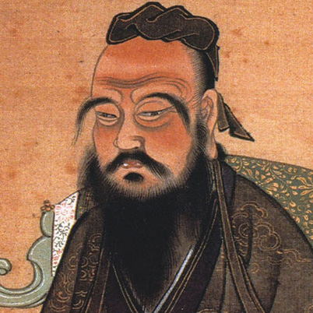
Critical Junctures: Confucius
Imperial China (2000 years) & Confucianism
Harmony, order, and peace
Five duties of universal obligation or basic human relations
Obedience to Authority, Hierarchy, Meritocracy
Civil service was created
Had to pass exams based on Confucian ethics
Ethnocentrism

Slide 5
Critical Junctures: Confucius
Discussion Question: What elements of Confucianism do you think can be found in modern Chinese political culture?

Slide 6
Critical Junctures: Confucius
Discussion Question: What elements of Confucianism do you think can be found in modern Chinese political culture?
Obedience to authority – acceptance of authoritarian rule
Hierarchy – structure of the CCP

Slide 7
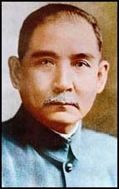
Critical Junctures: The Republic of China
1839 -1949: Century of Humiliation
Economic stagnation/poverty
Increased pressure from the outside/imperialism
Dynastic rule ends
Nationalism rises!
Revolution! (1911-12) Establishes Republic of China
Sun Yat-sen became President
Believed in nationalism, democracy, & social welfare
Could not hold power
Warlords rule
Sun Yat-sen
Father of the Republic Father of the Revolution
Notes:
Century of Humiliation
Loses Hong Kong to GB after Opium Wars (in 1841) – Returned to China in 1997
Revolution
Sun Yat-sen was American educated
Regional warlords challenged the govt – time of political chaos

Slide 8
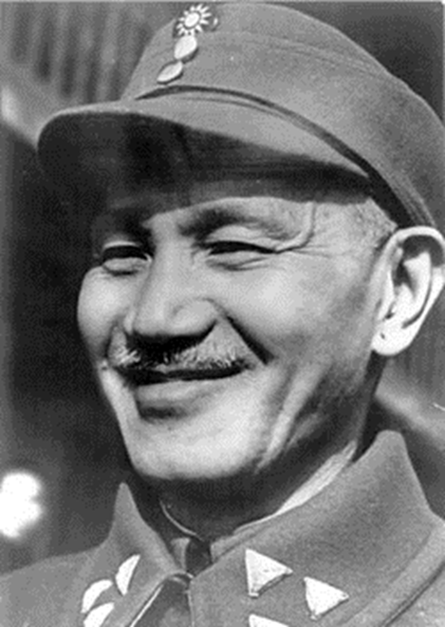
Critical Junctures: The Republic of China
1911 – 1949 Two political forces vie for power:
The Nationalist Party (KMT)
Led by Sun Yat-Sen
Focused on resisting foreign influence
Favored modernization and reform
Eventually led by Chiang Kai-Shek
Chinese Communist Party (CCP, founded 1921)
Led by Mao Zedong
By 1928, the CCP was forced West out of the cities and into the countryside
Chiang Kai-Shek
Leader of Nationalist Party
Notes:
China is about 80% rural at this time
Struggle for power
Chiang and Mao wrestle for power
Chiang takes power in 1928 & Mao/followers become enemies of the state

Slide 9
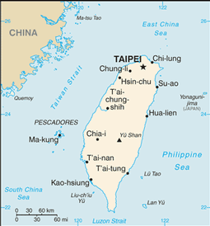
Critical Junctures: The People’s Republic of China
1934-1935: The Long March
Mao & supporters flee from Nationalist forces & gain support in the countryside (Mao becomes a hero to peasant class)
1941-1945: World War II
Communists more successful against Japan
1949: The People’s Liberation Army marches into Beijing unopposed, establishing the People’s Republic of China (PRC)
The Nationalists fled to Taiwan, where they established the Republic of China (ROC)
(international community does not recognize PRC until 1970s!)
Notes:
The Long March:
Chiang chased Mao into countryside to try to destroy him, but had the opposite effect. Mao gained more support.
Very important bc lays the foundation for Mao and the CCP.
Relationships developed between families at this time will continue to be important in terms of the Communist Party leadership (example of guanxi- informal politics)

Slide 10
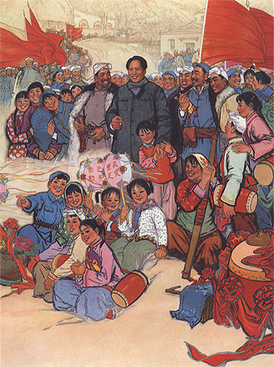
Critical Junctures: Maoism
Maoism – form of communism that believed in the strength of the peasant
Key Values:
Collectivism
Struggle and Activism
Egalitarianism
Self-Reliance
Mass Line: leaders would communicate their will/direction to people, but people would communicate through mass line their wisdoms to leaders
Notes:
Key Values of Maoism:
Collectivism: loyalty to party and state rather than family or village
Struggle and Activism: for the people (sacrifice) rather than maintain harmony by accepting status quo
Egalitarianism and populism rather than hierarchy with women and peasant at the bottom (CCP’s existence contradicts this)
Wanted to create more equal roles for men and women
Mao was committed to women’s equality b/c “women hold up half of the heaven”
Self-Reliance: people in charge of their destiny; isolate from abroad

Slide 11
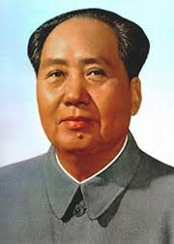
Critical Junctures: Maoism
The Soviet Model (1949-1957):
Land Reform
Redistributed property from rich to poor and increased productivity in countryside
Civil Reform
Free people from Opium addiction
Enhanced women’s legal rights
Five-Year Plans
Nationalized industry
Collectivized agriculture
Private property eliminated
Notes:
The USSR poured money and expertise into the PRC
With this help Mao and the Chinese Communist Party work on land reform, civil reform, 5 year plans

Slide 12
Critical Junctures: Maoism
Discussion Question: Compare how the Communist Party came to power in China with how it came to power in Russia – how was it different?
How was Maoism similar to Marxist-Leninism in the Soviet Union? Different?

Slide 13
Critical Junctures: Maoism
Discussion Question: Compare how the Communist Party came to power in China with how it came to power in Russia – how was it different?
China: Communists won popular support by defeating Japan in WWII and then defeating the Nationalists in a civil war. Then they established a communist state, the PRC, which replaced the republic of 1911
Russia: Bolsheviks led a communist revolution & overthrew the czar
How was Maoism similar to Marxist-Leninism in the Soviet Union? Different?
Similar: Democratic Centralism (Communist Party best directs needs of the masses); collectivization; nationalized industry
Different: Mao valued strength of peasant, instituted mass line

Slide 14
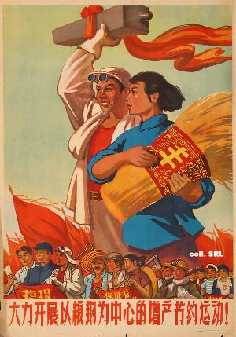
Critical Junctures: Maoism
The Great Leap Forward (1958-1966)
Wanted to free China from Soviet domination
Utopian effort to transform China into a radical egalitarian society
Reorganizes China into communes that would serve all basic social and economic functions
(all around development – equal emphasis on industry AND agriculture)
Backyard furnaces
Mass Mobilization (turn #s into asset)
Red vs. Expert
Failure - Famine
Notes:
Great Leap Forward:
All-around development – equal emphasis on industry AND agriculture
Backyard furnaces – people trying to make steel in countryside
Mass Mobilization (turn #s into asset)
Red vs. Expert - emphasis on party workers – not bureaucrats running govt. Cadres – party workers at lowest levels were expected to demonstrate party devotion by encouraging people to work hard
Decentralization – people can do it!
Estimates of death from famine as a result of this program and other factors range between 18 mil. and 45 million

Slide 15
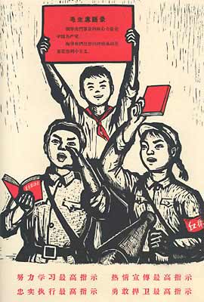
Critical Junctures: Maoism
The Cultural Revolution (1966-1976)
Goal – remove all vestiges of “old” China and its inequality
Scholars sent to fields to work
Universities/libraries destroyed
Emphasis on elementary education only
Student radicals (Red Guard) lead a purging of “class enemies”
Notes:
http://www.youtube.com/watch?v=M5Os4xdm5lI (brief Chinese History)
The Cultural Revolution:
Mao’s ideological crusade designed to jolt China back toward his vision of communism
Main objective – political purification through struggle against “class enemies”
Between 1960 and 1966, Mao allowed two of his faithful – Liu Shaoqi and Deng Xiaoping – to implement market-oriented policies to revive economy
But Mao was still unhappy with China’s progress toward true egalitarianism
Mao and his backers accuse members of the party of taking “the capitalist road”

Slide 16
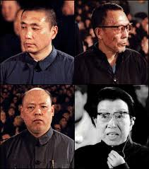
Critical Junctures: Maoism
1976: Mao dies leaving followers divided into factions
Radicals – led by Mao’s wife
One of the “Gang of Four” who supported radical goals of cultural revolution
Military
Moderates – moderates who emphasized economic modernization and some contact with other other countries
Moderates win and arrest Gang of Four
Crash Course World History – China’s Revolutions
Notes:
Each faction has ties back to Long March – importance of informal politics

