Slide 1
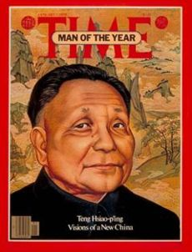
DENG XIAOPING
“It doesn’t matter whether a cat is white or black, as long as it catches mice.”
-Deng Xiaoping
Economic Reform

Slide 2
Critical Junctures: Deng Xiaoping
Discussion Question: Deng Xiaoping has a famous quote…
“It doesn’t matter whether a cat is white or black, as long as it catches mice.”
What does this mean?

Slide 3
Critical Junctures: Deng Xiaoping
Discussion Question: Deng Xiaoping has a famous quote…
“It doesn’t matter whether a cat is white or black, as long as it catches mice.”
What does this mean?
It doesn’t matter if a policy is socialist or capitalist if it helped the economy.

Slide 4
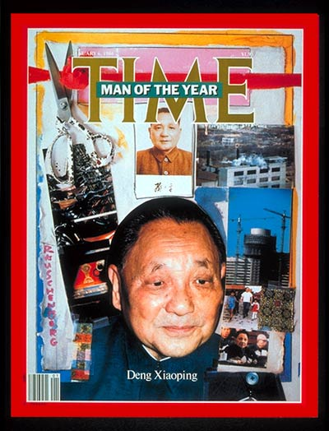
Critical Junctures: Deng Xiaoping
1979: Deng Xiaoping takes control of the Communist Party
Four Modernizations
industry, agriculture, science & military
Open Door Trade policy
Reforms in Education
Restored legal system/bureaucracy of Old China
Notes:
Deng Xiaoping
Was “purged” twice by Mao (reinstated and purged) and brought back by moderate leaders
Open Door Policy – Trade with everyone, including capitalist nations like the U.S. to boost China’s economy
Reforms in Education – Higher academic standards, expansion of higher education and research (reversal of Cultural Rev)

Slide 5
Critical Junctures: Deng Xiaoping
Socialist Market Economy
Household Responsibility System
Replaced communes
After paying taxes/contract fees to govt, families may consume/sell what they produce
More Economic Liberalization
Special Economic Zones (SEZs)
Promote foreign investment
Township and Village Enterprises (TVEs)
Notes:
Deng Xiaoping
Household Responsibility System: (early 1980s) Village owns farmland, but it is contracted out by the local govt to individual families
SEZ: regions in which foreign investors were given preferential tax rates and other incentives
TVE: market-oriented public enterprises under the purview of local governments (iron, steel, cement, chemical fertilizer, hydroelectric power, and farm tools) thrived from 1978 to 1996 ; ownership rights” stayed with the collective, while “use rights” were delegated to managers

Slide 6
Critical Junctures: Deng Xiaoping
Economic Success:
Fastest-growing major economy in the world for more than two decades
GDP per capita grew at avg rate of a little over 9% per year from 1990-2009
Economic Problems:
No more “iron rice bowl” – cradle to grave benefits
Unemployment
Inequality
Floating Population – urban migration & issues with hukou (household registration)
Notes:
1990-2009 – U.S. GDP grew at 1.5% per year
Iron Rice Bowl
Under Mao, guarantee of lifetime employment, income and basic cradle-to-grave benefits to most urban and rural workers
Workplace also provided housing, health care, day care, and other services
Floating Population
Peasants migrate to urban areas to find work
Approx 150 million people
Migrant workers are mostly employed in low-paying jobs, but fill an important niche in China’s changing labor market, esp in construction
Hukou – late 1950s, system that registers each citizen as entitled to work and to live in a specific urban or rural location
But this contributed to increasing inequality btw rural and urban bc limited farmers ability to go to cities
Authorities allowed recent migration b/c their labor was crucial to economic expansion BUT they have no rights in urban areas (education, for children health care, can be evicted by govt)

Slide 7
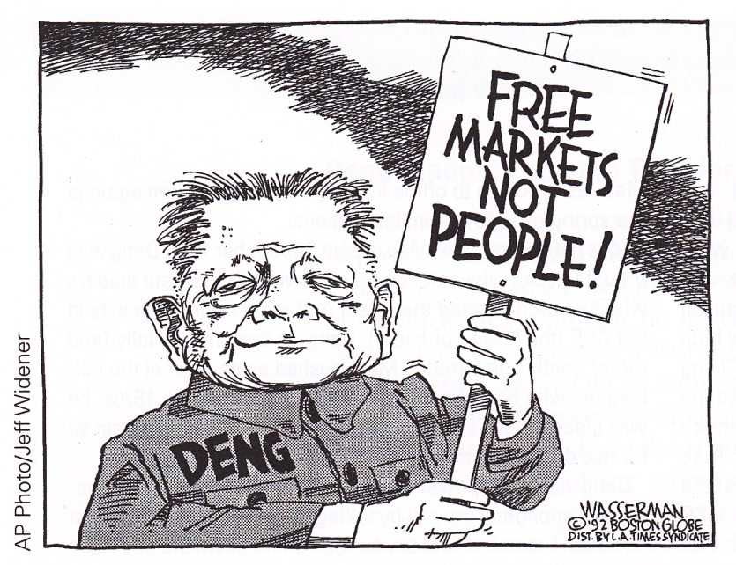
Critical Junctures: Deng Xiaoping
China embraced market reforms, gradually moving away from a command economy, but did NOT embrace political or democratic reform
1989: Tiananmen Square protests
Large scale demonstrations, esp among students and intellectuals for more political freedoms
Used army to crack down on protests
Death toll has not been revealed

Slide 8
Critical Junctures: Deng Xiaoping
Discussion Question: Classify the following as ideas under Mao Zedong (MZ) or Deng Xiaoping (DX) or Both (B):
Allowed foreign investment
Iron Rice Bowl
Communes
Open Door trade policy
Education limited to elementary school
No private property allowed
Household Responsibility System
Egalitarianism pursued
Market socialism
Believed Communist Party leadership should not be challenged

Slide 9
Critical Junctures: Deng Xiaoping
Discussion Question: Classify the following as ideas under Mao Zedong (MZ) or Deng Xiaoping (DX) or Both (B):
Allowed foreign investment (DX)
Iron Rice Bowl (MZ)
Communes (MZ)
Open Door trade policy (DX)
Education limited to elementary school (MZ)
No private property allowed (MZ)
Household Responsibility System (DX)
Egalitarianism pursued (MZ)
Market socialism (DX)
Believed Communist Party leadership should not be challenged (B)

Slide 10
Critical Junctures: Technocrats
After Deng dies, rise of technocrats
Career-minded bureaucrats who administer public policy according to technical rather than a political rationale
Professional competence & political loyalty
Jiang Zemin (1993-2003)
Hu Jintao (2003-2013)
Xi Jinping (2013 - ?)
All had university training in engineering
All were “groomed” by top leaders to move up in ranks
Notes:
Xi Jinping:
Has given high priority to promoting “people-centered” urbanization –
Urban registration will be extended to 100 million migrants currently living in cities, while another 100 million will be moved to urban areas btw 2014 and 2020.
Gov’t will invest in housing, schools, hospitals, & public transportation

