Slide 1
Basic Economic Goals

Slide 2
Do all countries have the same economic needs/goals?
NO!

Slide 3
Your goals in life are very different from a teenager who lives in North Korea
The reason for this is because you live in a different economic system

Slide 4
Basic Economic Goals
There are EIGHT economic goals of the United States:
Economic freedom
Economic efficiency
Economic equity
Economic security
Economic stability
Economic growth
Full Employment
Balance of Trade

Slide 5
Economic Freedom
You are free to make your own economic decisions:
Choose your job
Choose where and when you work
Work for yourself or someone else
Leave your job and to move to another job
Free to buy what we want
Notes:
Economic freedom allows Americans to start businesses, own property, and make their own decisions

Slide 6
Economic Freedom
Businesses are free to:
Choose which workers they want
Figure out how much business they want to do
Businesses are free to sell what they want
Notes:
Economic freedom allows Americans to start businesses, own property, and make their own decisions

Slide 7
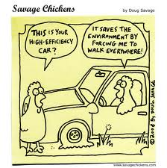
Economic Efficiency
Economic efficiency requires us to use our resources responsibly by
“obtaining the maximum output from available resources”
Notes:
Essentially, how well productive resources are allocated and, once distributed, how well inputs are combined into products people want and need
In command economies, resource allocation is determined by the central government; resources are redirected quickly, but businesses are often inefficient
In market economies, supply and demand (producers and consumers) determine allocation; redistribution of resources can be tedious, but business production must be efficient

Slide 8
Economic Equity
Basically, an Equitable Distribution of Income. One group shouldn’t have extreme luxury while another is in stark poverty.
Economic equity is desired to make sure all Americans have equal opportunity to be successful (wealthy)
This is why there are labor laws for equal pay and laws for equal access to education despite skin color
Wealth Inequality
https://www.youtube.com/watch?v=QPKKQnijnsM
VOX on Inequality
https://www.youtube.com/watch?v=6Xa9T2OMzmw
Notes:
Means what is fair. This can be seen as an equality of opportunity or an equality of outcome
In command economies, wages are often set by the government providing an equality of outcome
In market economies, equality of opportunity is emphasized; success is not guaranteed

Slide 10
Economic Security
Protecting consumers, producers, and resource owners from risks that exist in society. Each society must decide from which uncertainties individuals can and should be protected
Economic security is provided by the government with regards to issues that are beyond our control
Natural disasters, accidents, old age, bank failures
The government helps people by paying Social Security, Unemployment, or through FEMA and the FDIC
Notes:
In command economies, pensions, housing, health care, jobs, and income provided or guaranteed by the government
In market economies, consumers generally responsible for their own security; some programs address anomalies in the economy

Slide 11
Economic Security
Basically, provisions should be made for those not able to take care of themselves – handicapped, disabled, old age, chronically ill, orphans. Protection from lay-offs [unemployment insurance]. Also no discrimination.
Roughly 43 million Americans have some type of disability.
Hearing impaired: 22 million (including 2 million deaf)
Totally blind: 120,000 (Legally blind: 60,000)
Epileptic: 2 million
D. Paralyzed: 1.2 million
E. Developmentally disabled; 9.2 million
F. Speech impaired: 2.1 million
G. Intellectually Disabled: up to 2.5 million
H. HIV infected: 900,000
Notes:
Intellectually Disabled = Mentally Retarded - this is now not appropriate to say.

Slide 12
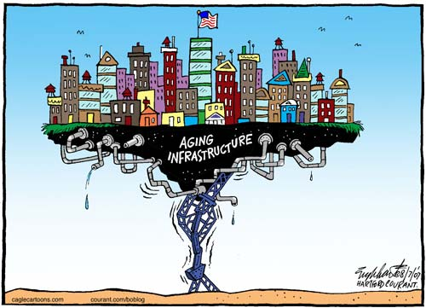
Economic Stability
Maintaining stable prices and full employment while keeping growth reasonably smooth and steady
America hopes to avoid extreme ups and downs in the standard of living
Standard of living: the material well being of an individual, group or nation measured by how well their necessities and luxuries are satisfied
https://www.usnews.com/news/best-countries/quality-of-life-full-list
The US has one of the highest standards of living in the world
Notes:
In command economies, no unemployment, prices usually set below market to ensure everything produced is sold
In market economies, some unemployment is tolerated; fiscal and monetary policies are used to prevent unemployment and inflation

Slide 13
Economic Stability
Price Level Stability – sizable inflation or deflation should be avoided. We had over 10% in 73, 79, & 80. Inflation was 2% in the 1950s, 2.3% in 1960s and 7.4% in 80s. A person making $25,000 a year at age 30 would need (with average inflation of 5%) $125,000 a year at age 65 to have the same standard of living.
U.S. Inflation Rate, $1 in 1950 to 2018
According to the Bureau of Labor Statistics consumer price index, prices in 2018 are 946.25% higher than prices in 1950. The dollar experienced an average inflation rate of 2.70% per year during this period.
In other words, $1 in 1950 is equivalent in purchasing power to $10.46 in 2018, a difference of $9.46 over 68 years.
The 1950 inflation rate was 1.26%. The current inflation rate (2017 to 2018) is now 2.70%¹. If this number holds, $1 today will be equivalent to $1.03 next year.
https://www.officialdata.org/1950-dollars-in-2018?amount=1

Slide 14
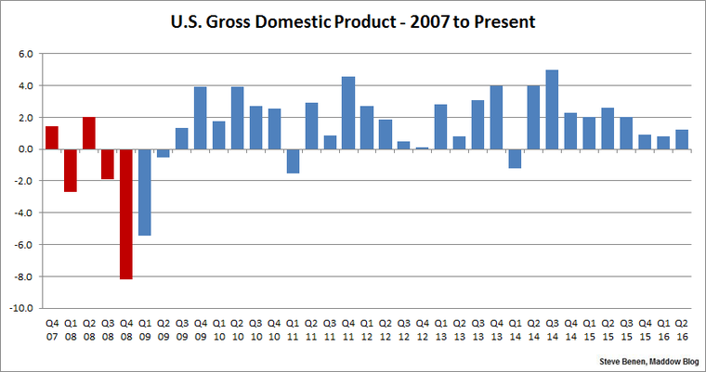
Economic Growth
Economic growth is a goal of all nations!
A country must be able to increase the amount of goods and services produced over time to keep up with expanding populations
Increasing the production of goods and services over time using Gross Domestic Product (GDP); a growth rate of 3-4% a year is considered sustainable.
How to Grow?
1. Increase our productive capacity
2. Increase capacity to create more GDPr
3. Need more people and resources
4. Improve technology (ability to produce)
5. 3% annual growth will increase our standard of living.
1929-Per capita=$792
1933-Per capita=$430
2010-per capita= $48,000
2018 –per capita = $57,608
Notes:
In command economies, growth targets are set and interpreted by central planners
In market economies, encourage specialization along with avoidance of waste

Slide 15
Full Employment
Full employment is an economic situation in which all available labor resources are being used in the most efficient way possible. Full employment embodies the highest amount of skilled and unskilled labor that can be employed within an economy at any given time. Any remaining unemployment is considered to be frictional, structural or voluntary.

Slide 16
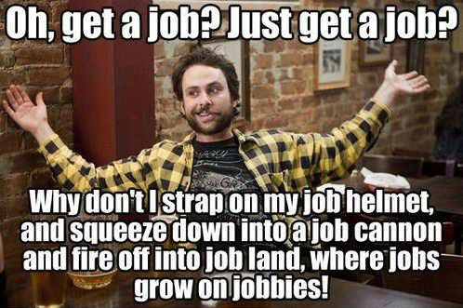
Full Employment
Full Employment – about 94-96% employment is full employment. In 1982, unemployment was 10.8% [12 M unemployed.]
When people work, they earn income for themselves while they produce goods and services for others.
As a result, people want their economic system to provide as many jobs as possible.
Notes:
What is 'Full Employment'
Full employment is an economic situation in which all available labor resources are being used in the most efficient way possible. Full employment embodies the highest amount of skilled and unskilled labor that can be employed within an economy at any given time. Any remaining unemployment is considered to be frictional, structural or voluntary.
Read more: Full Employment https://www.investopedia.com/terms/f/fullemployment.asp#ixzz5R36zcjGE Follow us: Investopedia on Facebook

Slide 17
Balance of Trade
The balance of trade is the difference between the value of a country's imports and exports for a given period.
Economists use the BOT to measure the relative strength of a country's economy.
The formula for calculating the BOT can be simplified as the total value of imports minus the total value of exports or,
Net Exports (X_{N}) = Exports – Imports
A country that imports more goods and services than it exports in terms of value has a trade deficit. Conversely, a country that exports more goods and services than it imports has a trade surplus.

Slide 18
Assignment
Rank our 8 economic goals 1 being the most important and 8 being the least important.
For each one give at least a one sentence explanation for why you put it where you put it.
Discuss your list with someone next to you.
What did you agree on and what did you disagree on?
Put a C next to the goals you think are conservative and an L next to the principles you think are liberal.

Slide 19
Conservative or Liberal
Full Employment, Economic Growth, Price Stability, Economic Freedom
Economic Security, Income Distribution Equity, Economic Efficiency, Balance of Trade
*Which one is which?

Slide 21
Positive or Normative?
1. It is too cold to play football today.
2. Gross Domestic Product grew 4% last year.
3. The temperature is too cold today.
4. The temperature is 92 degrees today.
5. The humidity is too hot.
6. People who are unemployed are just too lazy to work.
7. Suzie RahRah should be friendlier to me this time.
NOT
After turning me down 3 times, Susie RahRah should be friendlier to me this time.
Answers: 1. N 2. P 3. N
4. P 5. N 6. N 7. N
Notes:
This Slide goes with the intro to Econ PPT.

