Slide 1
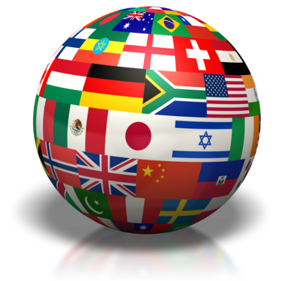
Part Two: Sovereignty, Authority & Power
“Sovereignty is not given, it is taken.” -- Kemal Ataturk (Turkish soldier)
“I have as much authority as the Pope, I just don't have as many people who believe it.” -- George Carlin (comedian)

Slide 2
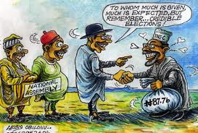
Sovereignty, Authority & Power
Power
The ability to direct the behavior of others through coercion, persuasion, or leadership
Authority
Legal right exercise power on behalf of society and/or gov’t
Sovereignty
Legal right and ability (power) of a state to carry out actions & policies within its territory
Notes:
Power:
Coercion/force, persuasion, incentives
Sovereignty:
Can be challenged internally or externally
External: not overly dependent on resources or decisions of another power
Internal: sole authority within a territory capable of making and enforcing laws and policies

Slide 3
Sovereignty & Capacity
Capacity
The degree to which a state or gov’t is able to implement its policies (i.e., able to exercise its sovereignty)
Some nation-states have greater capacity than others & therefore greater sovereignty
What might limit a state’s sovereignty & capacity?
Permeable borders – anything that crosses a nation-state’s borders without official sanction demonstrates a limit to that nation-state’s capacity and sovereignty
Notes:
Examples of things that get through borders:
Refugees, Pollution, Heroin, Petroleum, Invasive species, Wars, NGO’s, Technology
Jobs, Olympics, Human Rights Watch, Water, Organized crime, DiseaseEuros
Political ideas (democratization)

Slide 4
Discussion Question:
What are some examples of things that can pass through permeable borders?
Notes:
Examples of things that get through borders:
Refugees, Pollution, Heroin, Petroleum, Invasive species, Wars, NGO’s, Technology
Jobs, Olympics, Human Rights Watch, Water, Organized crime, DiseaseEuros
Political ideas (democratization)

Slide 5
Discussion Question:
What are some examples of things that can pass through permeable borders?
Refugees, Pollution, Heroin, Petroleum, Invasive species, Wars, NGO’s, Technology
Jobs, Olympics, Human Rights Watch, Water, Organized crime, Disease, Euros
Political ideas (democratization)
Notes:
Examples of things that get through borders:
Refugees, Pollution, Heroin, Petroleum, Invasive species, Wars, NGO’s, Technology
Jobs, Olympics, Human Rights Watch, Water, Organized crime, DiseaseEuros
Political ideas (democratization)

Slide 6
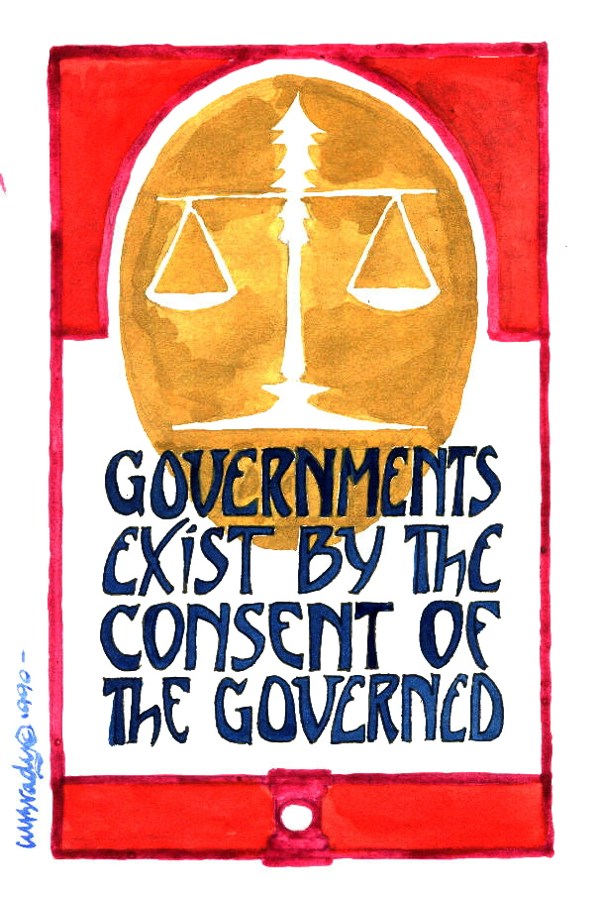
Concept of Legitimacy
General belief that the gov’t has the right to rule and exercise authority (popular acceptance of authority)
Traditional
Tradition determines who should rule and how
Charismatic
Dynamic personality of a leader
Rational-legal
Based on well-established laws and procedures (adherence to rule of law)
Common law
Code law (Constitutions!)
Notes:
Legitimate Governments
In political science, legitimacy is the popular acceptance of an authority, usually a governing law or a régime.
Basically, people accept the authority of leaders
Other countries recognize the regime’s right to rule
Authoritarian Governments generally ARE legitimate
Essentially, it confers authority and power based not on coercion, but on consent.
Traditional Legitimacy
Rests on the idea that someone or something is valid because “it has always been that way.”
The longer a traditional legitimacy has been in place, the more institutionalized it becomes and, thus, carries the weight of history on its side
A specific family for example
Most monarchies based on this concept
Charismatic Legitimacy
Is based on the power of ideas and is typically embodied by one individual
Rational-Legal Legitimacy
Is based on a system of laws and procedures that are highly institutionalized
People abide by the decisions in this system because they believe rulers serve the public’s best interest
Modern western nations are built on the rational legal foundation
Common Law: based on tradition, past practices, and legal precedents (Britain)
Code Law: based on written rules/codes of law (China, Mexico, Russia)

Slide 7
Concept of Legitimacy
Other factors that encourage legitimacy:
Nationalism
Shared Political Culture/Ideology
Shared Religion
Satisfaction with government’s performance/responsiveness
Success in state-sponsored economic growth

Slide 8
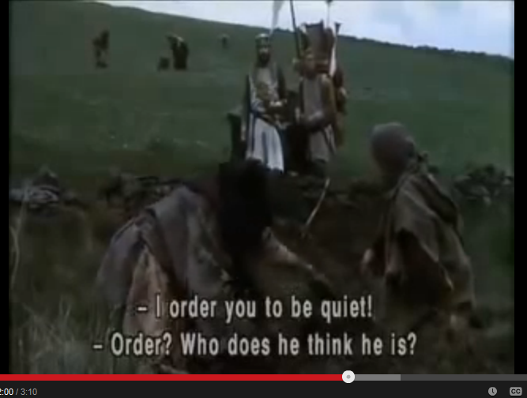
Concept of Legitimacy
How does this clip demonstrate a lack of legitimacy for the king?
Notes:
Legitimate Governments
People accept the authority of leaders
Other countries recognize the regime’s right to rule
Authoritarian Governments generally ARE legitimate
Essentially, it confers authority and power based not on coercion, but on consent.
Traditional Legitimacy
Rests on the idea that someone or something is valid because “it has always been that way.”
The longer a traditional legitimacy has been in place, the more institutionalized it becomes and, thus, carries the weight of history on its side
A specific family for example
Most monarchies based on this concept
Charismatic Legitimacy
Is based on the power of ideas and is typically embodied by one individual
Rational-Legal Legitimacy
Is based on a system of laws and procedures that are highly institutionalized
People abide by the decisions in this system because they believe rulers serve the public’s best interest
Modern western nations are built on the rational legal foundation
Common Law: based on tradition, past practices, and legal precedents (Britain)
Code Law: based on written rules/codes of law (China, Mexico, Russia)

Slide 9
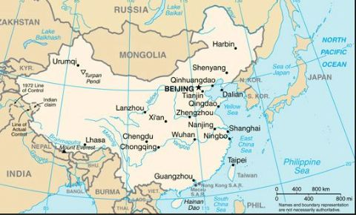
States, Nations, and Regimes
State – political system that has sovereignty (political power) exercised over a population in a defined geographic territory through a set of public institutions
Institutions such as executives, legislatures, judiciaries, bureaucracies
Establish and maintain armed forces
Notes:
State
= population + defined territory + governing institutions + sovereignty + international recognition
Can maintain armed forces – use violence if necessary
Political institution:
set of rules, norms, or standard operating procedures that is widely recognized and accepted by the society and that structures and constrains political actions
In order to carry out public policies, government structures such as parliaments, bureaucracies, and administrative agencies perform functions, which in turn enable the government to formulate, implement, and enforce policies
formal and informal rules that structure the relationship among individuals
Institutions are stable and long-lasting (even when leaders change)

Slide 10
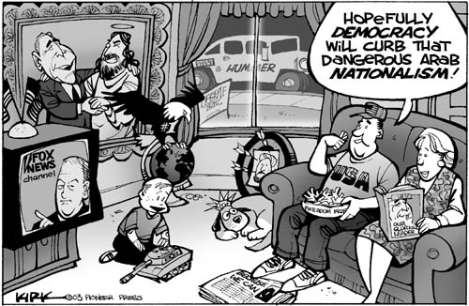
States, Nations, and Regimes
Nations
Human community with shared history, culture and/or political identity
Nationalism = common political identity
Often share common ethnic identity
Notes:
Nations:
Nations larger than states: Germans found in Austria, Switzerland, Netherlands
Nations divided in two: Korea
Nations without states: Basques, Jews in past, Palestinians
Nationalism
pursuit of a set of rights for a nation, including the right of political control over a certain territory
Nation-state:
state boundaries AND nation identity coincide

Slide 11
States, Nations, and Regimes
Regimes
Political system of a state
Rules that states set and follows in exerting power over time
Endure beyond individual governments or leaders
Government
The group of people and organizations that hold political authority in a state at any one time
Metaphor
“The state is the machinery of politics and the regime is its programming, the government is the operator."
Notes:
Government is the leadership or elite in charge of running the state

Slide 12
REGIMES
STATES
LESS INSTITUTIONALIZED
GOVERNMENTS
MORE INSTITUTIONALIZED
COUNTRY
Notes:
A country is what contains all the concepts discussed (state, government, regime) and all the people living within its political system. The ENTIRE political entity and its system.

Slide 13
Discussion Questions…
Can a legitimate regime be sovereign?
Can a nation be a nation-state?
Can a gov’t have power without authority?
Does efective rule of law make legitimacy harder to achieve?
Can a sovereign nation-state have permeable borders?

Slide 14
Review/Discussion Questions…
Can a legitimate regime be sovereign?
Yes, and legitimacy aids sovereignty
Can a nation be a nation-state?
Yes, if the borders of the group coincide with the borders of the nation-state
Can a gov’t have power without authority?
Yes, powerful forces (the military) can impose gov’t on a nation-state without authority or legitimacy
Does effective rule of law make legitimacy harder to achieve?
No, it makes legitimacy easier to earn
Can a sovereign nation-state have permeable borders?
Yes, nearly all do

Slide 15
Discussion Questions
1. Can you think of any historical examples where the government of the United States has had high legitimacy? Low legitimacy?

Slide 16
Types of Regimes - Democracy
What is Democracy?
The word democracy means many different things to many different people. For many, “democratic” means good things and “nondemocratic” means bad.
Basic Definition: political power exercised either directly or indirectly through participation, competition, and liberty.
BUT even political theorists can’t agree on exact definition…more of a spectrum.

Slide 17
Types of Regimes - Democracy
Various Textbook Definitions:
(Almond) - a political system in which citizens enjoy a number of basic civil and political rights, and in which their most important political leaders are elected in free and fair elections and accountable under a rule of law.
(Barrington) A regime type that involves the selection of government officials through free and fair elections, a balance between the principle of majority rule and the protection of minority interests, and constitutional limitations on government actions.
Notes:
There is no guarantee that democracies will grant human rights and civil liberties to all people. Democracies are supposed to find a balance between respecting the will of the majority and protecting the rights of the minority.

Slide 18
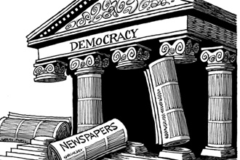
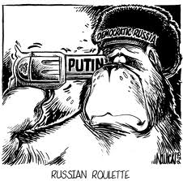
Types of Regimes – Democracy (Liberal vs Illiberal)
Liberal (substantive) Democracies typically include:
Competitive Elections
Civil liberties
Rule of law
Neutrality of the judiciary
Open civil society
Civilian control of the military
Illiberal or Procedural Democracies
Appear like other established democracies (elections) but do not have many of the features listed above
Notes:
A liberal democracy is the term used by many political scientists to imply a system that promotes participation, competition, and liberty.
Competitive elections: regular, free, and fair
These types of democracies are rooted in the idea of liberalism, with an emphasis in individual rights and freedom.
Participation is central to a liberal democracy. The most basic way to participate is through voting and elections. Through these, the public is given the opportunity to have control over public officials and their policies.
In a liberal democracy, suffrage (the right to vote) must be available to all adult citizens with few restrictions.
Rule of Law
"For the United Nations, the rule of law refers to a principle of governance in which all persons, institutions and entities, public and private, including the State itself, are accountable to laws that are publicly promulgated, equally enforced and independently adjudicated, and which are consistent with international human rights norms and standards. It requires, as well, measures to ensure adherence to the principles of supremacy of law, equality before the law, accountability to the law, fairness in the application of the law, separation of powers, participation in decision-making, legal certainty, avoidance of arbitrariness and procedural and legal transparency."
Illiberal Democracy: a governing system in which, although elections take place, citizens are cut off from knowledge about the activities of those who exercise real power because of the lack of civil liberties. It is not an 'open society'.

Slide 19
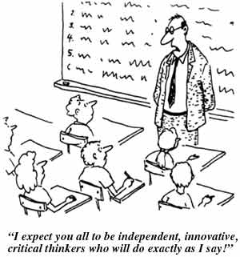
Types of Regimes - Authoritarian
Authoritarianism is a political regime where a small group of individuals exercises power over the state without being constitutionally responsible to the public.
Examples?
Notes:
Examples?
Single dictator, hereditary monarch, small group of aristocrats, or single political party

Slide 20
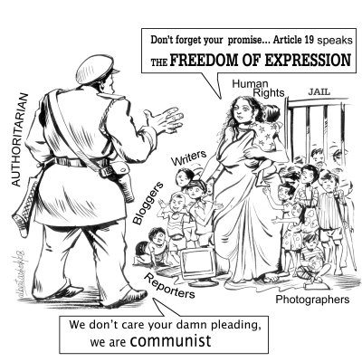
Types of Regimes: Authoritarian
Authoritarian Characteristics:
Elites who hold political power make decisions
Some based on Communism
Some based on Corporatism
Gov’t officials interact with people/groups outside gov’t before they set policy
Patron-Client Systems – Favors and services to their supporters
Economy is tightly controlled by the political elite
Citizens have little to no input on selection of leaders
Restriction of civil liberties very common
Notes:
Communist party controls gov’t, economy, social life

Slide 21
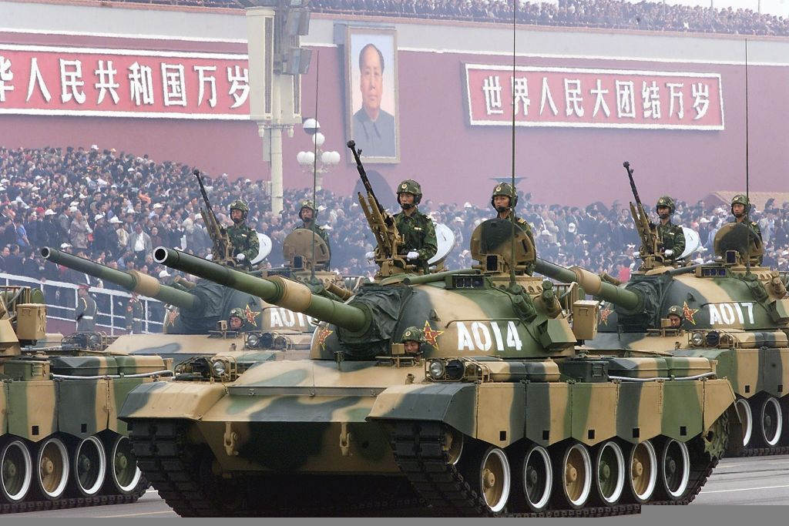
Totalitarian Regimes
Totalitarianism is a highly centralized regime that possesses some form of strong ideology that seeks to transform and absorb aspects of the state, society, and the economy.
Much more negative connotation than authoritarian
Very repressive
Use violence/terror
Examples?
Notes:
Examples: Hitler's Nazi's rule Germany, Stalin's Soviet Russia, and Mussolini's Italy, are all cases of totalitarian governments. Modern day example - North Korea

Slide 22
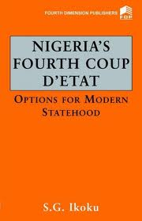
Military Regimes
Military rule
Nondemocratic
Prevalent in Latin America, Africa and parts of Asia
Usually begins with a coup d’etat
Examples?
Notes:
Military Rule
Increasingly, more common in states that are struggling with legitimacy and stability and in those where there is a high level of public unrest or violence
The military sees itself as the only organized force able to ensure stability
Coup D’etat
Coup may or may not have widespread support among the people
Once they take control, leaders often restrict civil rights and keep political parties from forming
Usually lack a specific ideology or source of authority

Slide 23
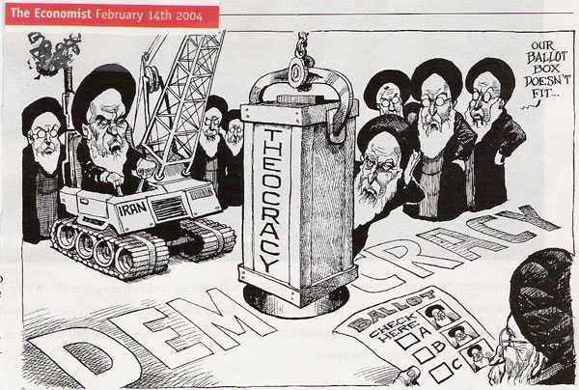
Theocracy
Theocracy: a political system in which religious leaders control political decisions and religious law provides the basis for policy decisions.
Examples?

Slide 24
Review!!
Which of the following is NOT an essential ingredient for a liberal democracy?
A. Open civil society
B. Proportional Representation
C. Neutrality of the judiciary
D. Rule of Law
E. Civil Liberties
Notes:
Answer: B

Slide 25
Review!!
Frequent coups d’etat are most often associated with regimes that are
A. Totalitarian
B. Parliamentarian
C. Presidential
D. Corporatist
E. Under military rule
Notes:
Answer: E

Slide 26
Review!!
Countries that have democratic procedures in place but have significant restrictions on them are referred to as
A. Totalitarian regimes
B. Authoritarian regimes
C. Substantive democracies
D. Illiberal democracies
E. Liberal democracies
Notes:
Answer: D

